Slide 1
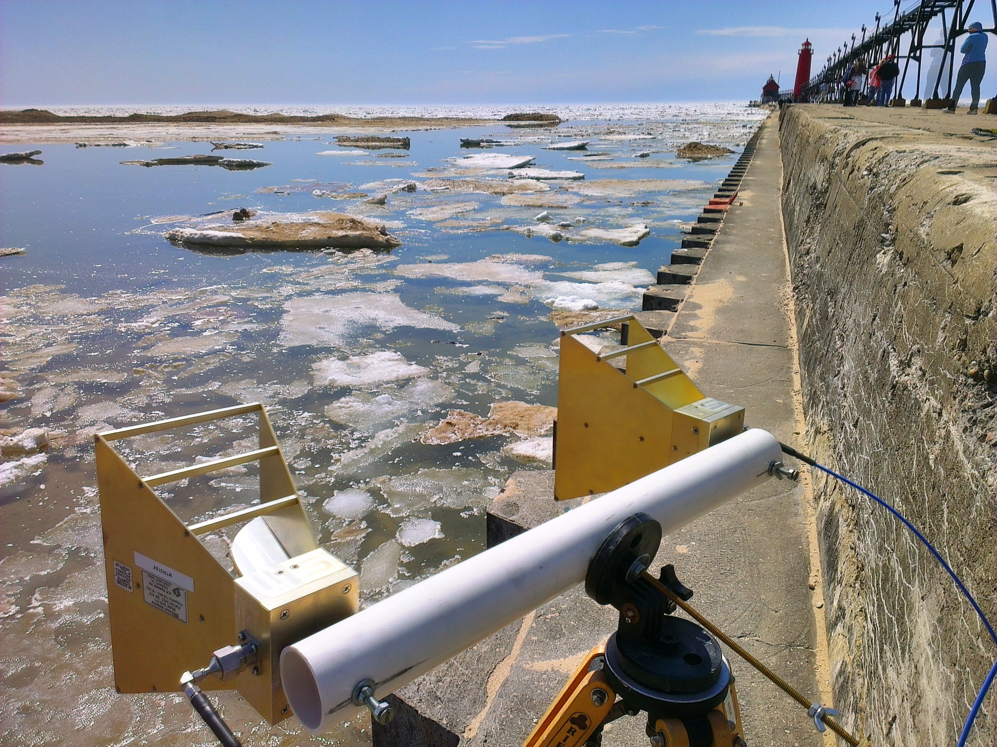
Stepped-Frequency Ice Radar
Don Atwood

Slide 2
“Ice Radar” IR&D Project
Goal: Investigate the use of radar systems for identifying and characterizing the motion of ice
Use Akela stepped-frequency radar
Employ interferometric coherence to identify ice, land, and water
Use phase to determine ice velocity
Two experiments conducted:
4 April : Grand Haven Harbor Entrance
4-7 May : Keweenah Waterway, Houghton

Slide 3
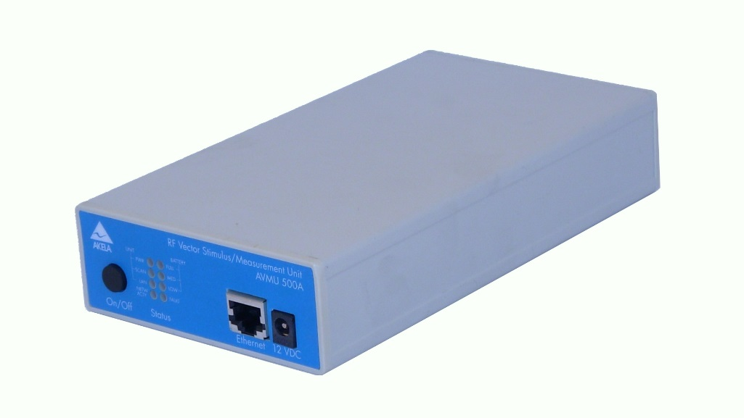
Akela RF Vector Signal Generator
Emission – Stepped Frequency Continuous Wave (SFCW)
Frequency Range – 500 MHz to 6 GHz Frequency Hopping Rate – 14 user selectable options, 20 to 90,000 per second
Power Input – 12 watts nominal
Power Output – 17 dBm nominal
Size – 4.25″ x 7.5″ x 1.5″, 1.1 lbs
Communications Interface – 10/100 Base T Ethernet
Software Interface – LabVIEW

Slide 4
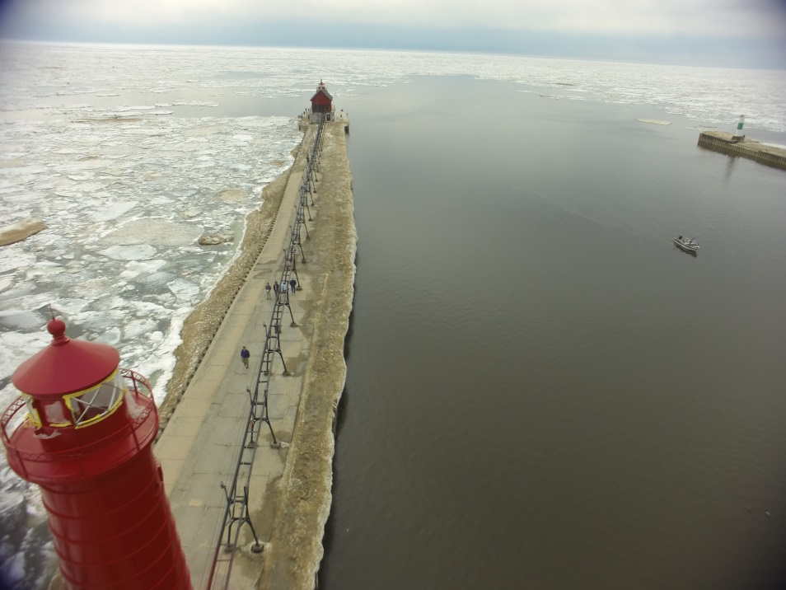
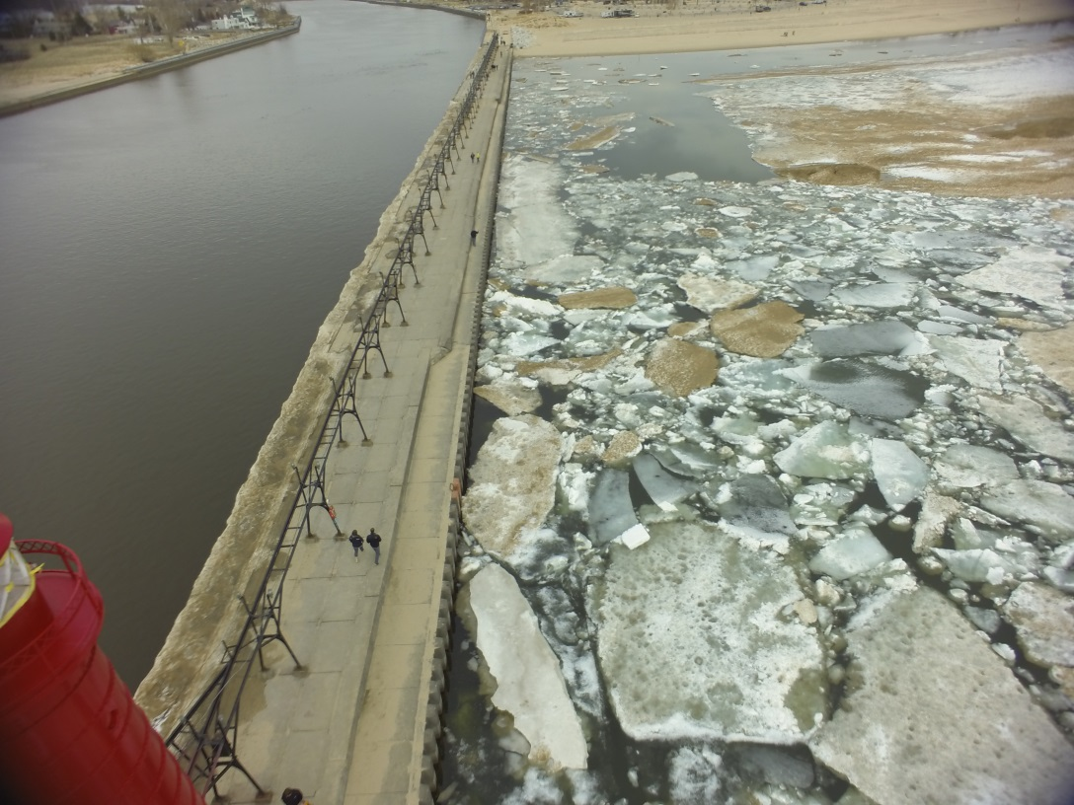
Grand Haven Experiments
Grand Haven (on shore of Lake Michigan) chosen for availability of near-shore ice
Ice present at end of channel and along-shore to south of pier
Images acquired by GoPro camera on Phantom UAV

Slide 5
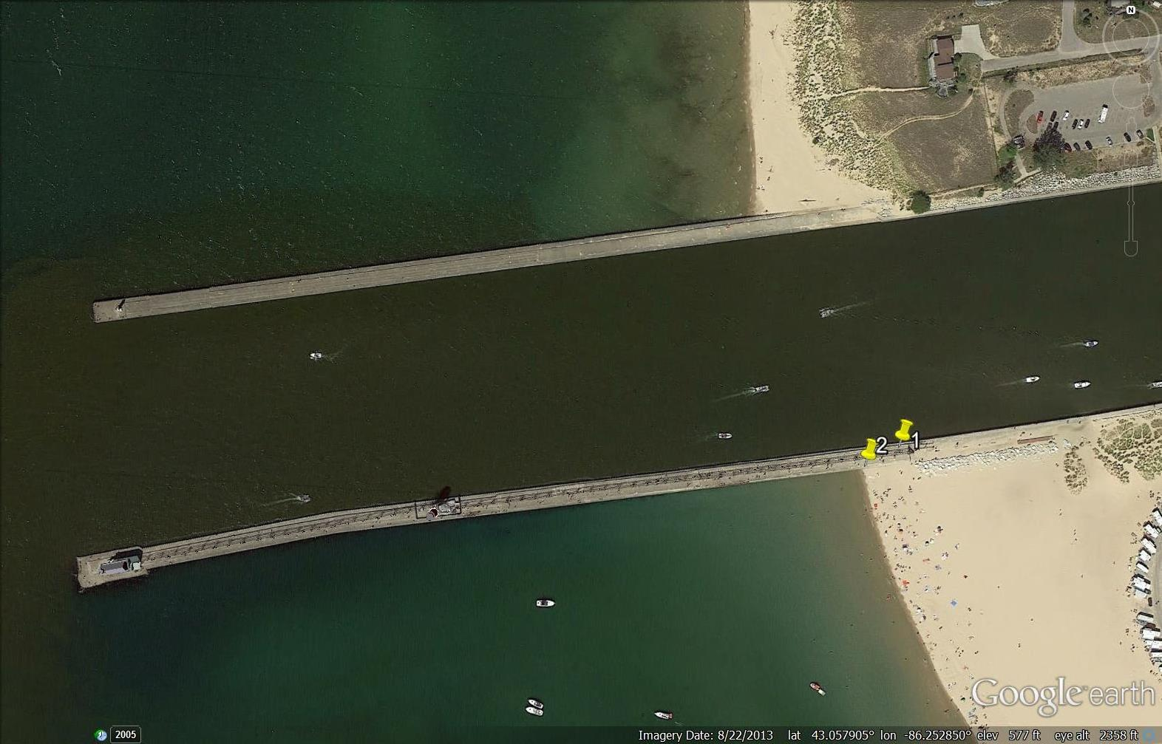
Grand Haven Experiments
Akela deployed beach side (Site #2) of jetty

Slide 6
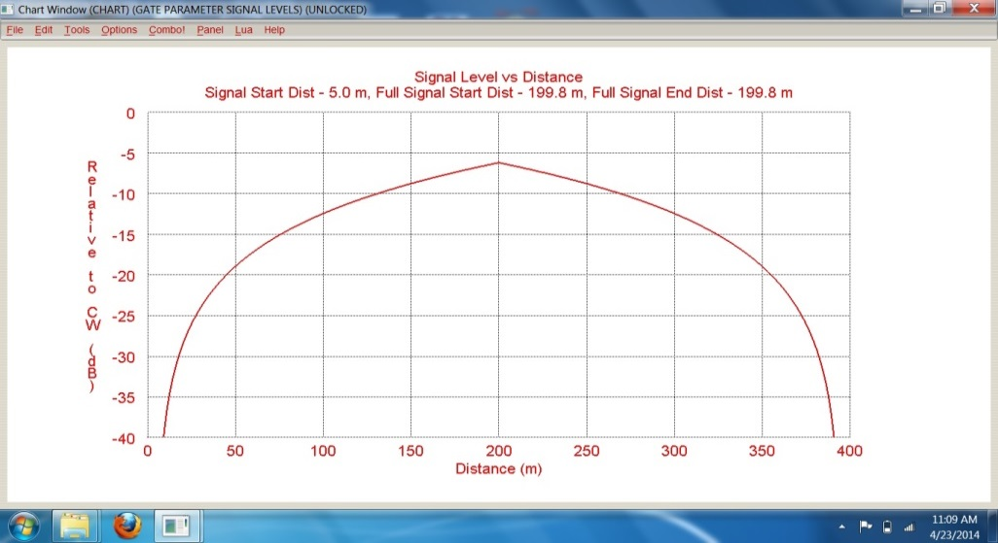
Grand Haven Akela Experiments
Band (GHz) | # Frequencies | Hopping Rate | Sweep PRF (Hz) | Max. Range (m) | Resolution (m) | Numscans | Label
1-6 | 4000 | 15,300 | 3.8 | 120 | 0.03 | 462 | wideband_girl
1-3 | 4000 | 15,300 | 3.8 | 300 | 0.075 | 462 | narrowband_girl
3-6 | 4000 | 15,300 | 3.8 | 200 | 0.05 | 462 | narrowband_girl2
1-2 | 4000 | 15,300 | 3.8 | 600 | 0.15 | 462 | narrowband_1_2
2-3 | 4000 | 15,300 | 3.8 | 600 | 0.15 | 462 | narrowband_2_3
3-4 | 4000 | 15,300 | 3.8 | 600 | 0.15 | 462 | narrowband_3_4
4-5 | 4000 | 15,300 | 3.8 | 600 | 0.15 | 462 | narrowband_4_5
5-6 | 4000 | 15,300 | 3.8 | 600 | 0.15 | 462 | narrowband_5_6
5-6 | 4000 | 45,000 | 11.25 | 600 | 0.15 | 1362 | narrowband_5_6_45k
2-3 | 4000 | 45,000 | 11.25 | 600 | 0.15 | 1362 | narrowband_2_2_45k

Slide 7
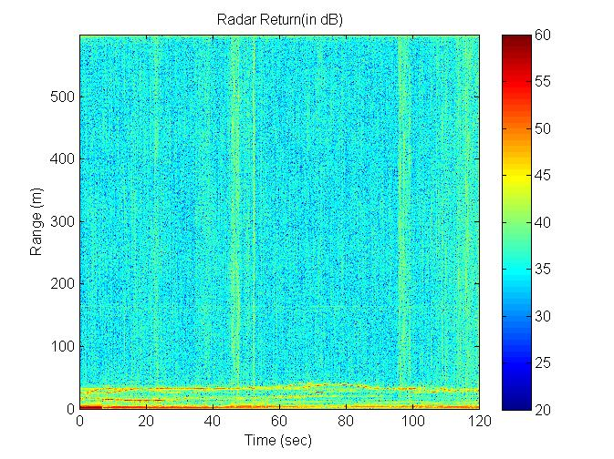
Processing the Akela Radar (Part 1)
1D FFT to convert stepped frequency data into Range vs. Slow Time
Create Pulse-pair Interferogram

Slide 8
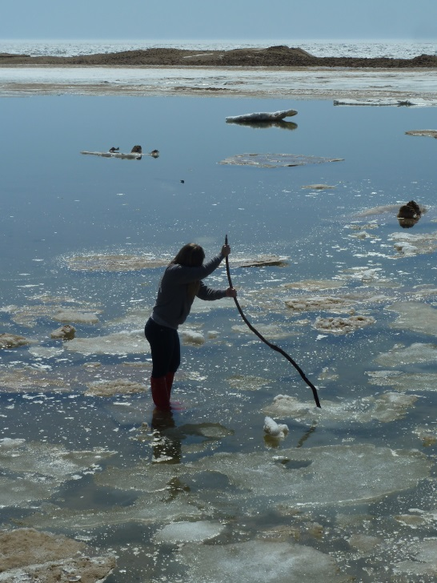
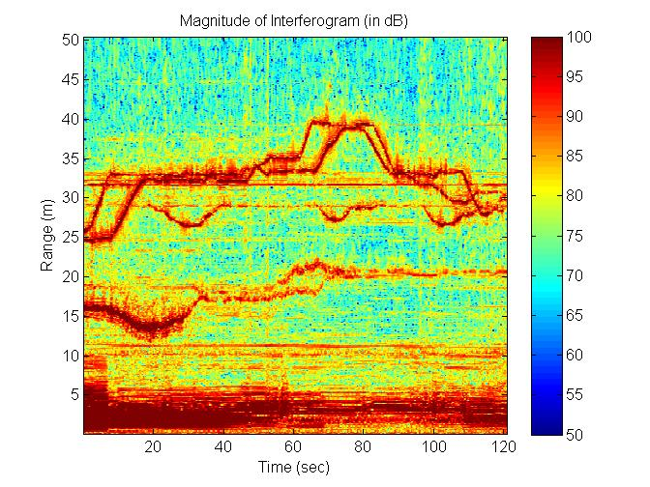
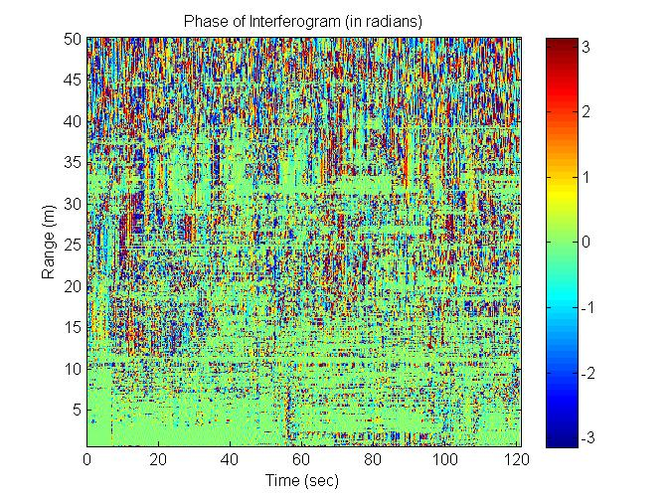
Preliminary Akela Results
Near-shore ice and “movers” seen in image
Constant phase versus slow time indicates stationary targets
But small range bins (3-15 cm) and low PRF (3.8 Hz) are ill-suited for velocity estimation.
Rapid motions are not seen in phase.
Interferometric Magnitude (left) and Phase (right) for Narrowband_1_2

Slide 9
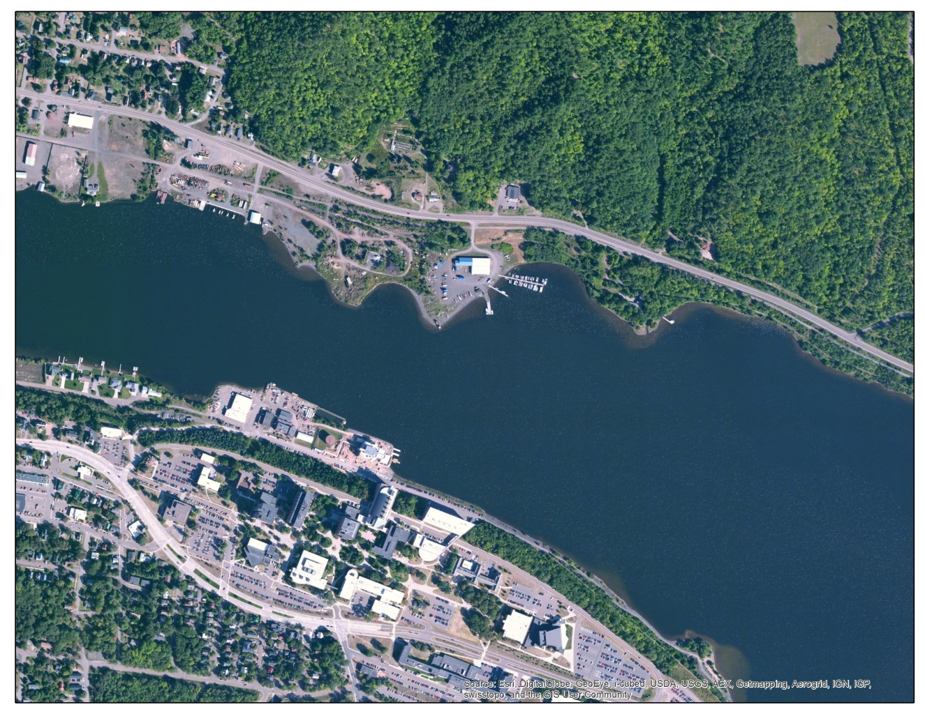
Houghton Experiments
Houghton chosen for availability of moving ice and good working environment atop the Great Lakes Research Center
Akela deployed during passage of ice

Slide 10
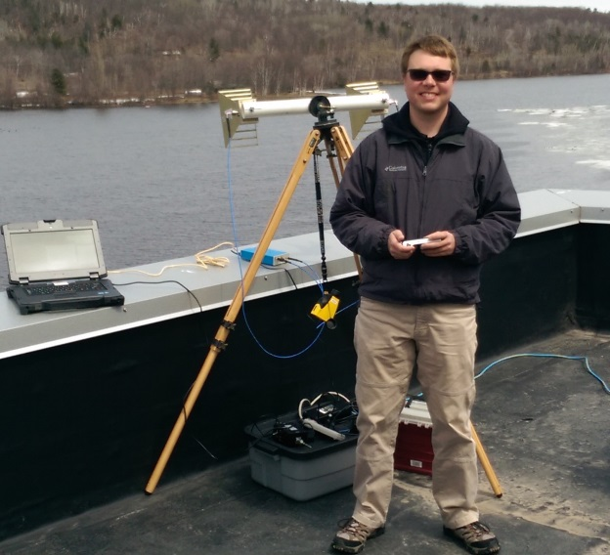
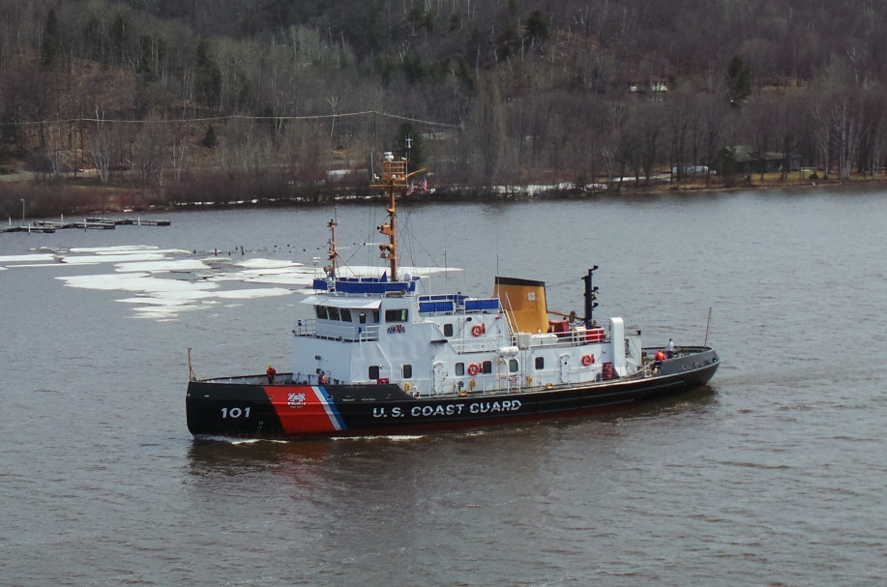
Houghton Experiments
Experiments coordinated with U.S.C.G. breaking ice in Keweenah Waterway
Coast Guard broke the ice and an East wind blew the ice down the waterway

Slide 11
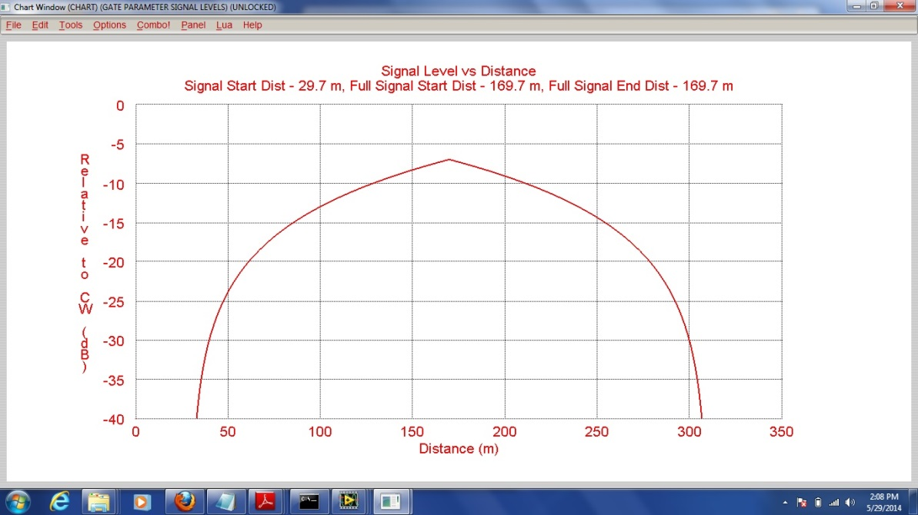
Houghton Akela Experiments
Band (GHz) | # Frequencies | Hopping Rate | Sweep PRF (Hz) | Max. Range (m) | Resolution (m) | Numscans | Label
1-2 | 2000 | 30,000 | 15 | 300 | 0.15 | 462 | glrc_1_2
2-3 | 2000 | 30,000 | 15 | 300 | 0.15 | 462 | glrc_2_3
3-4 | 2000 | 30,000 | 15 | 300 | 0.15 | 462 | glrc_3_4
4-5 | 2000 | 30,000 | 15 | 300 | 0.15 | 462 | glrc_4_5
5-6 | 2000 | 30,000 | 15 | 300 | 0.15 | 462 | glrc_5_6

Slide 12
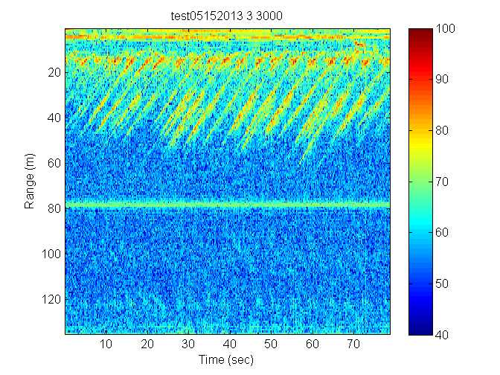
Processing of Akela (Part 2)
Alternative to more typical Pulse-Pair Interferogram
Use:
Interferometric Coherence to distinguish between ice and water
Interferometric Phase to monitor time-evolving velocity
Start with Range-compressed
Akela “image”

Slide 13
Coherent Processing of Akela (Part 2)
Step #1
Create a stack of N complex (I&Q) Akela range-compressed “images”
Each successive layer displaced one frequency sweep to the left.
Third dimension of complex array now represents N sequential time slices
Slow-time Axis
Step #2
Drilling up through each pixel, unwrap phase and perform linear regression on phase.
“Slope” is used to compute Instantaneous LOS Speed
Step #3
Use slope to remove phase gradient for each pixel.
Slow-time Axis

Slide 14
Coherent Processing of Akela (Part 2)
Step #4
Using the Multi-temporal stack at each pixel, compute the Coherence to identify water, stationary targets and movers.
$$γ=\frac{\sum{M∗S^{∗}}}{\sqrt{\sum{M^{2}}\sum{S^{2}}}}$$
Step #5
Compute a Coherence Mask, for all coherence values less than prescribed threshold (e.g. 0.65)
Slow-time Axis
Range
Slow-time Axis

Slide 15
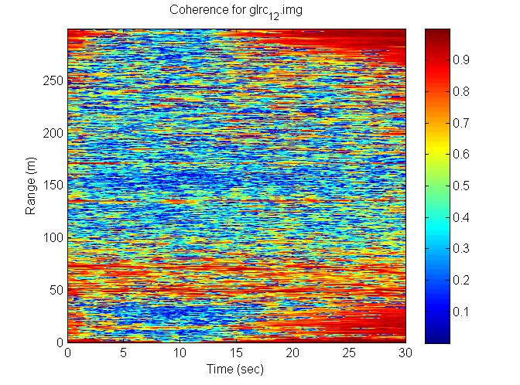
Akela Results
Coherence delineates between water (low coherence) and ice/land (high coherence)

Slide 16
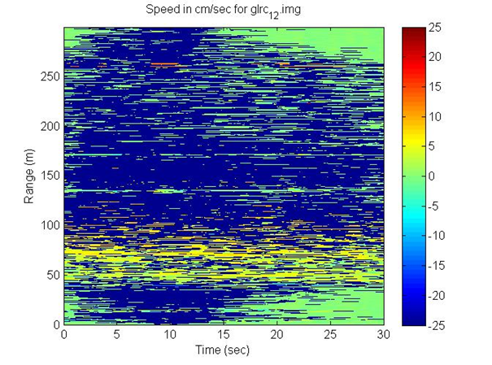
Akela Results
Coherence mask set at $γ$= 0.65 to remove water
Use Phase slope from linear regression used to compute LOS speeds
Result validation: Ice passing GLRC pier was clocked at ~4 cm/sec

Slide 17
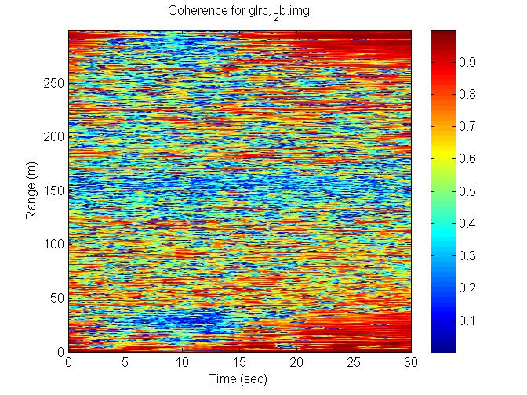
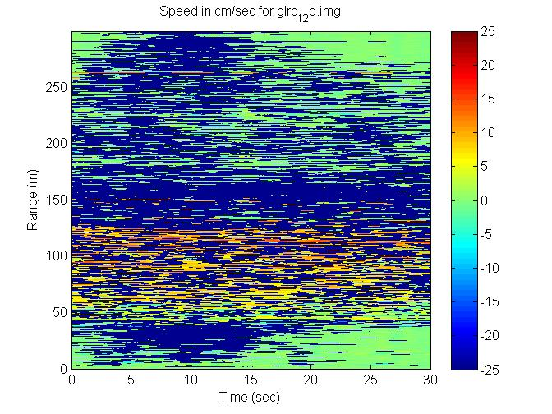
Akela Results
Coherence and Speed results for data taken at later time (with increasing ice coverage spanning the waterway)

Slide 18
Conclusions
Akela Radar is well-suited for short-range applications (such as the Waterway), but low PRF may limit longer range applications
Any Akela application in the Arctic would require weatherization effort
Interferometry provides an alternative approach to Real-aperture Radar, providing the means to both identify non-water targets and characterize the speed of movers

