Slide 1
ASSESSMENT OF CROSS-SHORE WAVE TRANSFORMATION BASED ON RADAR OBSERVATIONS
Guillermo M. Díaz Méndez & Merrick C. Haller
Radar Remote Sensing Estimates of Waves and Wave Forcing at a Tidal Inlet, 2015,
JTech (32), G. Díaz Méndez, M. Haller, B. Raubenheimer, S. Elgar & D. Honegger
SoMAR-3 | Applied Physics Laboratory, University of Washington | July 15, 2015

Slide 3
Goal: use of radar-derived parameters to assess wave-height transformation in the nearshore.
2D wave-action balance equation [Kirby 1984]:
Model of breaking-induced wave energy dissipation [Janssen & Battjes 2007]:
Approach: estimate Q_{b} based on the analysis of normalized histograms (PDFs) of radar echos from the sea surface.

Slide 4
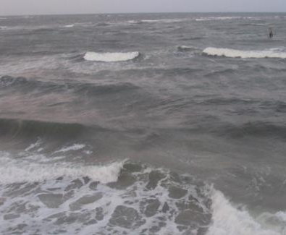
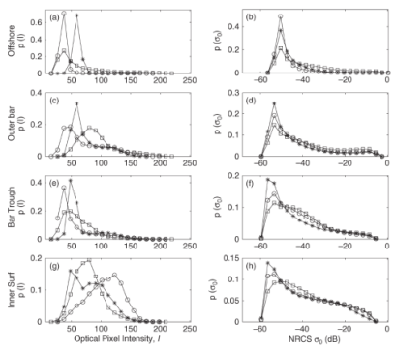
Biggest challenge: identify radar signal associated with active breaking
active breaking
non-breaking
steep waves
foam
New River Inlet, NC, May 7, 2012
Fig. 5 of Catalán et al. 2011. Normalized histograms of optical pixel intensity (left) and NRCS (right)

Slide 5
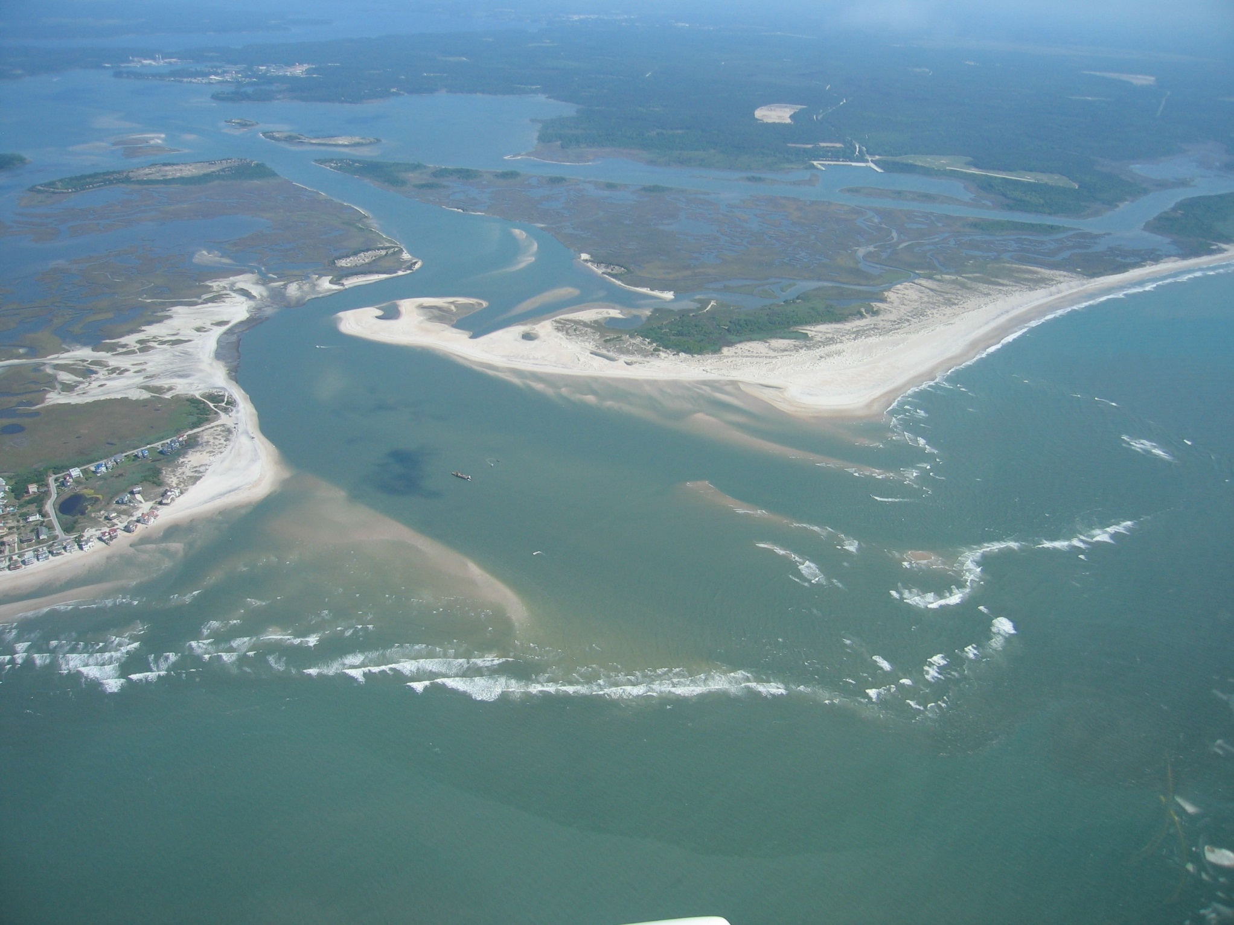
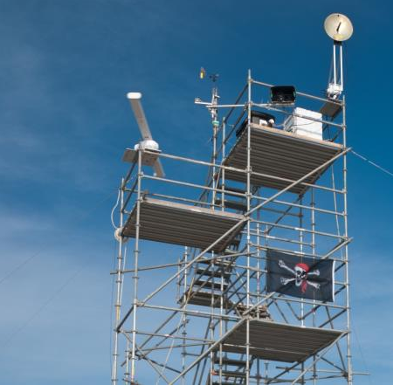
Radar data came from the New River Inlet, NC
Field campaign on May, 2012.
photo by D. Honeggers
Radar sampling scheme:
half-hourly runs (May 7—15, 2012)
footprint radius r ≈ 1.5—3 km
azimuth coverage azi ≈ 290º
rotations = 1024 (τ ≈ 20 min)
Δ_{range} = 3 m; Δ_{azimuth} = 0.57º
Δ_{t} ≈ 1.2 s (Δ_{f} = 0.83 Hz )
10.2 m NAVD88
photo by G. Farquharson

Slide 6
Snapshot (uncalibrated radar intensity)
N
Camp Lejeune
New River Inlet
OSU
WIMR
3 km
North
Topsail
beach

Slide 7
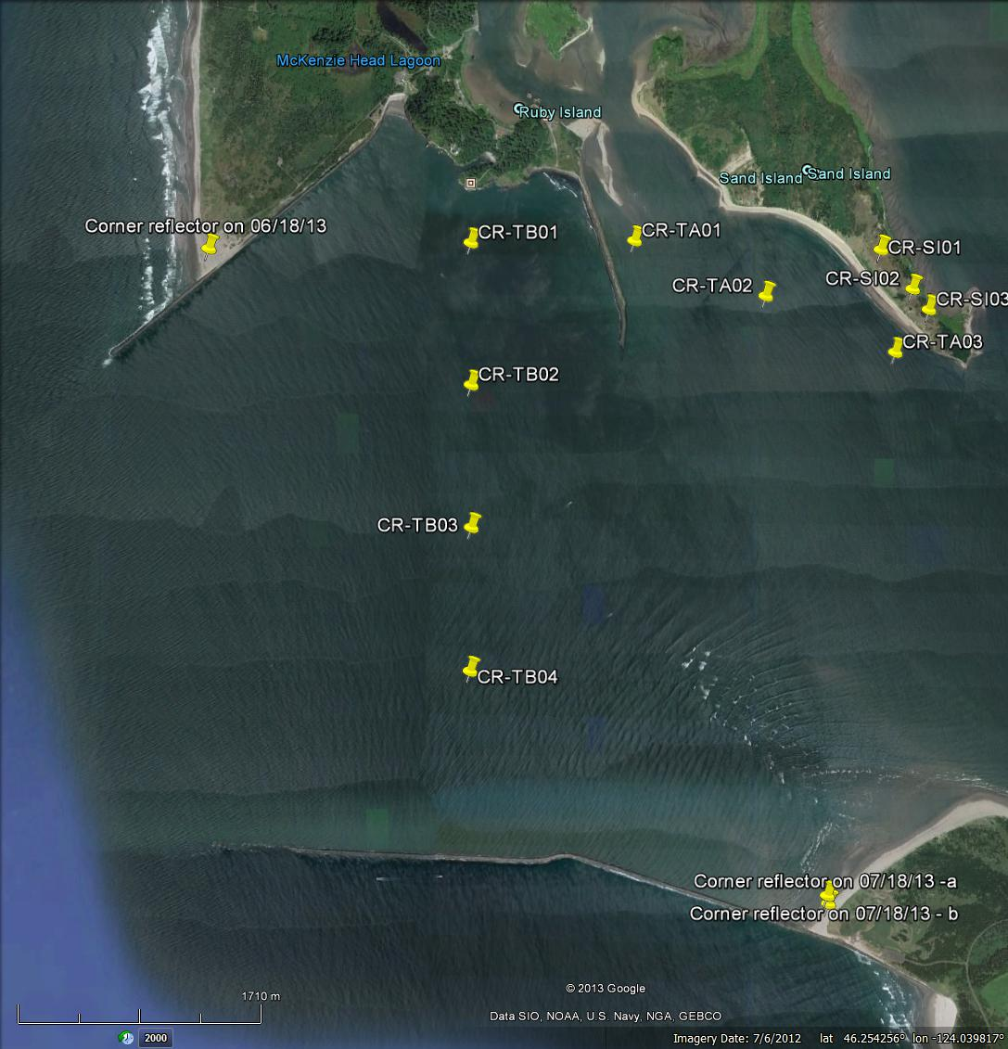
Corner reflector on jet ski
azi = 112°
azi = 180°

Slide 8
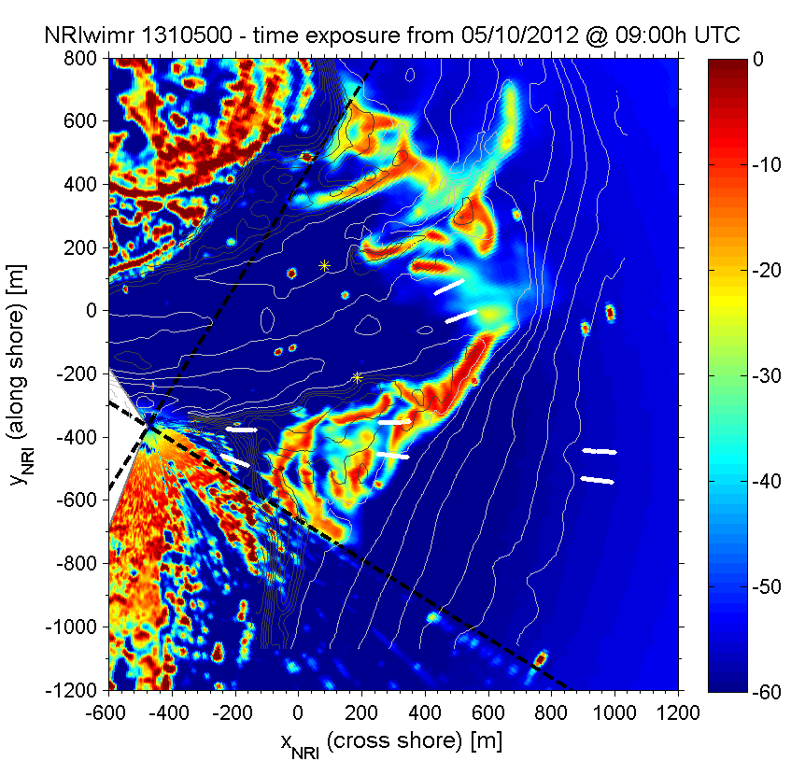
PDF analysis: four areas with different characteristics
Time-average of calibrated radar intensity σº [dB]
(10 May 2012 @ 9:00h UTC)
1. South beach
DIB @ High tide
2. Navigation channel
CIB @ Low tide
3. South ebb-shoal
DIB @ Low tide
4. Offshore
no breaking expected
2
1
σº [dB]
3
4
N
DIB = depth-induced breaking
CIB = current-induced breaking

Slide 9
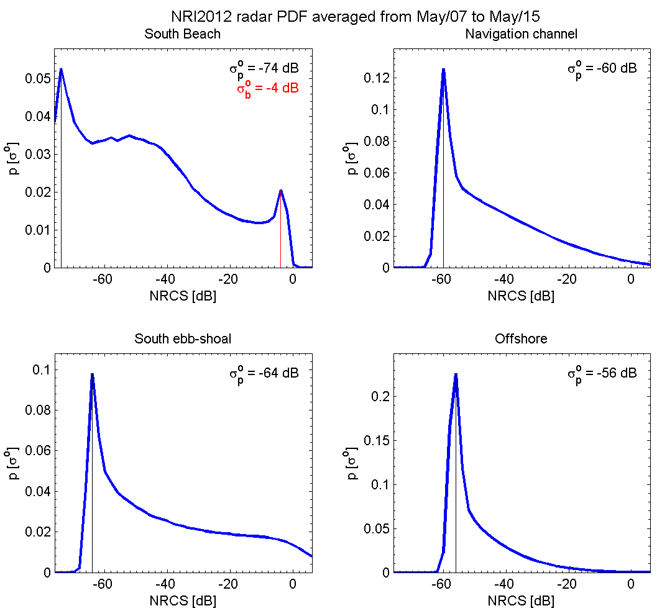
PDF analysis: 9-day average
σº_{p} = low-NRCS peaks (non-breaking)
σº_{b} = high-NRCS peak (active breaking)
May 7-15, 2012

Slide 10
Correlation analysis: NRCS to ocean conditions
Correlation of p(σº_{b = -4dB}) vs η
R = | 0.86 | -0.57 | -0.67 | 0.04
lag_{xCorr} = | 0 | 0 | 0 | n/s
spring tides
neap tides
Notes:
17 high tides (and 16 low tides total).

Slide 11
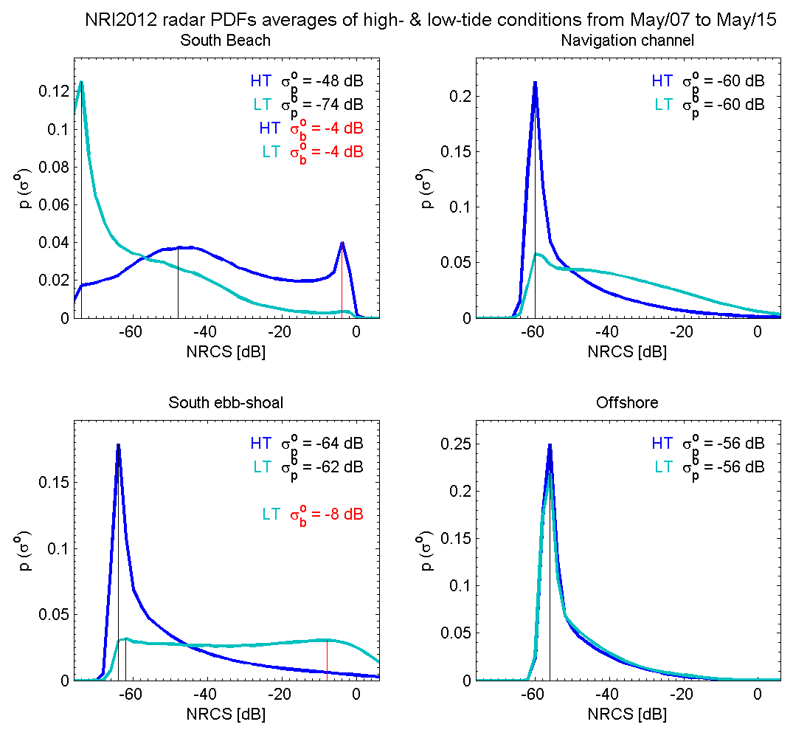
PDF analysis: high- and low-tide averages
High- & low-tides

Slide 12
Estimation of Q_{b}: breaking threshold σ⁰_{br} = -4 dB used as filter
Hypothesis: σ⁰ >= σ⁰_{br} = active breaking
Fraction of breaking Q_{b} [Keen & Holman 2012]:
Radar-derived Q_{b} (10 May 2012 @ 9:30h UTC)
Camp
Lejeune
N_{b} = total number of breaking waves
N_{tot} = τf_{p} = total number of waves observed
τ = record length ~ 20 min
f_{p} = radar-derived peak frequency
Y_{NRI} (alongshore) [m]
North
Topsail
X_{NRI} (cross-shore) [m]
Notes:
local Ecgx is found through a forward differencing scheme

Slide 13
Validation of Q_{b}: modeling cross-shore wave height transformation
Radar-derived Q_{b} (7—15 May 2012)
assuming stationarity, and neglecting U & along-shore variablity...
Camp
Lejeune
where
Q_{b}
and
North
Topsail
64-by-64 pix
640 m
[Young et al.'85]
cBathy [Holman et al.'13]
local H_{rms} is predicted as:
Wrightsville Beach, NC
Notes:
local Ecgx is found through a forward differencing scheme

Slide 14
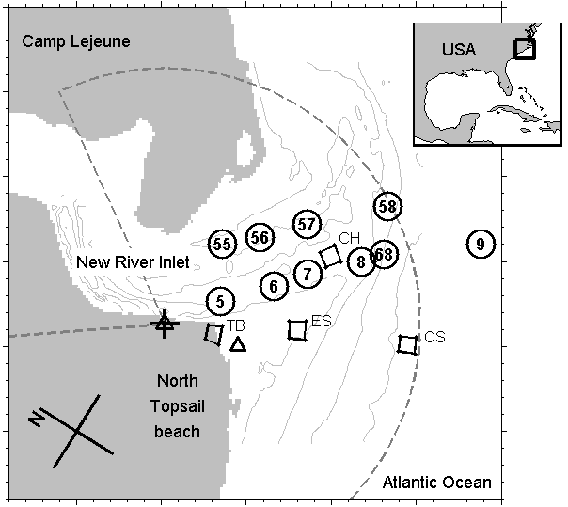
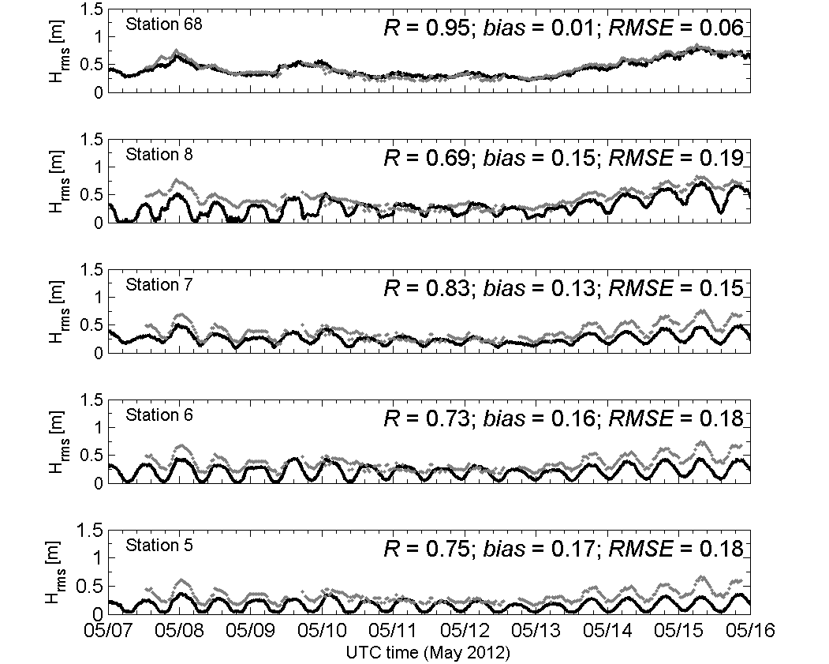
Results: cross-shore variation of H_{rms}
South Inlet transect
observed predicted

Slide 15
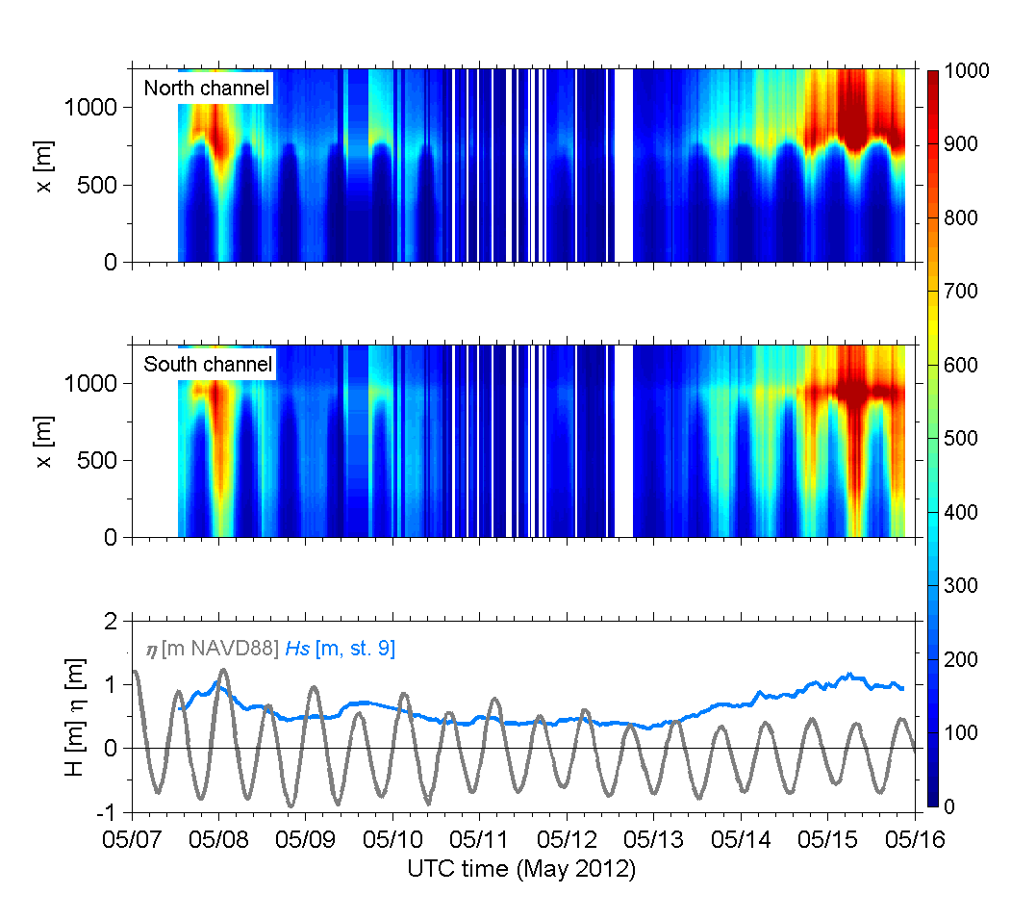
Results: time & space variation of cross-shore radiation stress S_{xx}
Defined as
[Longet-Higgins & Stewart, 1964]
S_{xx} [kg s⁻² m⁻¹]

Slide 16
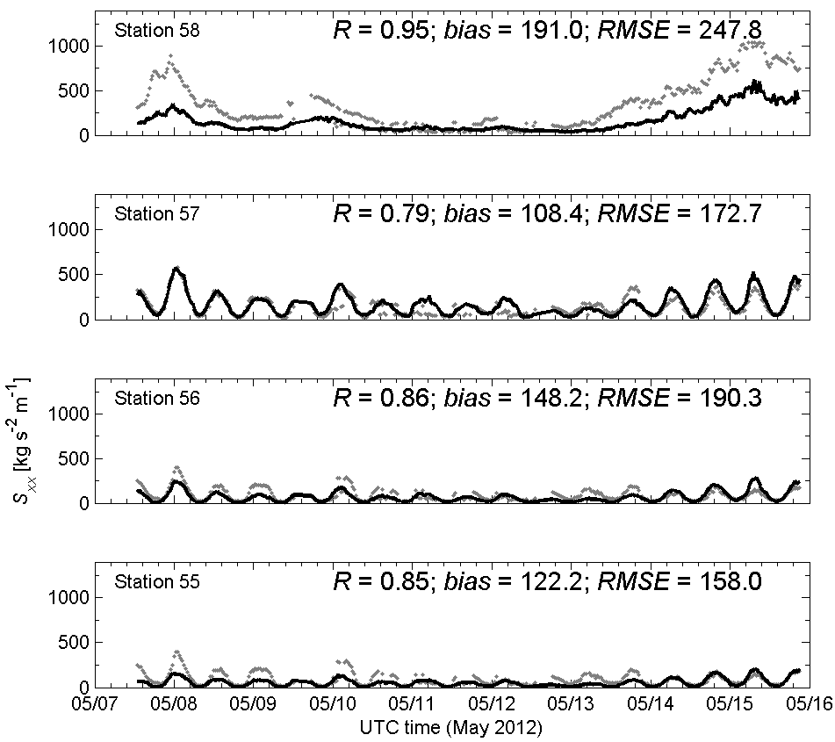
Results: cross-shore variation of S_{xx}
North Inlet transect
observed predicted

Slide 17
Summary
Rapid assessment approach to evaluate variability of wave energy transformation based almost entirely on remote sensing observations
Q_{b}, f_{p}, α_{p}, h. [H_{s} & η - in situ]
time and space distribution of wave breaking identified using a threshold developed via the NRCS PDFs
Methodology tested at NRI, where strong (spatial) gradients of H_{s}, mostly driven by tide, occur at the inlet mouth
Predicted H_{rms} & S_{xx} agree well with observations
R = 0.68─0.96; bias = -0.05─0.17 m; rmse = 0.06─0.19 m;
R = 0.79─0.95; bias = 72─191 kg s⁻² m⁻¹; rmse = 138─247 kg s⁻² m⁻¹;
Results are consistent with other studies
Zippel & Thomson 2014; Wargula et al. 2014; Chen et al. 2014;
Is it possible to discriminate between the different stages of breaking using radar alone?

Slide 18
THANK YOU
gdiaz@cicese.mx
Playa de Merón, Spain, March 3, 2014 - (http://www.youtube.com/watch?v=2aOmzNjliE0)

Slide 19
EXTRA SLIDES

Slide 20
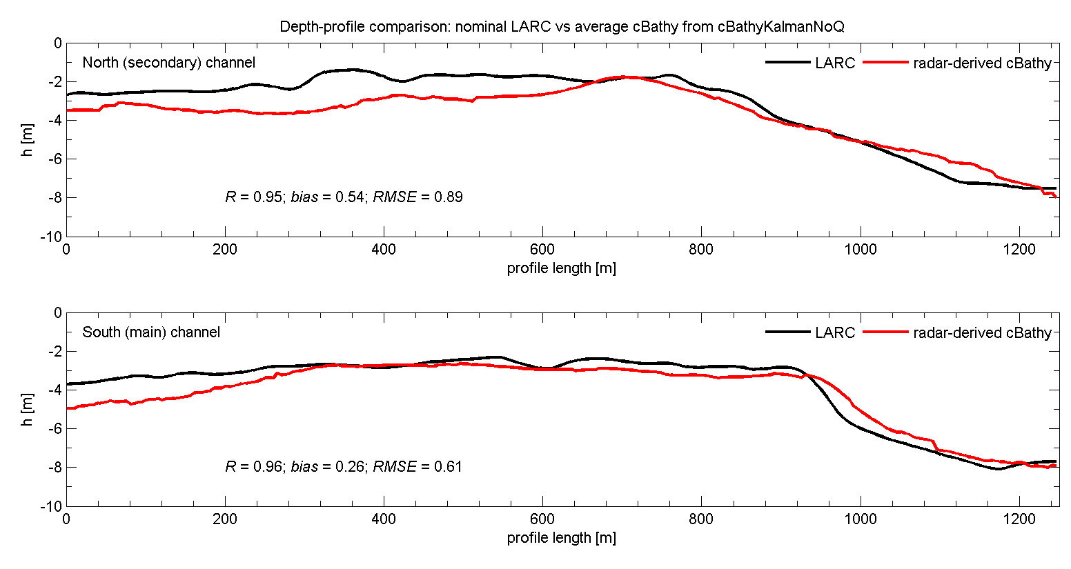
Along-profile depth estimates: surveyed vs radar-derived
h_{s55} = 2.6 m
3.5 m
h_{s56} = 2.2 m
3.6 m
h_{s57} = 1.7 m
3.0 m
h_{s58} = 5.1 m
5.1 m
h_{s68} = 6.1 m
5.3 m
h_{s05} = 3.7 m
4.9 m
h_{s06} = 2.7 m
2.7 m
h_{s07} = 2.3 m
2.7 m
h_{s08} = 2.9 m
3.3 m

Slide 21
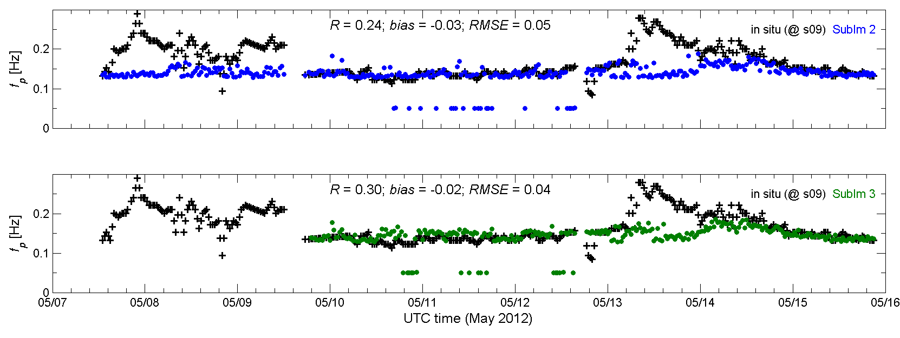
Radar-derived wave parameters: f_{p} and α_{p}
In situ @ station 9 (Nortek AWAC, WHOI) vs radar-derived

Slide 22
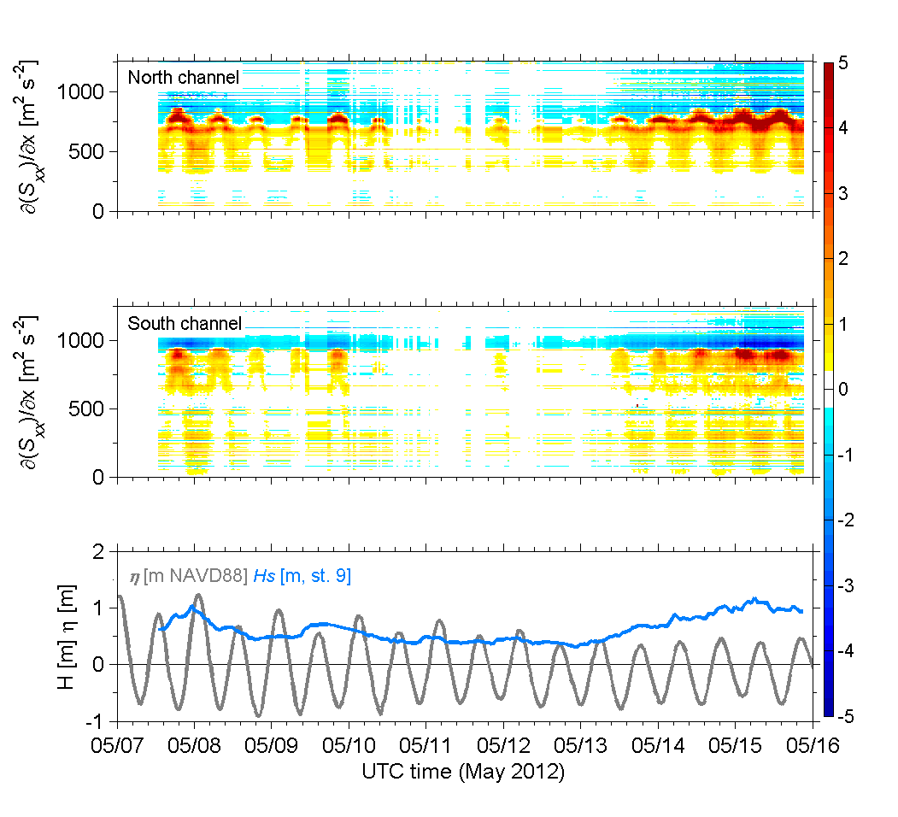
Time & space variation of wave forcing (along-transect )

Slide 23
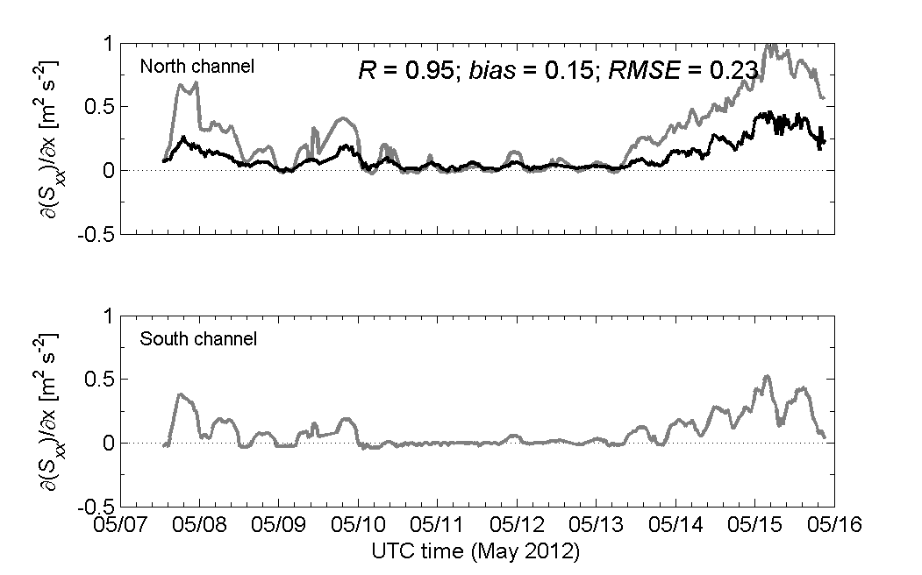
I. Introduciton II. Synthetic Aperture Radar III. Marine Radar IV. Summary
III.1. Remote sensing of ocean waves via Marine Radar III.2 Nearshore wave energy dissipation
Wave forcing (along-transect )
— measured
predicted
mean = 0.252; mean = 0.108
mean = 0.088
Note – While the gradient along the south channel was estimated for the whole length of the transect (1250 m), gradients along the north channel were estimated between stations s55 (x = 0 m) and s58 (x = 1000 m) only.

Slide 24
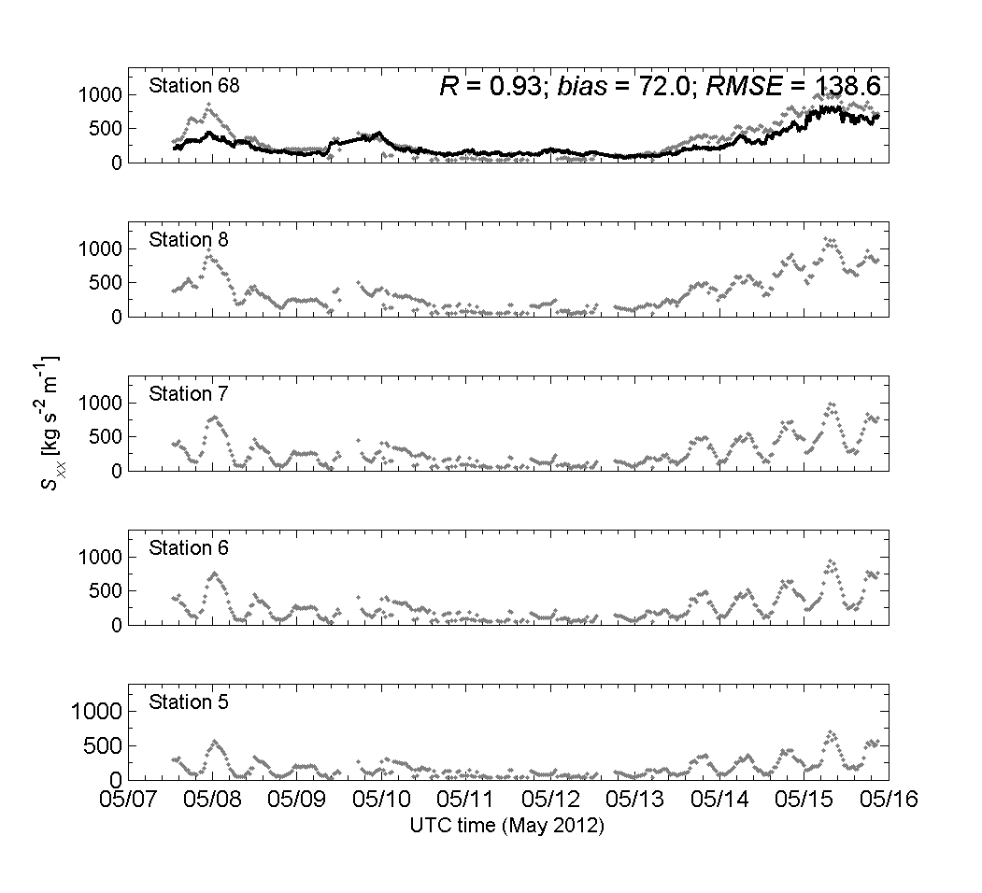
Results — cross-shore variation of S_{xx} — South channel
— measured
predicted

