Slide 1
Intrusion fronts and internal jumps at the MCR, observed via shore-based marine radar
David Honegger
Merrick Haller

Slide 2
MCR Wave averaged image time series
Notes:
NOW THAT WE’RE AT THE MCR, RETURN TO THE WAVE AVERAGED MOVIES
APPLIED THIS METHOD TO MCR DATA
HIGHLIGHTS WHAT APPEARS TO BE A RICH SIGNAL
WE SEE BRIGHT ANOMALIES AND DARK ANOMALIES
TWO APPEAR TO MOVE UPCHANNEL, ONE APPEARS QUASI-STATIONARY
IN ORDER TO
IN LIGHT OF THESE FEATURES, PRESENT THE 3RD AND 4TH CHAPTERS OF THESIS …

Slide 3
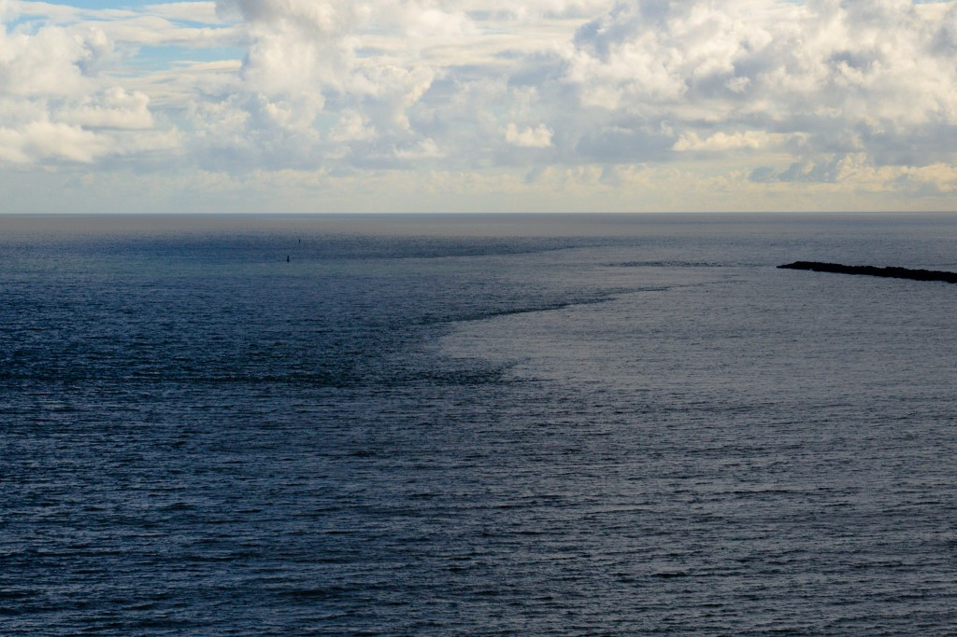
Photos from Cape Disappointment (z=60 m)
“Tide Lines”

Slide 4
Overview
Sharp flow gradients are navigational challenges
➔ Rapid acceleration, deceleration, or rotation
Fronts separate water bodies of differing bulk $S$,$T$, etc.
➔ Affect sound speed & help define limits of nutrient/pollutant dispersion
Short time & length scales are challenging to model in large domains
➔ e.g. MCR domain $O{\left(10−100 km\right)}^{2}$; fronts can vary $O(1−10 m)$
X-band marine radar observations of:
Near-field ebb plume front
Surface intrusion front
Bottom intrusion front*
Oblique internal jump*

Slide 5
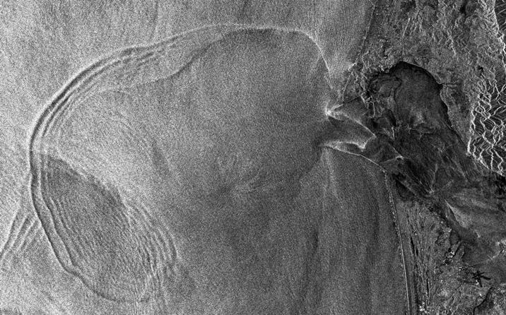
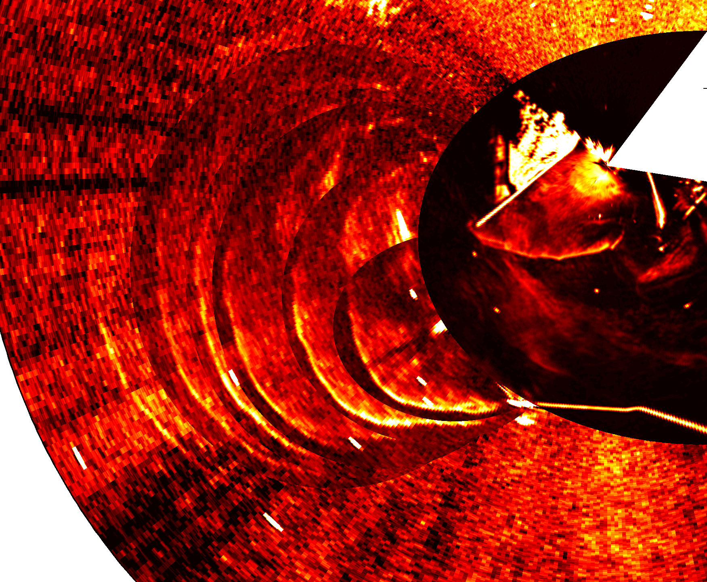
Marine radar: near-field plume front
12 km
Cape
Disappointment
Wave
&
Wind
Plume front propagation
(over ~2.5 hrs)
Canadian Space Agency via David Jay (PSU)

Slide 6
Support data: WHOI, USGS, NOAA, APL-UW
Notes:
COLLECTED DATA FROM NUMEROUS SOURCES

Slide 7
Ebb: Plume front
Flood: Surface intrusion front
River
Ocean

Slide 9
Positive anomaly: Intrusion front
Salinity
$$y$$
s
$\frac{∂u_{s}}{∂s}=−4.6×{10}^{−3} s^{−1}$
1 km
James River: ${10}^{−3}−{10}^{−2} s^{−1}$
Marmorino & Trump (1998)
$$x$$
NLIW: ${10}^{−3} s^{−1}$
Chang et al. (2008)
Strain rate

Slide 10
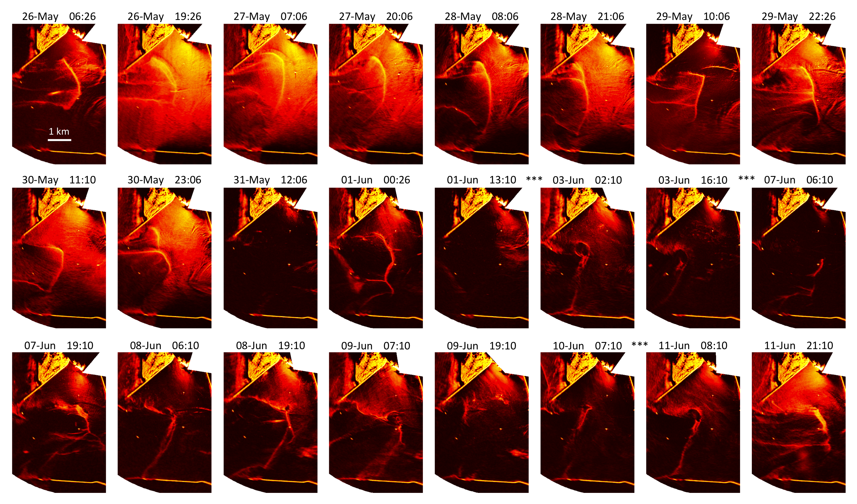
Positive anomaly: Intrusion front

Slide 11
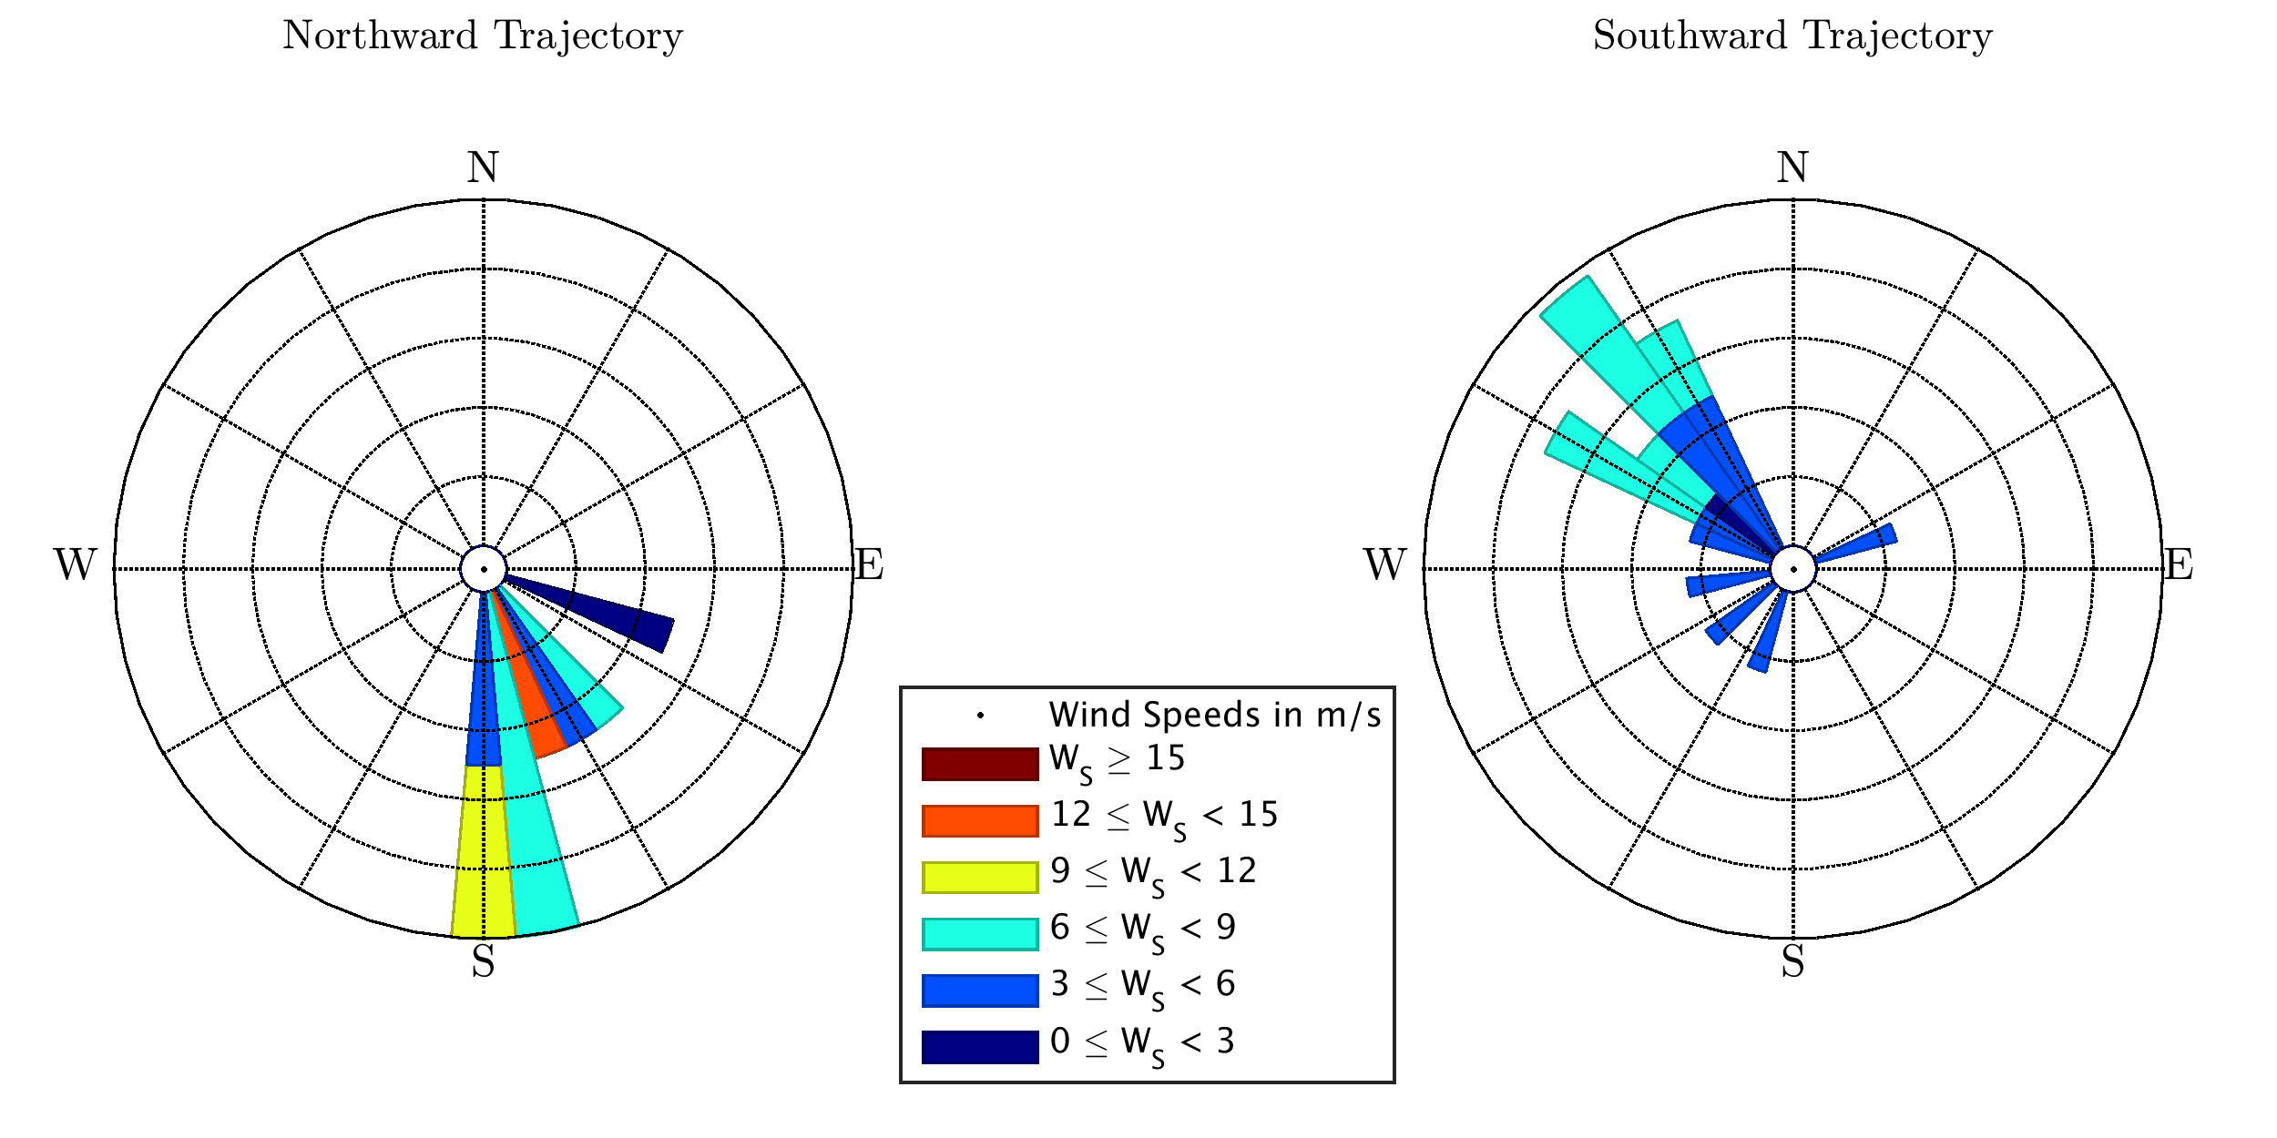
Positive anomaly: Intrusion front
Northward Trajectory
Southward Trajectory
Eastward
or uncertain

Slide 12
Negative anomaly

Slide 13
River (fresh, lighter)
Ocean (salty, denser)
Flood: Bottom intrusion front

Slide 14
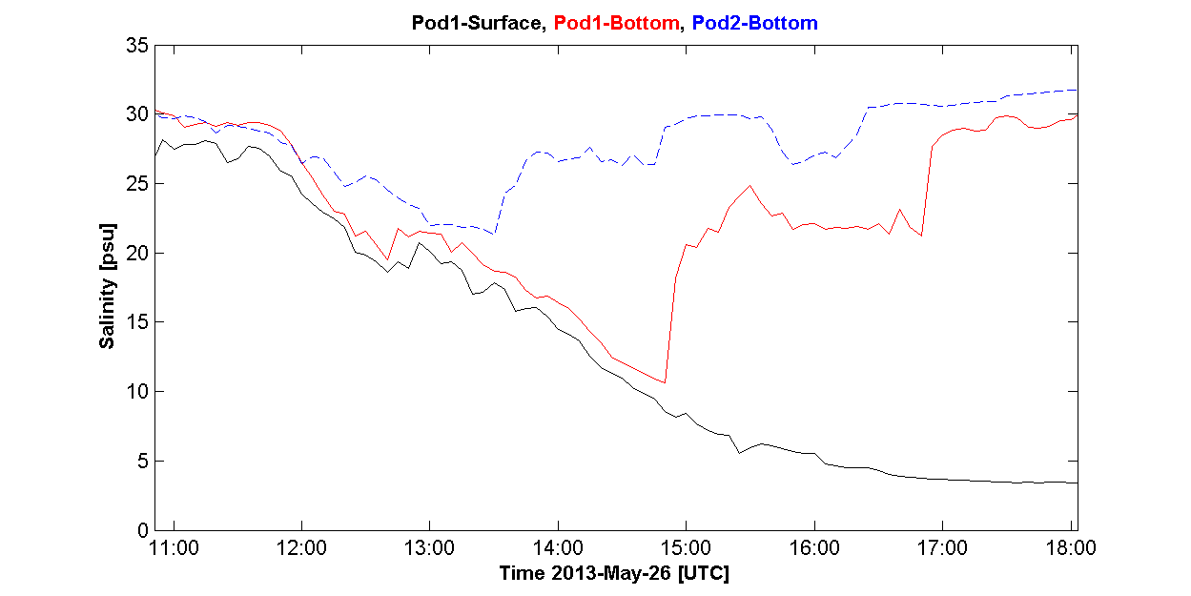
Negative anomaly: Bottom front
Sharp increase in
(near) bottom salinity
Event moves inland against ebb flow
Pod1
Pod2
1 km
Pod2-bottom
Pod1-bottom
Pod1-top

Slide 15
Negative anomaly: Bottom front
1 km
$$y$$
s
$\frac{∂u_{s}}{∂s}=2.4×{10}^{−3} s^{−1}$
$$x$$

Slide 16
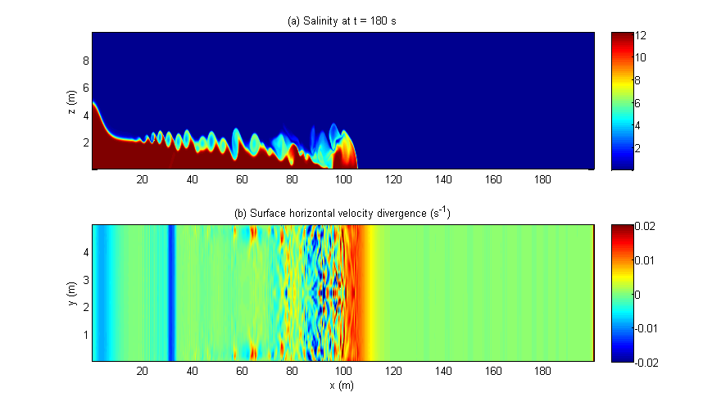
Non-hydrostatic model NHWAVE
Surface
Divergence
Provided by Dr. Tian-Jian Hsu & Dr. Xiao Yu (UDEL)

Slide 17
Oblique, internal hydraulic jumps

Slide 18
Oblique, internal hydraulic jumps

Slide 19
1 km

Slide 20
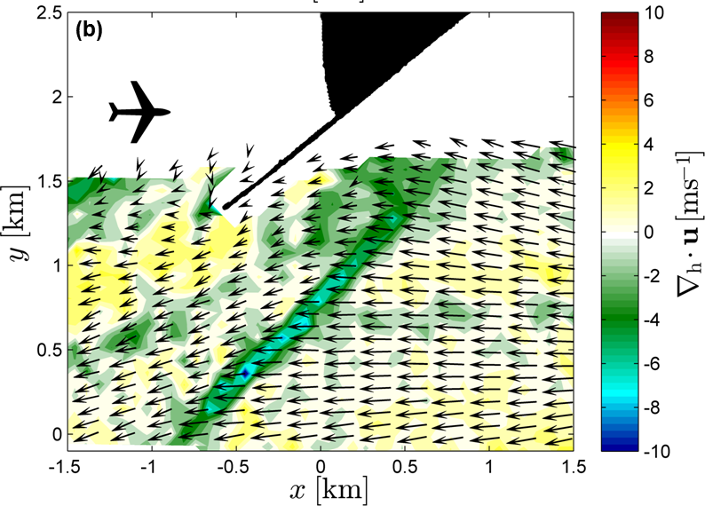
Oblique anomaly

Slide 21
Oblique anomaly

Slide 22
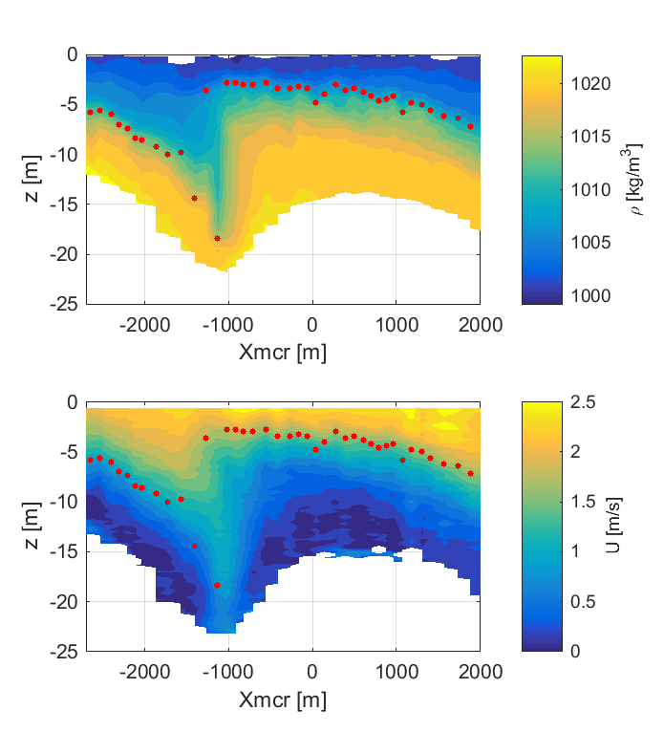
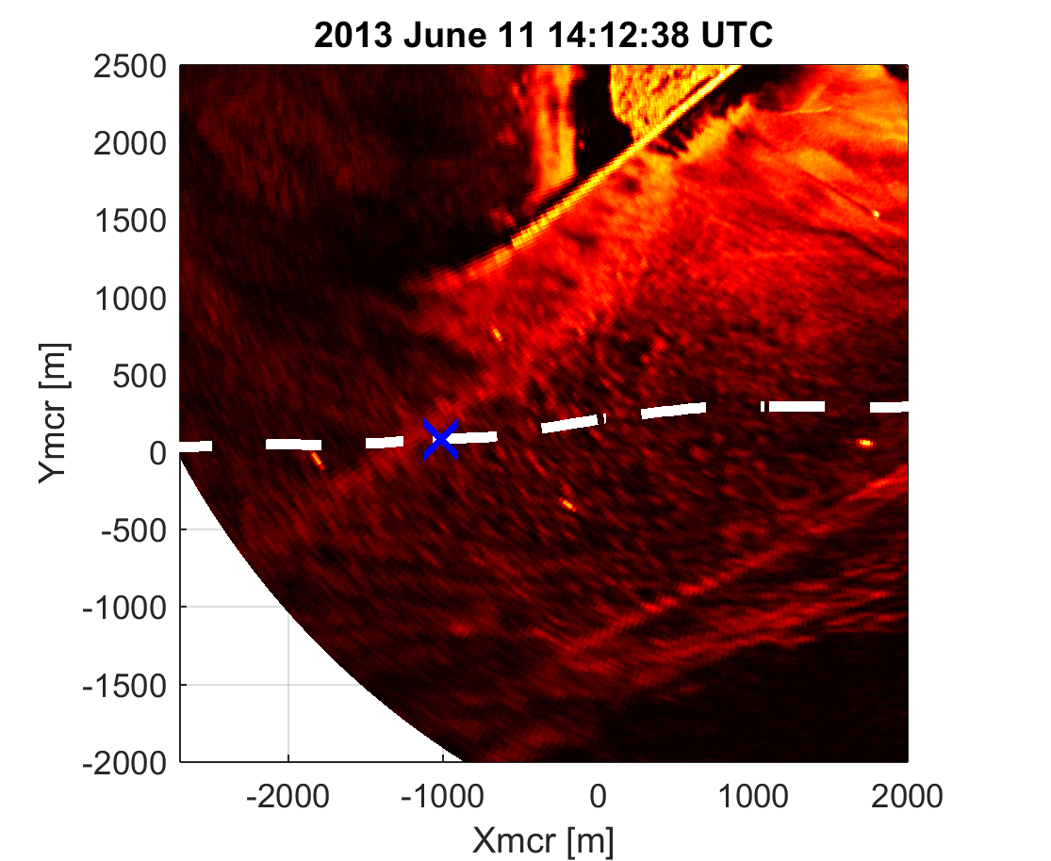
Oblique anomaly
X
Density
X
Velocity

Slide 23
Oblique anomaly: internal hydraulic jump
Subcritical flow
Supercritical flow
Jump
$$h_{1}$$
$$u_{2}^{′}$$
$$u_{2}$$
$$h_{1}′$$
$$ρ_{2}$$
$$H$$
$$u_{1}^{′}$$
$$u_{1}$$
$$ρ_{1}$$

Slide 24
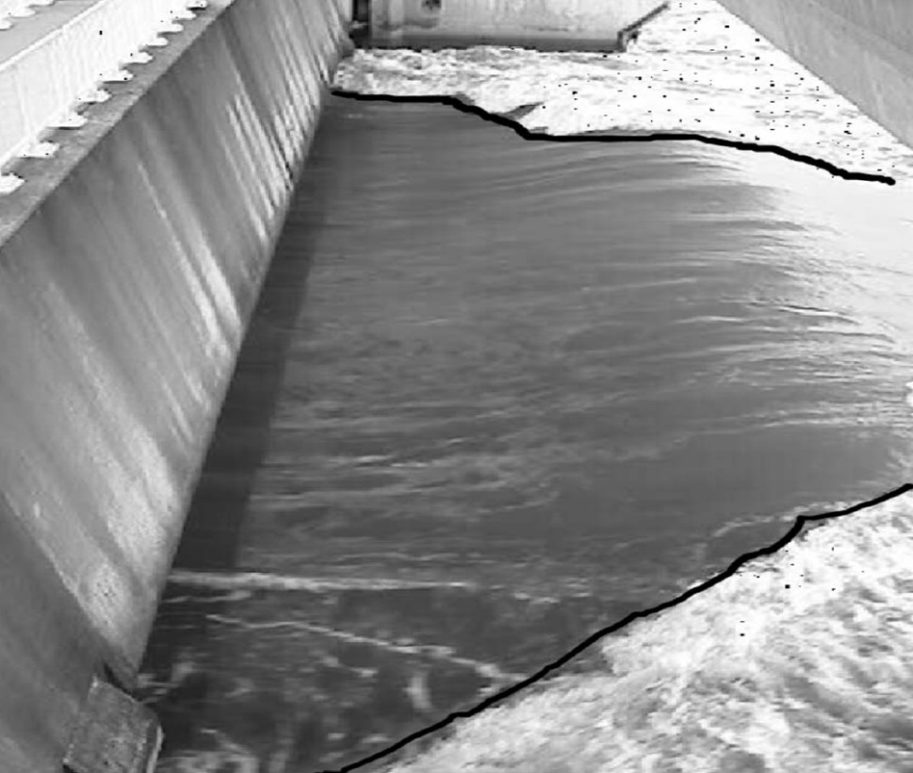
Oblique anomaly
Density
Velocity
Akers and Bokhove (2008)
(flipped horizontally)

Slide 25
Summary
Kinematics/dynamics of stratified flow can cause detectable microwave backscatter intensity modulations (old news)
Filtered image time series + high vantage point
➔ rich signal
Long-term dwell at stratified inlets:
Monitoring of complex, 2-D hydraulic structures
Identification of hydraulic structures not previously studied

