Slide 1
Phase-based depth estimates at open beaches and tidal inlets
David Honegger
Merrick Haller
Rob Holman

Slide 2
Depth estimation via “cBathy”
Holman et al. (2013)
Design environment:
High spatial depth variability
Negligible current field
Phase-based scheme for $(f,\vec{k})$ pairs
Reports uncertainty from fits
Updates via Kalman filter
Does not support currents*

Slide 3
cBathy Overview
Compute normalized temporal Fourier Transform,
Compute the cross-spectral matrix, for a number of f-bands
Compute the first complex EOF, expressed as phase and amplitude maps
Model the first EOF of C as a plane wave
Compute weighted cost function, where weighting $w$ is product of EOF magnitude and spatial Hanning filter
Use nonlinear least-squares to find $kx$, $ky$ (or $k,α$) that minimize $J$.
$$G = FT(I)/|FT(I)|$$
Stage 1:
$k,α$ estimates
Stage 2:
$\hat{h}$ estimate
Stage 3:
$\overline{h}$ estimate
$$C=\left\langle G^{∗}G\right\rangle$$
$$v={EOF}_{1}\left(C\right)$$
$$v^{′}=Ae^{i\left(xkcos\left(α\right)+yksin\left(α\right)+φ^{′}\right)}$$
$$J=w{\left|v−v^{′}\right|}^{2}$$

Slide 4
cBathy Overview
Establish new weighting function* as product of wavenumber fit skill $s$, the eigenmode’s proportional variance $λ$, and the spatial Hanning filter $Γ$
Perform nonlinear fit to the dispersion relation using $w_{h}$ via Levenberg-Marquart (e.g. nlinfit.m in Matlab)
Report uncertainty metrics
Adjust to common vertical datum (e.g. NAVD 88) using local measurements or XTide
Stage 1:
$k,α$ estimates
Stage 2:
$\hat{h}$ estimate
Stage 3:
$\overline{h}$ estimate
$$w_{h}=sλΓ$$
*Note that prior to (1), low skill and low proportional variance eigenmodes are removed via threshold (typically enforce $s>0.5 \& λ>15$).

Slide 5
cBathy Overview
Kalman filter
$\hat{h}=$ current depth estimate
$\hat{σ}$ = current uncertainty estimate
Stage 1:
$k,α$ estimates
Stage 2:
$\hat{h}$ estimate
Stage 3:
$\overline{h}$ estimate
$\overline{h}=$ moving avg depth estimate
$\overline{σ}$ = moving avg uncertainty estimate
$${\overline{h}}_{k}={\overline{h}}_{k−1}+K_{k}\left({\hat{h}}_{k}−{\overline{h}}_{k−1}\right)$$
$k^{th}$ updated
depth estimate
Kalman gain $∈[0,1]$: $f(\hat{σ},\overline{σ},Q)$
If large, weighted toward new estimate
If small, weighted toward running average estimate

Slide 6
cBathy extension to marine radar
Beaches:
Duck, North Carolina*
Benson Beach, Washington*
Zandmotor, The Netherlands**
Inlets:
New River Inlet, North Carolina*
Ameland Inlet, The Netherlands**
Columbia River Mouth, OR/WA*
* HH-pol ISR
** HH-pol SeaDarQ

Slide 7
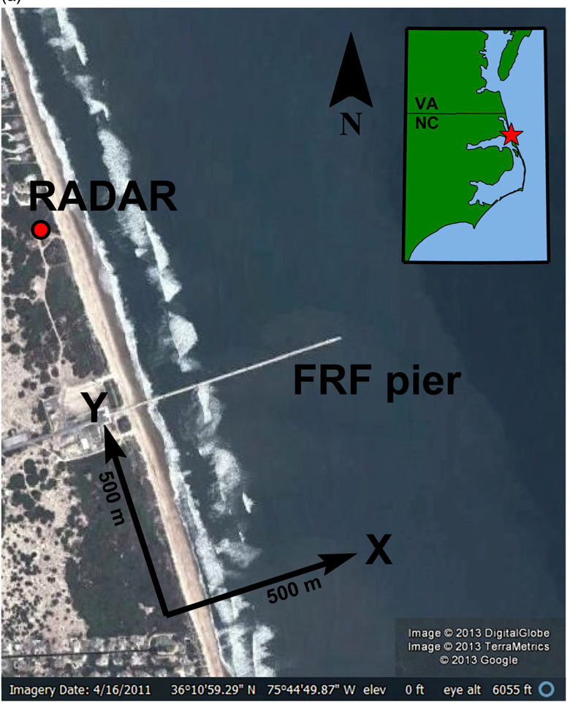
Duck, North Carolina
Radar
cBathy domain
ARGUS
ARGUS
cBathy domain

Slide 8
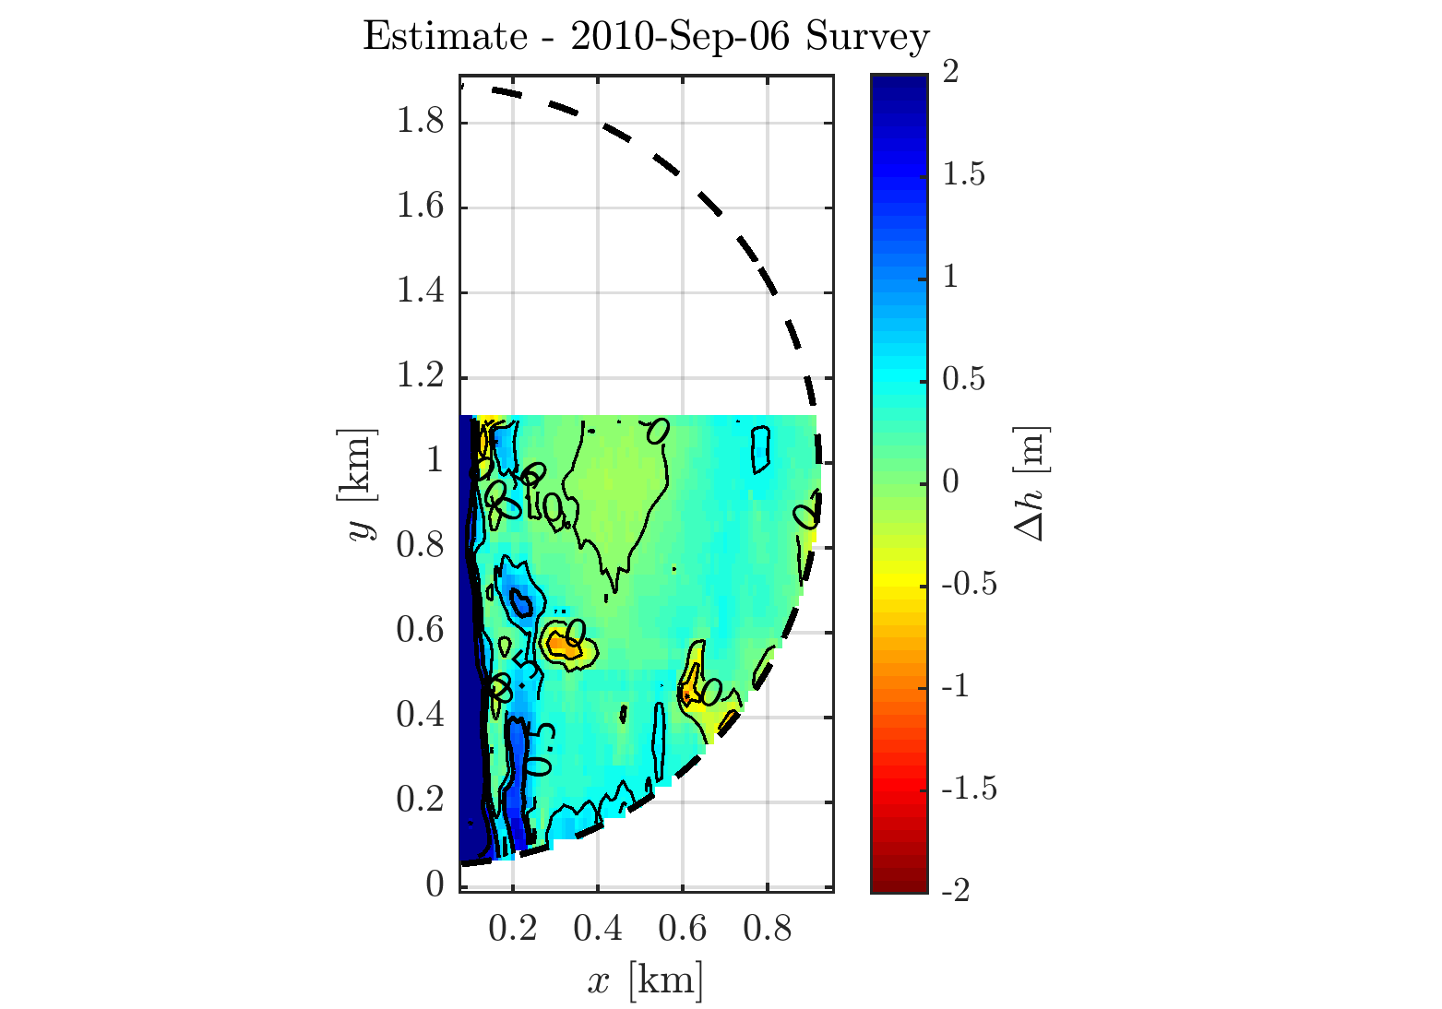
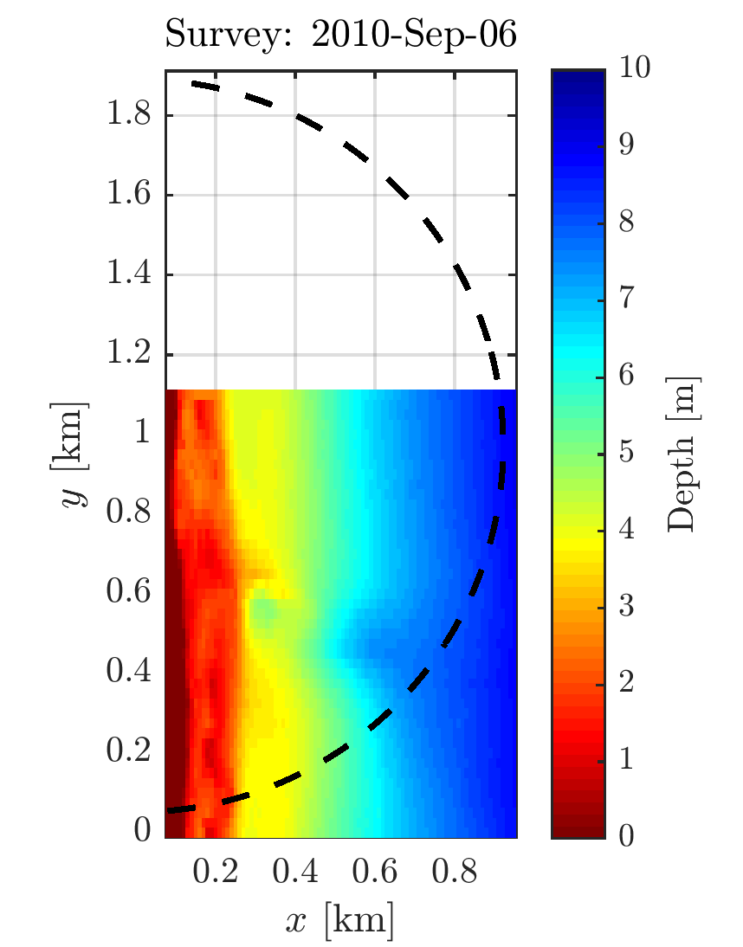
Duck, North Carolina
Holman et al. (2013)

Slide 9
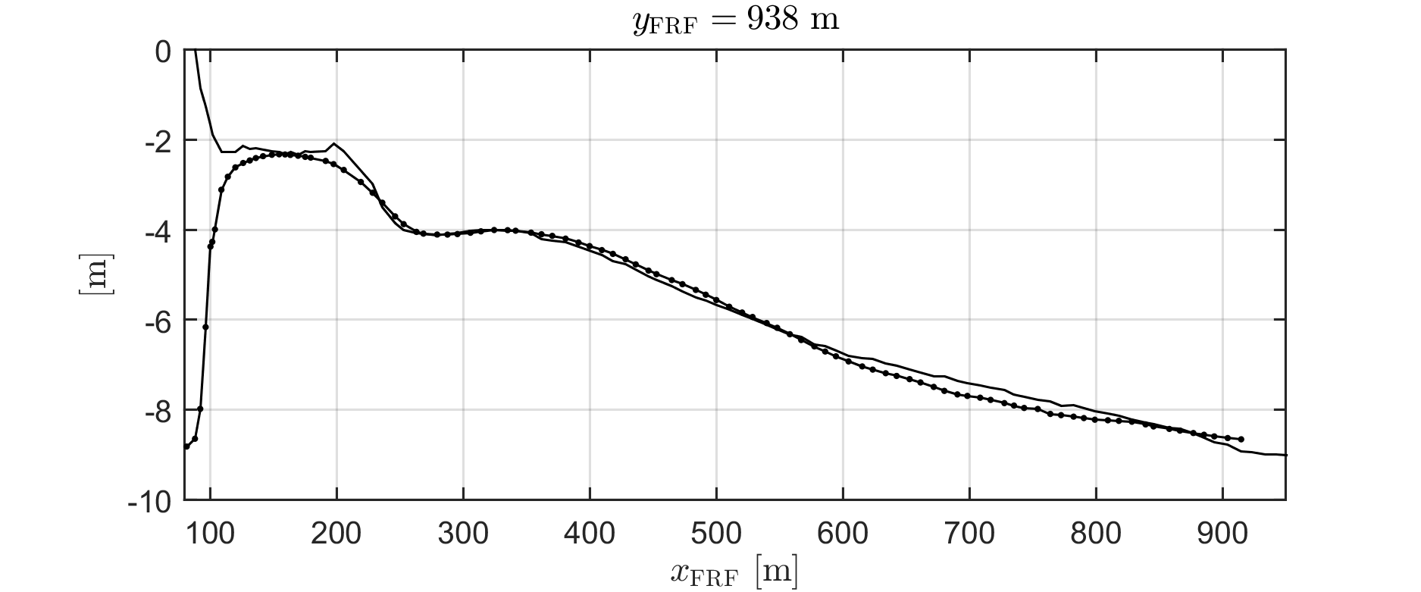
Duck, North Carolina
Survey line
Estimate

Slide 10
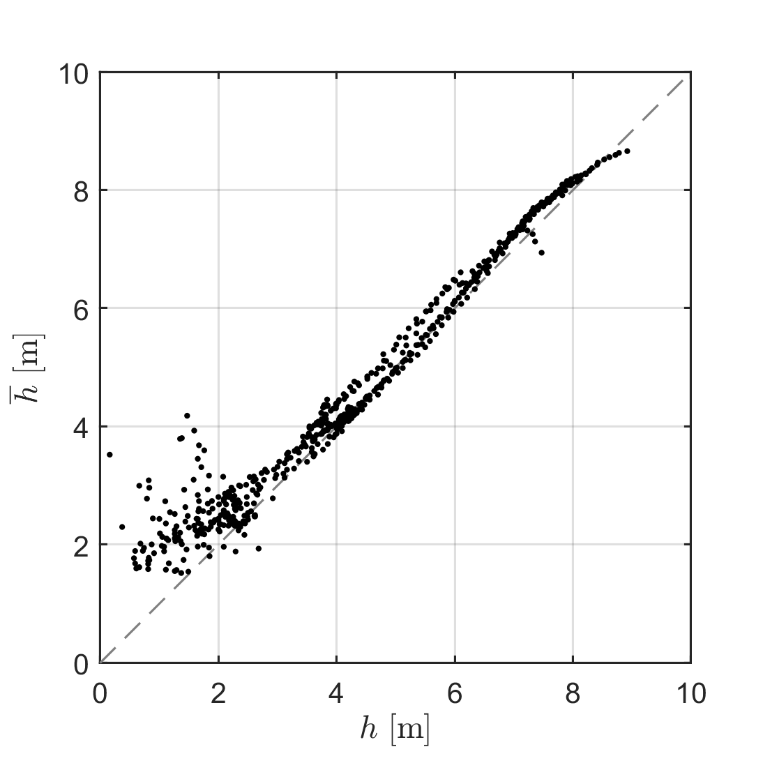
Duck, North Carolina
Bulk
RMSE: $0.63 m$
Bias: $0.34 m$
$$h>2.5 m:$$
RMSE: $0.25 m$
Bias: $0.13 m$
Estimated
Surveyed
(Optical)
RMSE: 0.44 m
Bias: 0.28 m

Slide 11
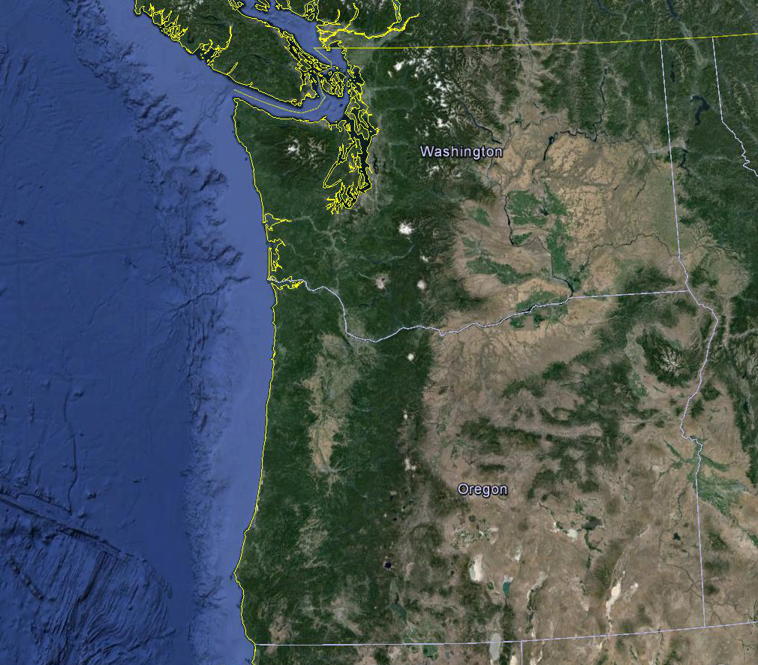
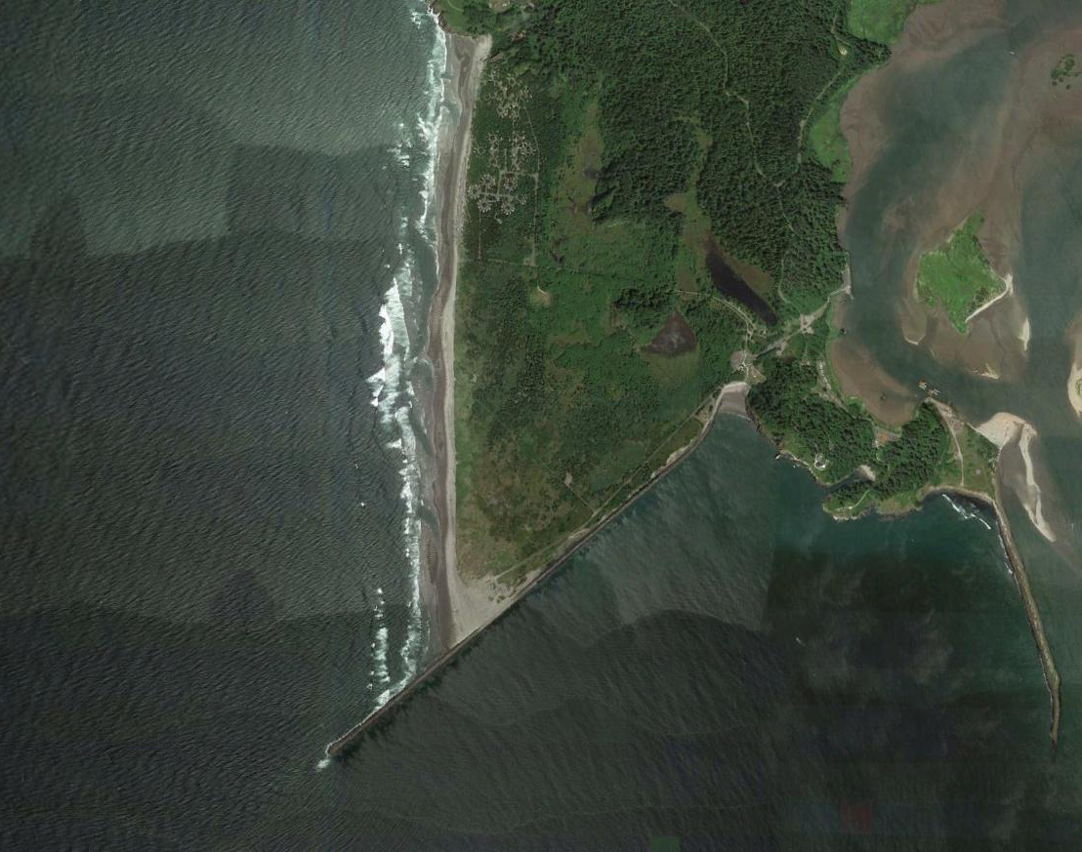
Benson Beach, Washington
Benson
Estimate
Domain
Washington
Duck
Estimate
Domain
Oregon

Slide 12
Benson Beach, Washington
Estimate
Survey Ruggiero
Estimate - Survey
Bulk
RMSE: 0.43 m
Bias: -0.25 m

Slide 13
Benson Beach, Washington
07 August, 2013
Estimate
Survey Ruggiero
Estimate - Survey
Bulk
RMSE: 0.43 m
Bias: -0.25 m

Slide 14
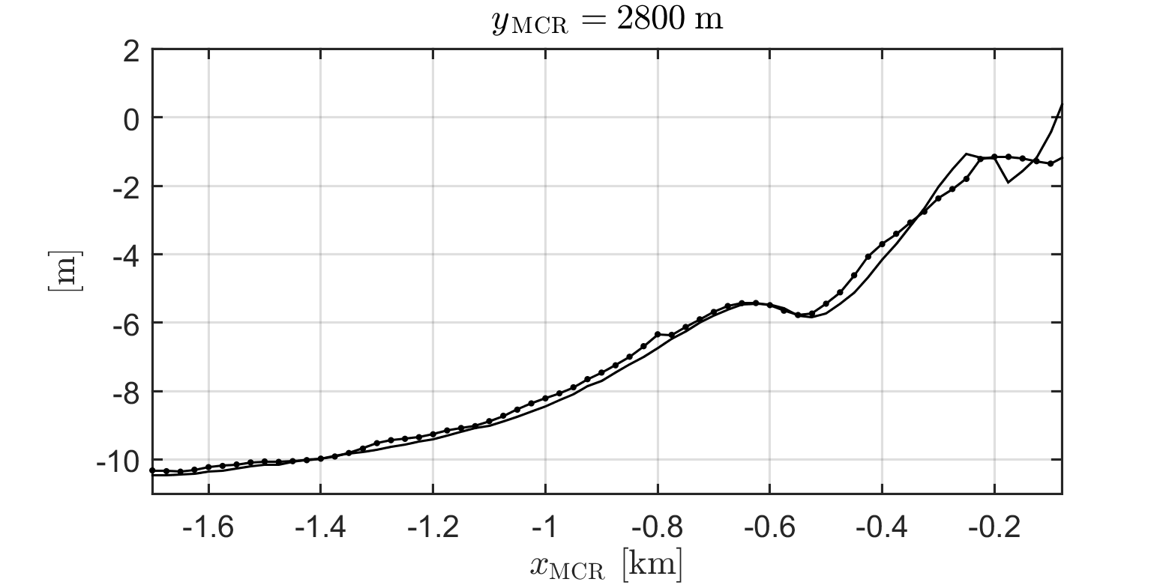
Benson Beach, Washington
Estimate

Slide 15
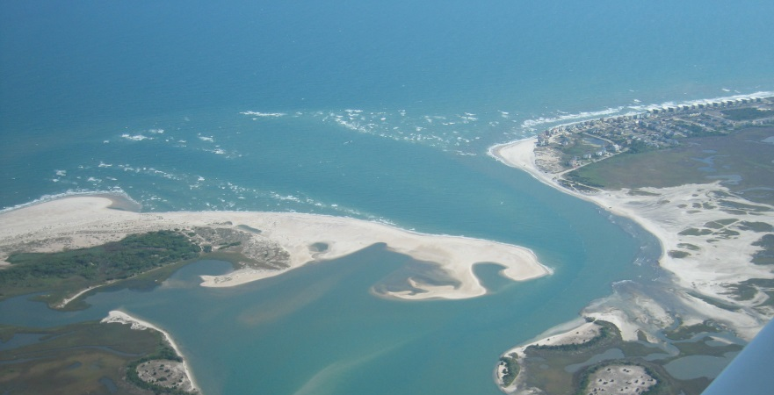
New River Inlet, North Carolina
1 km
RADAR
Gordon Farquharson
Gordon Farquharson

Slide 16
New River Inlet, North Carolina
Estimate at slack
Survey LARC
RMSE: 0.35 m; Bias: 0.03 m

Slide 17
Columbia River Mouth, OR/WA
Washington
Oregon
Currents + shear + fronts

Slide 18
Columbia River Mouth, Oregon/Washington
Estimate
DEM

Slide 19
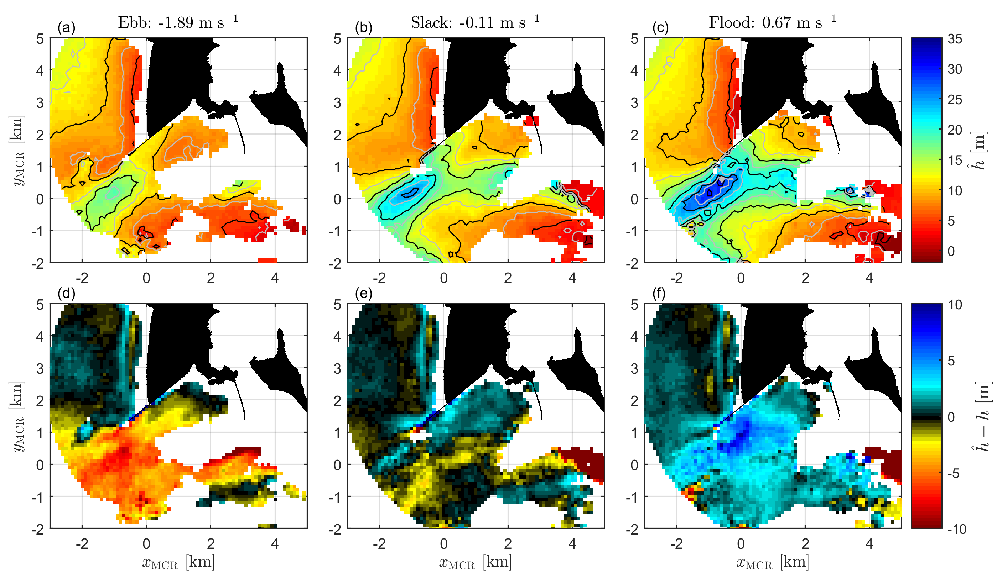
Inversion effects of a neglected Doppler term (linear dispersion)
Mooring data: Gelfenbaum (USGS)

Slide 20
Currents & the Doppler Term
Options:
Neglect and tidally average
Solve $(u,h)$ simultaneously (à la 3D-FFT)
Identify slack times and invert $(u,h)$ separately
Locations:
New River Inlet, NC: $U≤1.5 m/s$, $h=1−8 m$
Columbia River Mouth, OR/WA: $U≤3.5 m/s$, $h=5−45 m$

Slide 21
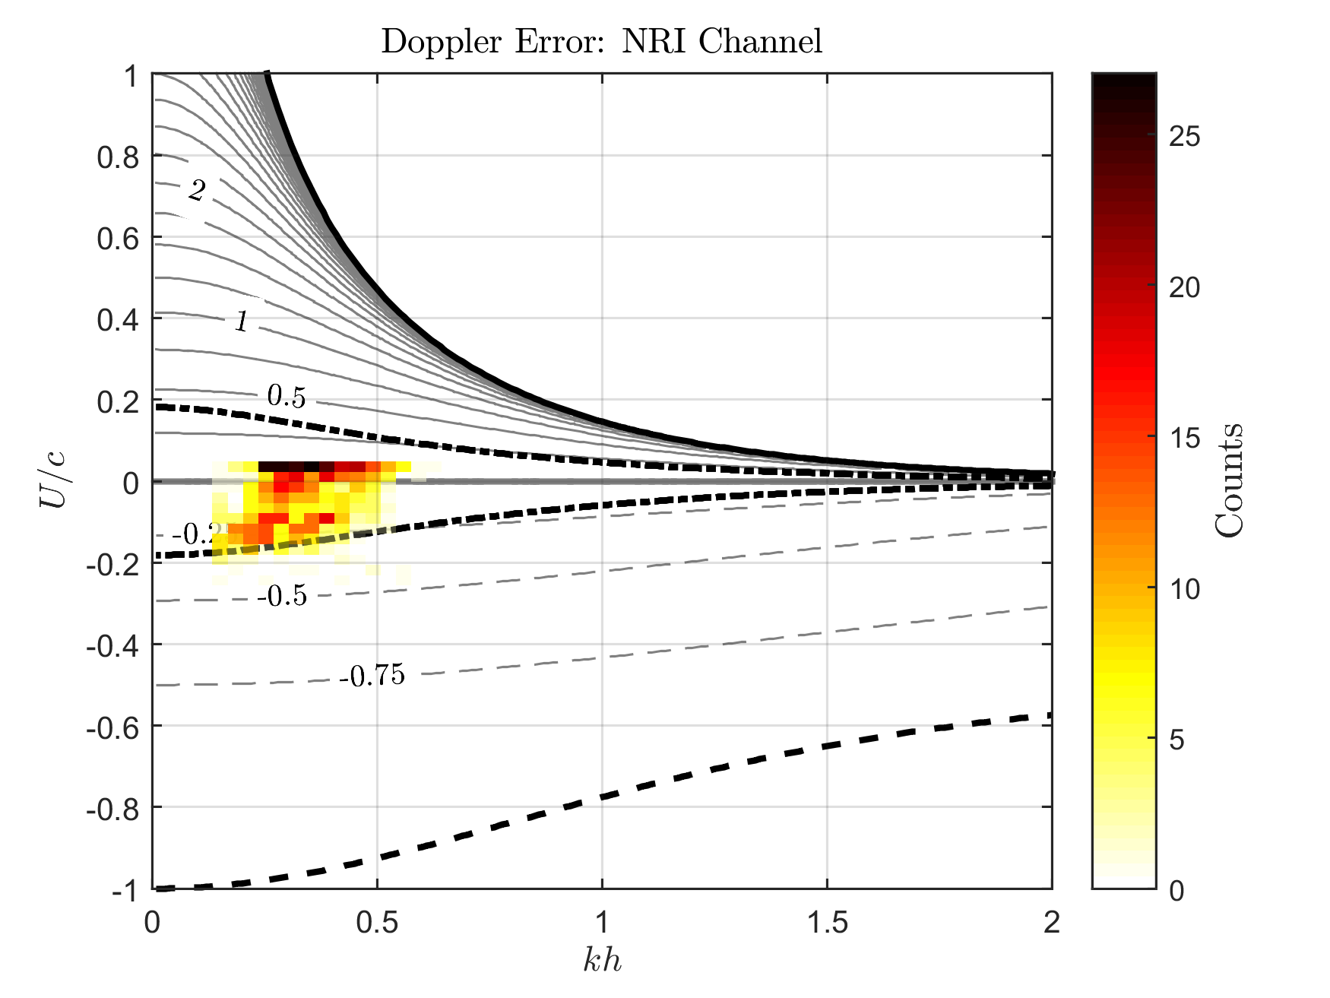
Tidal averaging:
How bad is it?
$${∆h}/h$$
Relative error
incurred by neglecting
the Doppler term
Deep water limit
Following
$$\frac{∆h}{h}=\frac{1}{kh}\tanh^{−1}\left[{\left(1+\frac{U}{c}\right)}^{2}\tanh\left(kh\right)\right]−1$$
Counter
Wave blocking limit
Mooring data: Elgar & Raubenheimer (WHOI)

Slide 22
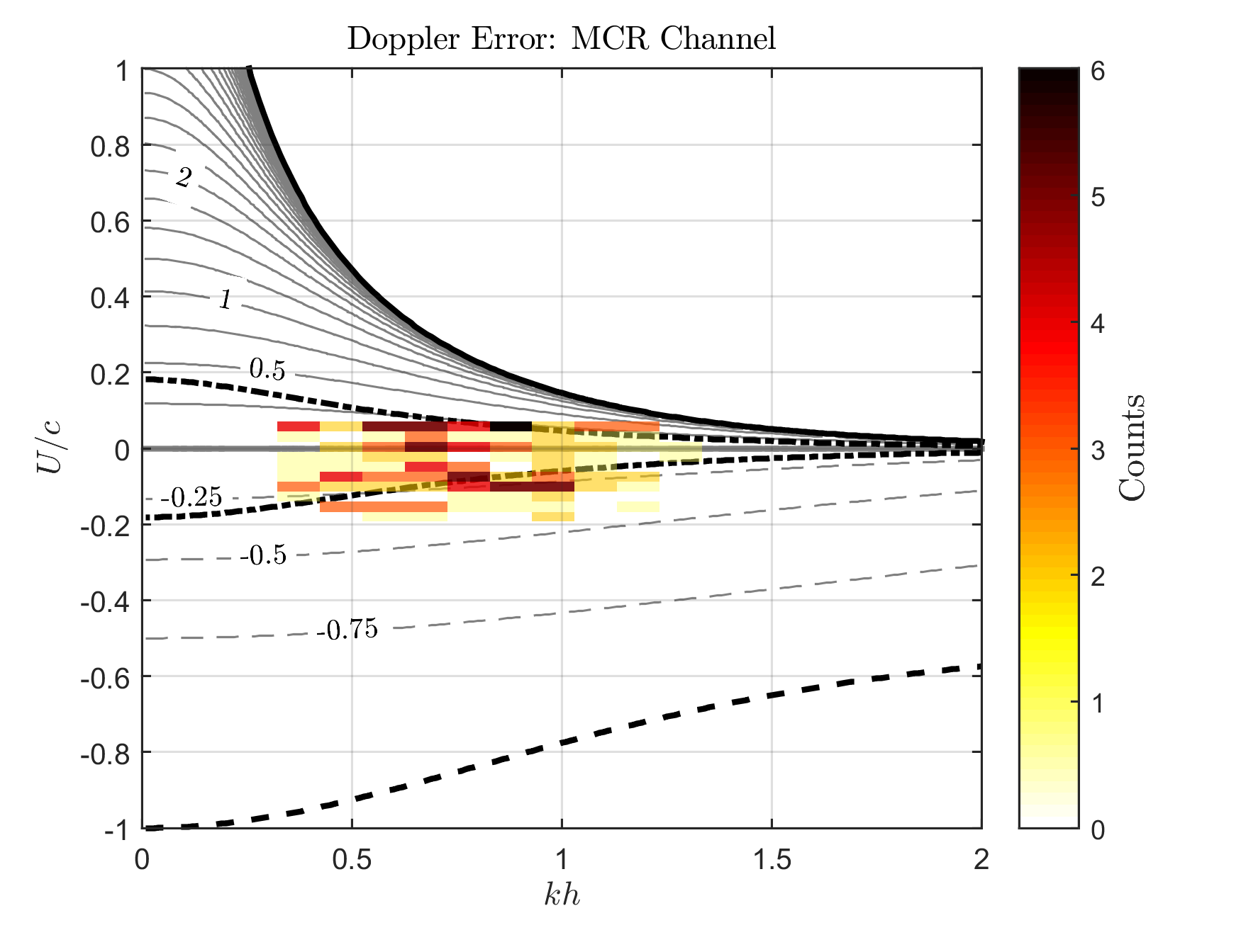
Tidal averaging:
How bad is it?
$${∆h}/h$$
Relative error
incurred by neglecting
the Doppler term
Deep water limit
Following
$$\frac{∆h}{h}=\frac{1}{kh}\tanh^{−1}\left[{\left(1+\frac{U}{c}\right)}^{2}\tanh\left(kh\right)\right]−1$$
Counter
Linear region
Wave blocking limit
Mooring data: Gelfenbaum (USGS)

Slide 23
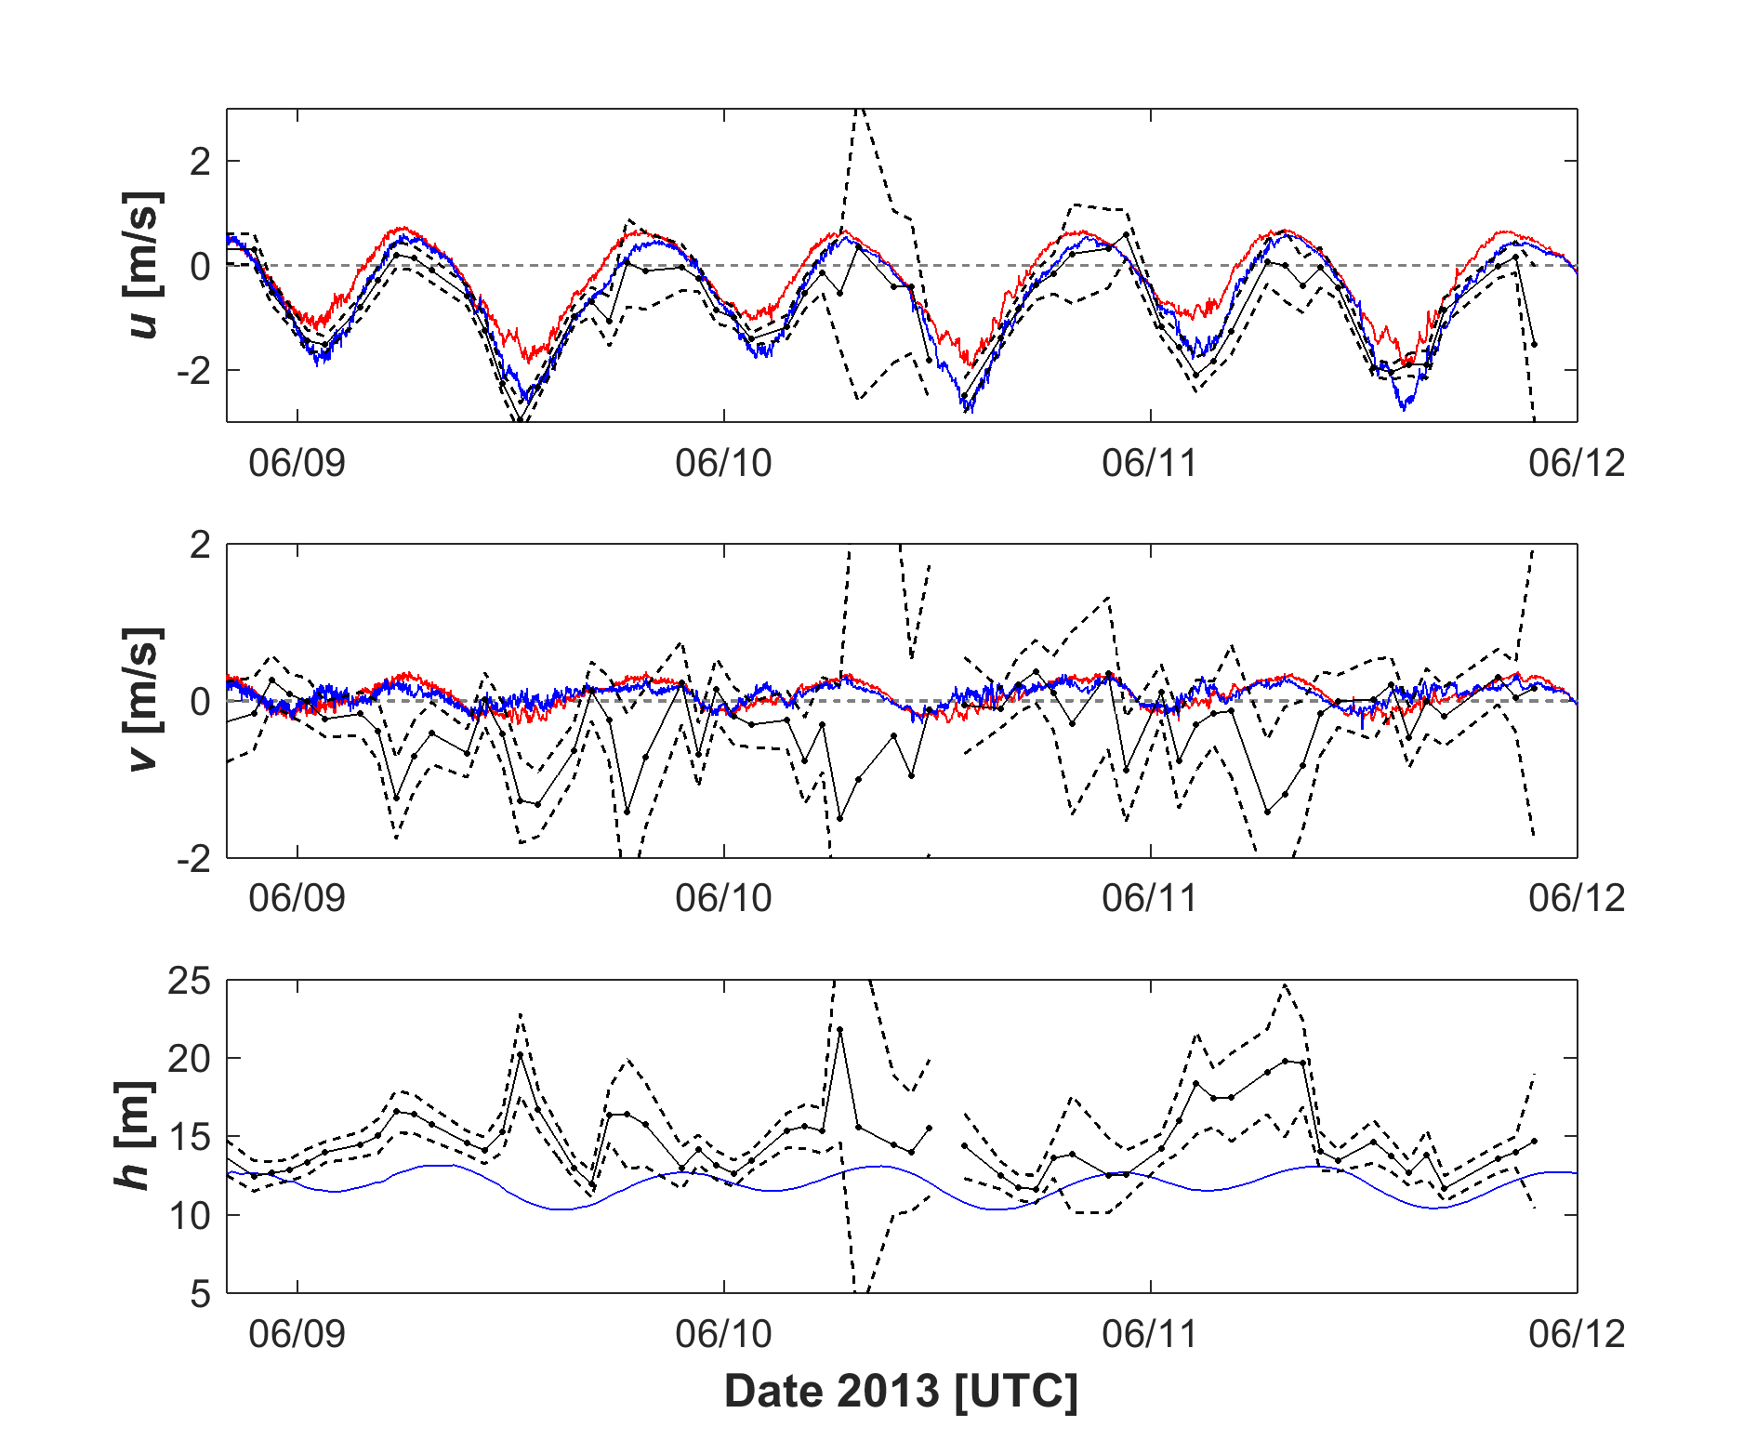
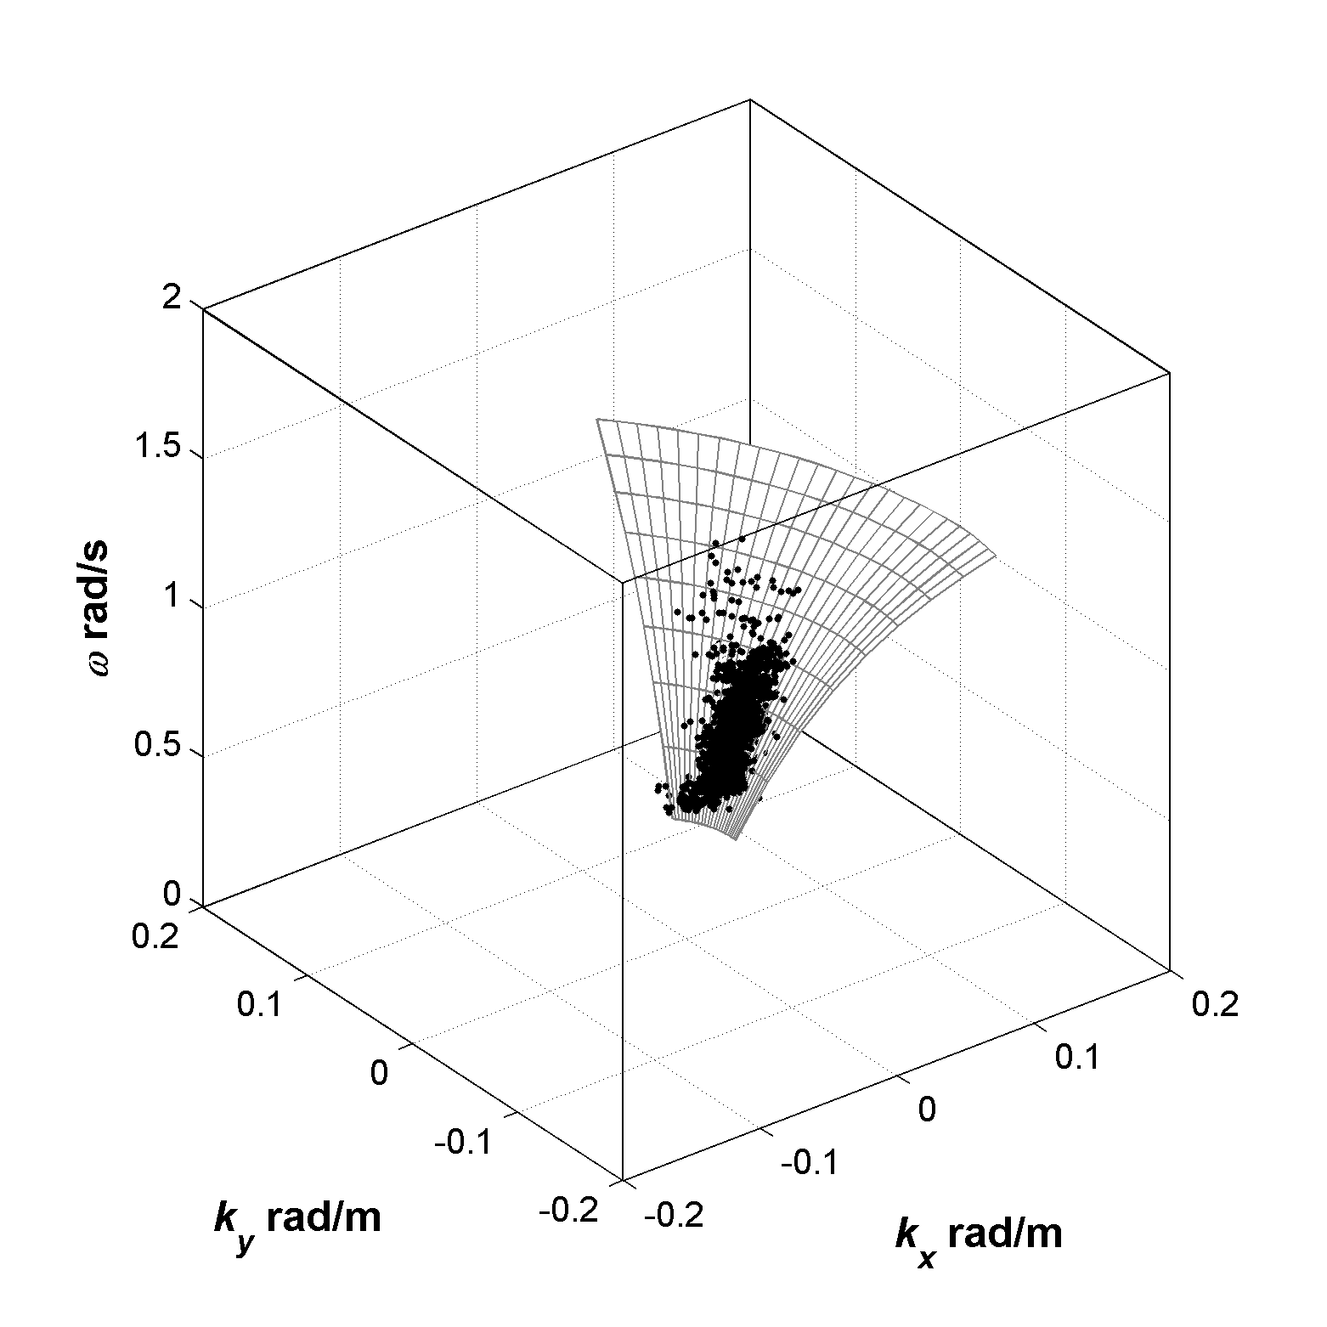
Mooring data: Gelfenbaum (USGS)
Simultaneous Inversion of
$$(u,h)$$
$${\hat{u}}_{x}±{\hat{σ}}_{u_{x}}$$
Depth avg
Upper 1/3
$${\hat{u}}_{y}±{\hat{σ}}_{u_{y}}$$
$$\hat{h^{′}}±{\hat{σ}}_{h}$$
$$h_{pressure}$$

Slide 24
Simultaneous Inversion of
$$(u,h)$$
Mooring data: Gelfenbaum (USGS)

Slide 25
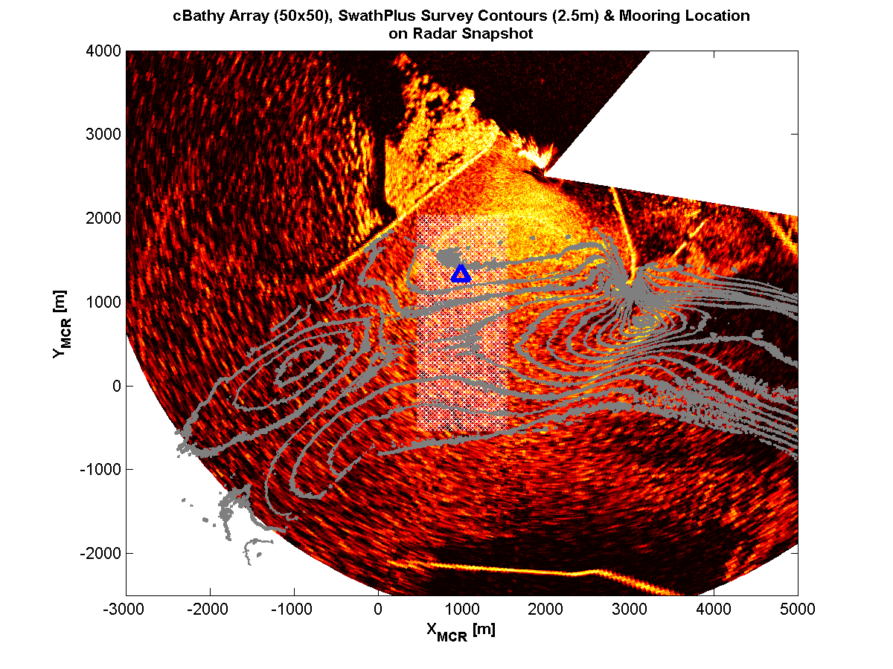
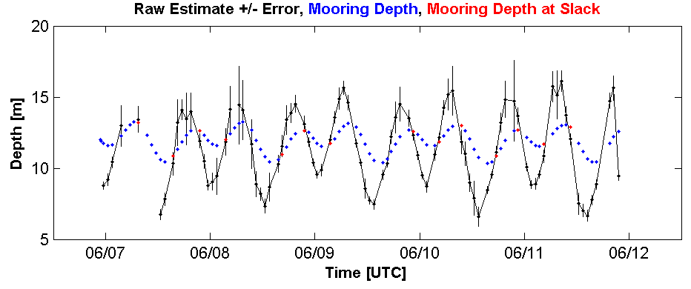
Utilize outside information:
Inversion separation
Estimates best at slack
Identify slack (mooring, simulation, etc.)
Estimate depth only during slack
Lock depth and estimate current
Mooring data: Gelfenbaum (USGS)

Slide 26
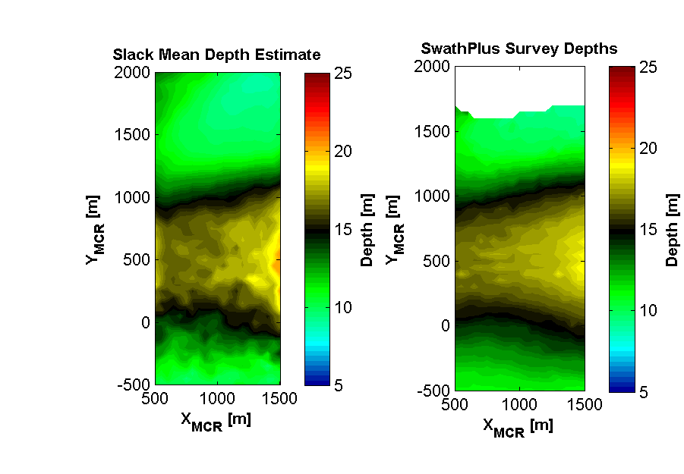
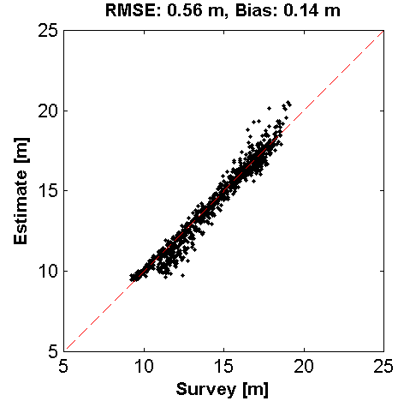
Utilize outside information:
Inversion separation
RMSE: $0.56 m$
Bias: $0.14 m$
Mooring & survey data: Gelfenbaum (USGS)

Slide 27
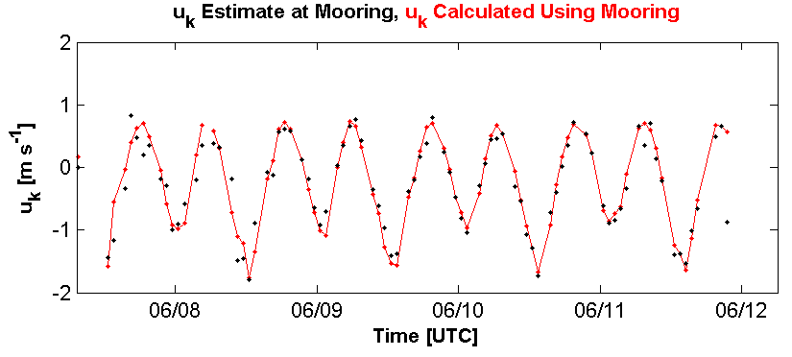
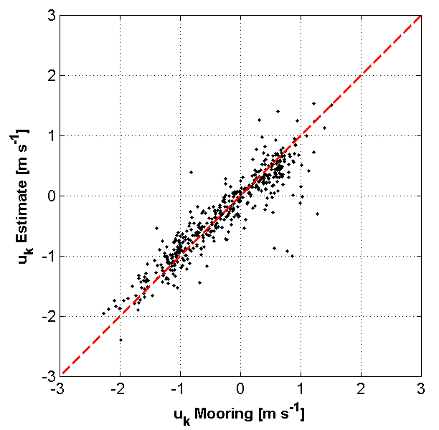
Utilize outside information:
Inversion separation
Handling the Doppler term
$$u_{k}=\frac{1}{k}\left(ω^{2}−gktanh\left(kh\right)\right)$$
RMSE: $30 cm/s$
Bias: $−2 cm/s$
Mooring & survey data: Gelfenbaum (USGS)

Slide 28
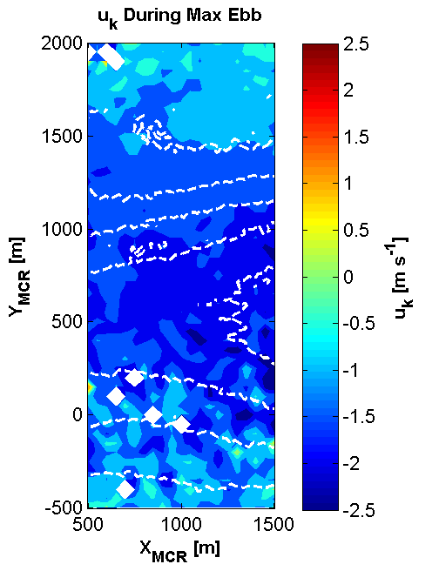
Handling the Doppler term
Utilize outside information: Inversion separation
Flow maximum is collocated with channel
Mooring & survey data: Gelfenbaum (USGS)

Slide 29
Summary
cBathy-derived depth estimates via marine radar:
$$RMSE = 30−60 cm; Bias = 10−35 cm$$
Tidal averaging is crude, but can be effective at shallow relative depths ($kh$ small)
Simultaneous inversion is attractive but challenging
Knowledge of slack times at tidal inlets is powerful information for separating depth and current retrievals

