Slide 1


Further Validation of the Polar-Current-Shell Current Algorithm for X-band Marine Radar
Weimin Huang, Ruben Carrasco, Chengxi Shen, Eric W. Gill, Jochen Horstmann

Slide 2
Outline
1. Introduction
2. Polar-Current-Shell (PCS) Algorithm
3. Experiment Results
4. Conclusion

Slide 3
1. Introduction

Slide 4
Typical Pulsed Marine Radar Image

Slide 5
Existing Current Algorithms
Least-squares (1985)
Weighted least-squares (2002)
Iterative least-squares (ILS) (2001)
Dispersive Surface Classificator (DiSC) (2007)
Normalized scalar product (NSP) (2010)

Slide 6
2. Polar-Current-Shell (PCS) Algorithm

Slide 7
Key steps
1. Collecting temporal sequence of radar sub-images
y
t
x
32Δt

Slide 8
2. Obtaining 3-D image spectra by 3-D FFT on sub- image sequence
3. Extraction of the dispersion shell
4. Obtaining polar current shell
5. Determining the current parameters
See more details on next slide.

Slide 9



Block diagram
$$ω_{U}\left(k_{x},k_{y}\right)=kUcos\overline{θ}=ω_{0}\left(k_{x},k_{y}\right)−\sqrt{gk}$$
$$ω_{U}\left(k,θ_{\vec{k}}\right)=kUcos\overline{θ}=kUcos(θ_{\vec{k}}−φ_{U})$$
$$\frac{ω_{U}(k,θ_{\vec{k}})}{k}=Ucos(θ_{\vec{k}}−φ_{U})$$

Slide 10
3. Experiment Results

Slide 11
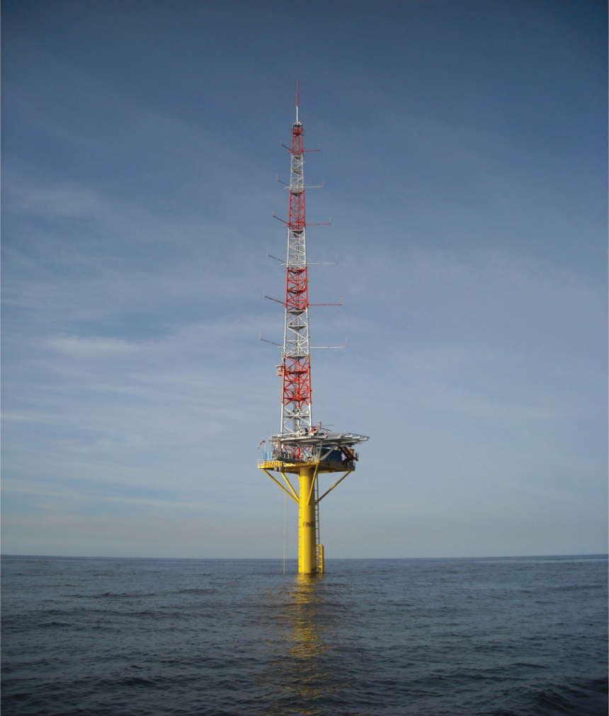
Radar data information
Radar system specification
Collecting date | 07/30/2014; 08/28/2014
Polarization | VV
Radar location (FINO3 platform) | 55.195 N, 7.158 E
Antenna rotation speed | 28 rpm
Range resolution | 7.5 m
FINO-3 offshore research platform

Slide 12
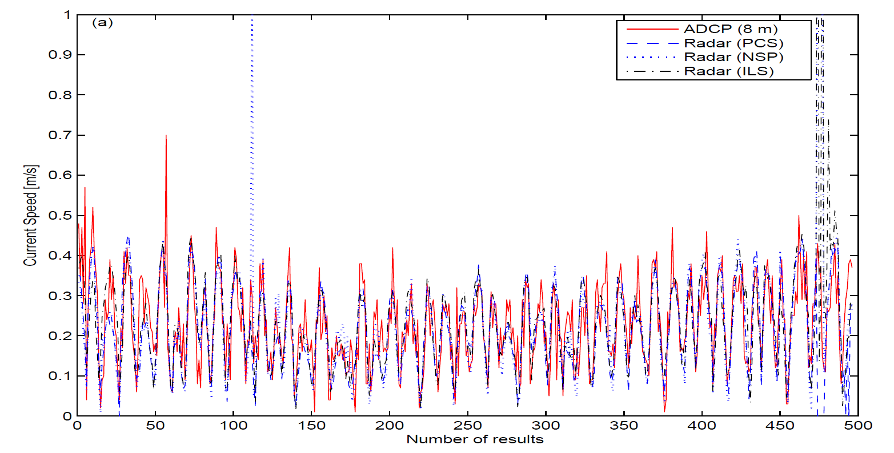
Results (current speed)
Comparison of ADCP-measured and radar-derived current speed

Slide 13
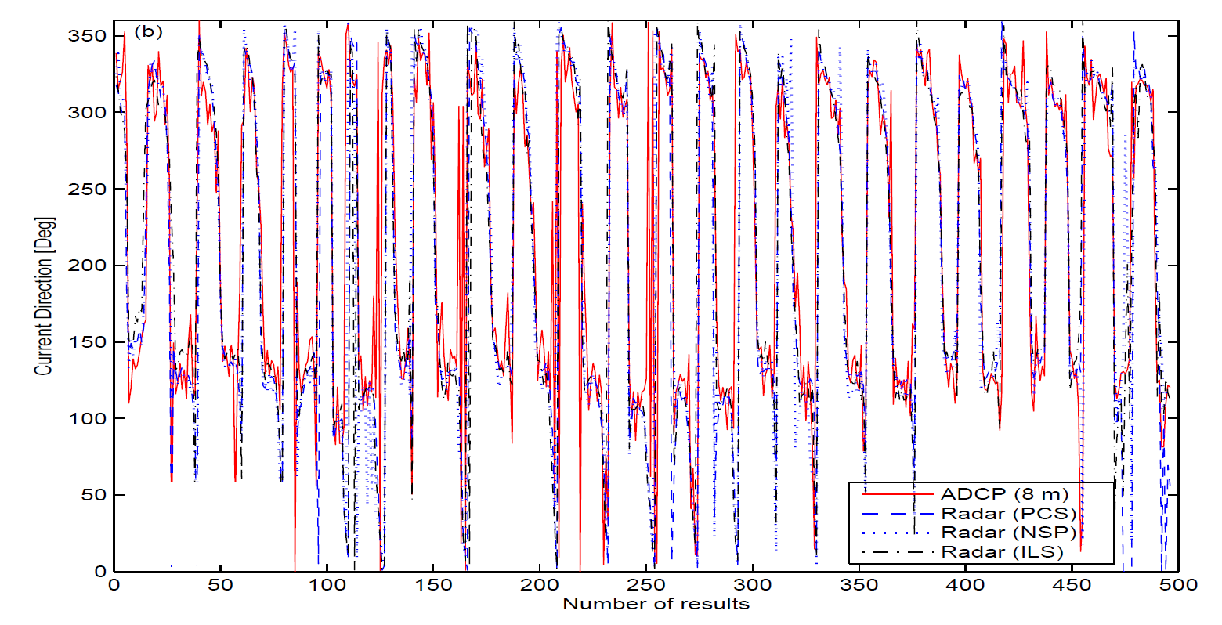
Results (current direction)
Comparison of ADCP-measured and radar-derived current direction

Slide 14
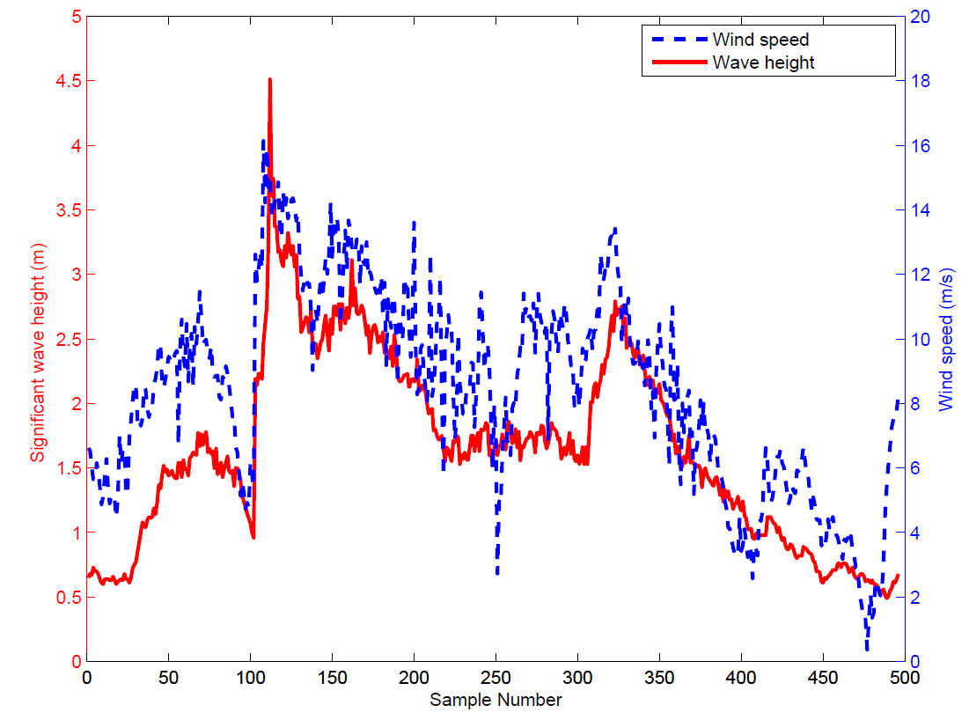
Results (sea state)
Significant wave height (blue) and wind speed (red)

Slide 15
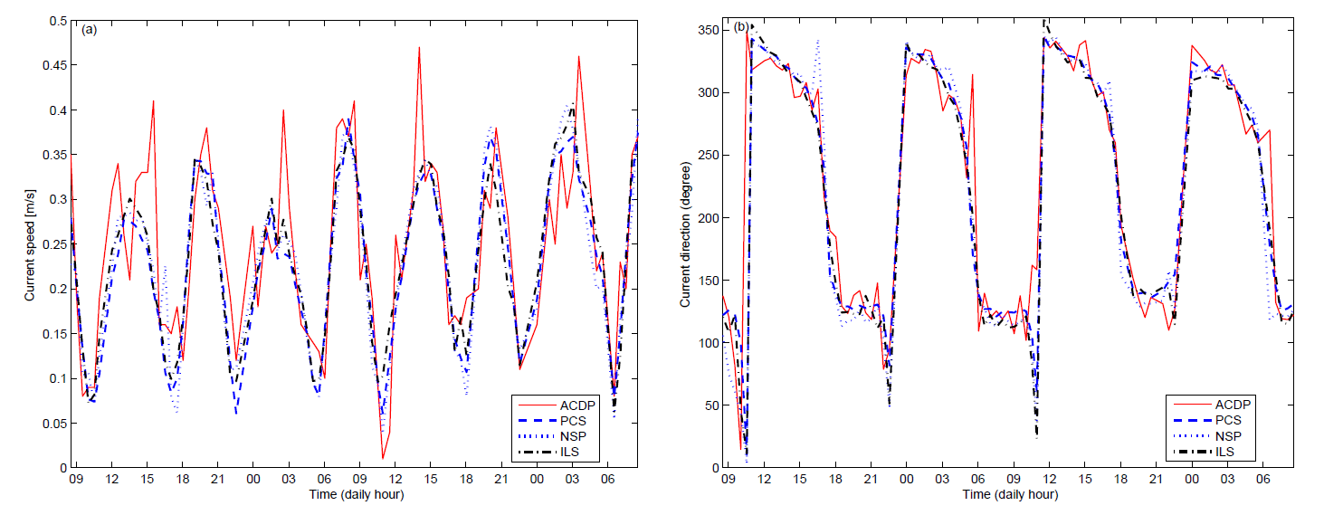
Results (cont.)
Zoomed view of current results: speed (left); direction (right)

Slide 16
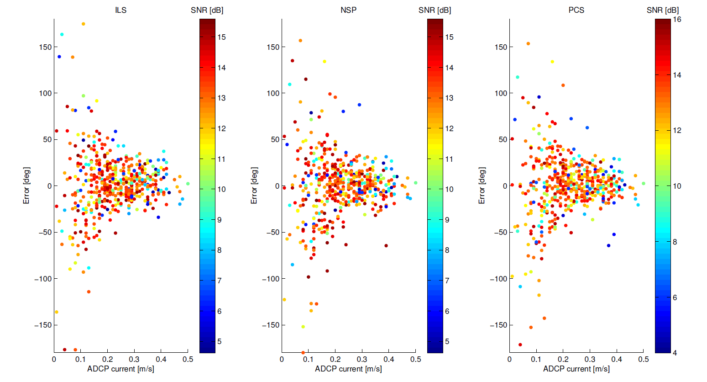
Results (cont.)
Distribution of current direction estimation error with respect to ADCP-measured current speed.

Slide 17
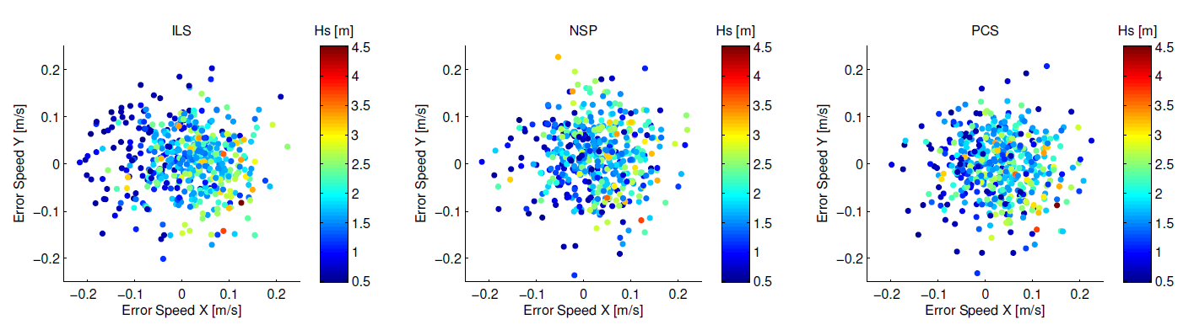
Results (difference)
Scatter plot of the difference of current vector East and North components measured by ADCP (at 8 m depth) and radar (left) ILS; (middle) NSP; (right)PCS.

Slide 18
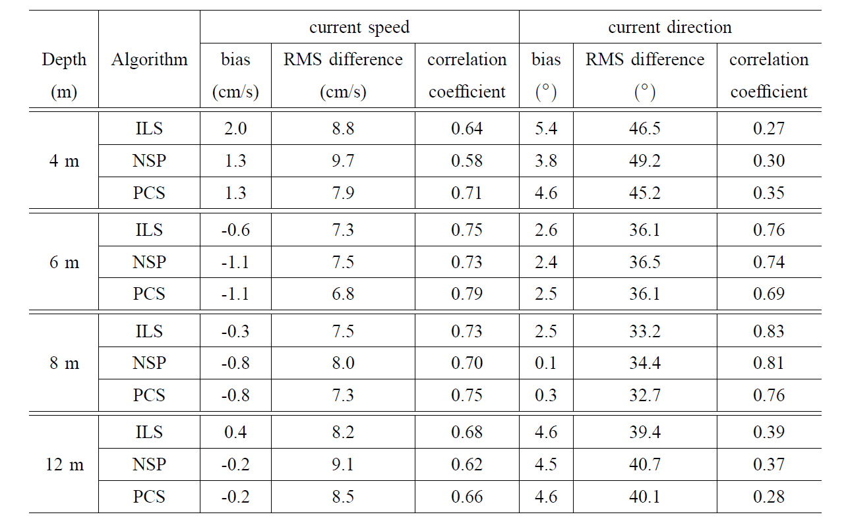
Results (error statistics)

Slide 19
4. Conclusion

Slide 20
Current information extracted from V-pol marine radar images using the polar-current-shell (PCS) algorithm.
Radar results from the PCS algorithm agree with the ADCP data.
The performance of the PCS algorithm is similar to that of the NSP and ILS methods.

Slide 21
Acknowledgement
1. NSERC Discovery grant support.
2. Department of Innovation, Business and Rural Development of Newfoundland and Labrador grant support.

Slide 22
Thank you!
Any questions?

