Slide 1
A Simple Model for Marine Radar Images of the Ocean Surface
David R. Lyzenga
David T. Walker
SRI International, Inc.
Ann Arbor, MI
SOMaR-3 Workshop
July 14-16, 2015
Seattle, WA

Slide 2
Bragg Scattering
According to the small-perturbation method (e.g. Valenzuela, 1978) the normalized radar cross section of the ocean surface can be written as
where θ is the local incidence angle, ϕ is the azimuthal angle, k is the radar wavenumber, g_{pp}(θ ) is the first-order Bragg scattering coefficient,
k_{B} = 2k sinθ is the Bragg wavenumber, and S(k,ϕ) is the wave spectrum
At low grazing angles, and for horizontal polarization, this reduces to
where , and where η_{r} is the radial component of the surface slope, h is the antenna height, and r is the range distance

Slide 3
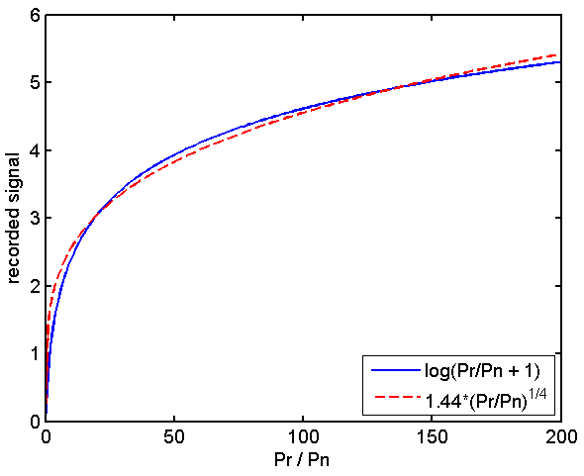
Approximation of Log Function
Most marine navigational radars employ a logarithmic amplifier, and the video signal (or image intensity) can be written as I = a log(P_{r} /P_{n} +1) where P_{r} is the received power and P_{n} is the noise power
Coincidentally, the log function is closely approximated by the fourth root function, i.e. for 0 < P_{r} /P_{n} < 200

Slide 4
Log-Amplified Signal Model
Combining this approximation for the log function with the Bragg scattering model for low grazing angles, and including an r ⁻³ falloff in the received power, we have the expression
for the log-amplified video signal or image intensity, neglecting antenna gain variations
If there were no wave shadowing, averaging this signal over time would yield the result
since ⟨η_{r} ⟩ = 0

Slide 5
Wave Shadowing Effects
From simple geometric considerations, the mean surface slope within any geometrically shadowed region can be shown to be equal to –h/r (for r » h » η )
The ensemble-averaged slope in partially shadowed regions can then be written as ⟨η_{r} ⟩ = f_{s} ⟨η_{rs} ⟩ + (1 – f_{s})⟨η_{ri} ⟩ = 0 where f_{s} is the shadowing fraction, ⟨η_{rs} ⟩ = –h/r is the mean slope in shadowed regions, and ⟨η_{ri} ⟩ is the mean slope in illuminated (unshadowed) regions
The average surface slope in unshadowed regions is therefore
⟨η_{ri} ⟩ = (h/r) f_{s} / (1 – f_{s})
The time-averaged signal in partially shadowed regions is then

Slide 6
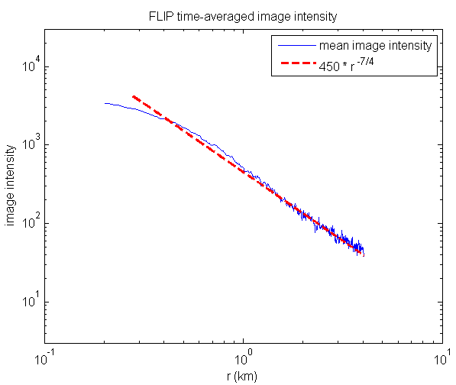
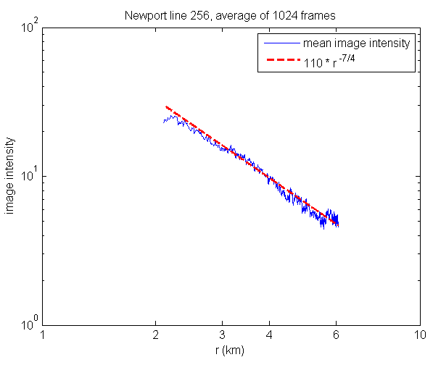
Comparisons With Marine Radar Data
Time-averaged X-band image intensities collected from FLIP during Hi-Res experiment (courtesy Eric Terrill, Scripps Institution)
Time-averaged X-band image intensities collected near Newport, Oregon (courtesy Merrick Haller, Oregon State University)

Slide 7
Surface Slope Estimation
Using the previously described model, the radial component of the surface slope can be estimated as
where ,
is the image intensity and represents a suitable ensemble average (possibly a low-pass filtered version) of the image intensity
This relationship is assumed to be valid in unshadowed regions: within shadowed portions of the surface and , and this equation yields an estimated slope of – h / r, which is a valid estimate of the slope at the first shadowed point and of the mean slope within the shadowed region

