Slide 1
The RCS of seabirds: shedding (microwave) light on an old detection problem
David McCann

Slide 2
Is it a bird? Is it a plane?
German radar operators in WW2 encountered targets they dubbed ‘Scheinziele’ (“Spurious Echoes”), suggesting they encountered birds on radar but concluded “it is probably a matter of sharply bounded layers of discontinuity in the atmosphere” (McKay, 1945).
Phantom radar echoes plagued American submariners in the S. Pacific, sometimes showing inexplicable signals from UFO’s travelling on collision courses at 36 knots. Various explanations were put forward by everyone from “four-stripers to radar strikers” but no one suspected birds. (Buss, 1946).
It was not until experienced ornithologists (or more commonly, duck-hunters and skeet shooters serving in the navy) made optical verifications that the veil of enigma was lifted.

Slide 3
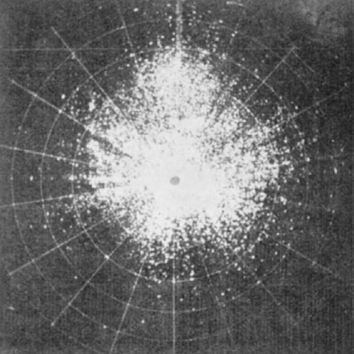
An old detection problem
Originally dubbed ‘angels’ by radar operators and aviators in WW2, the detection of birds with centimetric radar has been an active area of research since the early 50’s.
As early as 1945 marine radar was targeted as a research tool for avian research after naval officers in the Pacific “detected the presence of good sized birds, albatrosses, man-’o-war birds, etc., at distances as great as five or six thousand yards” (Brooks, 1945). The movement of marine radar hardware to the civilian sector was cited as the greatest barrier to this research.
‘Angels’ on a 10cm PPI. From Harper (1957)

Slide 4
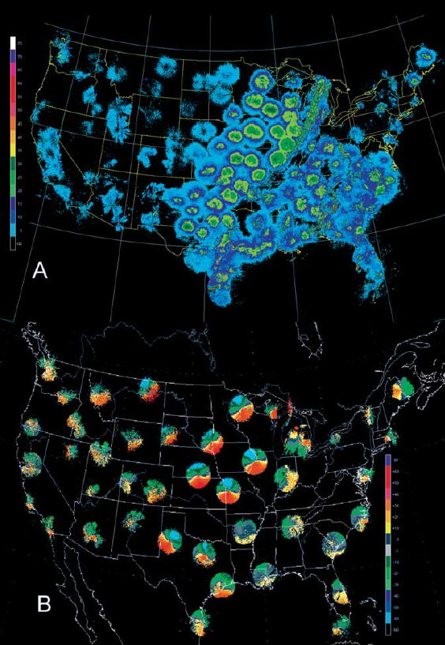
Birds on radar
(Top) Trans-Gulf migrants off SW Louisiana on a 50kW X-band PPI.
(Right) Unfiltered reflectivity (A) and Doppler velocities (B) of birds migrating along the Mississippi River Valley from the National WSR-88D weather radar network.

Slide 5
Moving targets in digitised marine radar imagery
Marine radar indiscriminately captures information on any radar scatterers within it’s swept area
A simple ‘eyeballing’ of images recorded in coastal waters can display vast numbers of small, fast-moving scatterers that appear to display the kinematics and behaviour of seabirds
A suite of multiple-target-tracking (MTT) algorithms was developed at the NOC to detect, identify and track the targets that seem so simple for the human eye to follow.

Slide 6
Moving targets in digitised radar imagery

Slide 8
Uses an adapted form of the Global Nearest Neighbour (GNN) MTT of Konstantinova et al (2003).
Birds are modelled using the simple yet robust Singer acceleration model (Singer, 1970), using a white noise process on the first derivative of acceleration to simulate free will.
Target-track association performed using Munkres’ algorithm (Munkres, 1957)
Track update performed using an extended Kalman filter

Slide 11
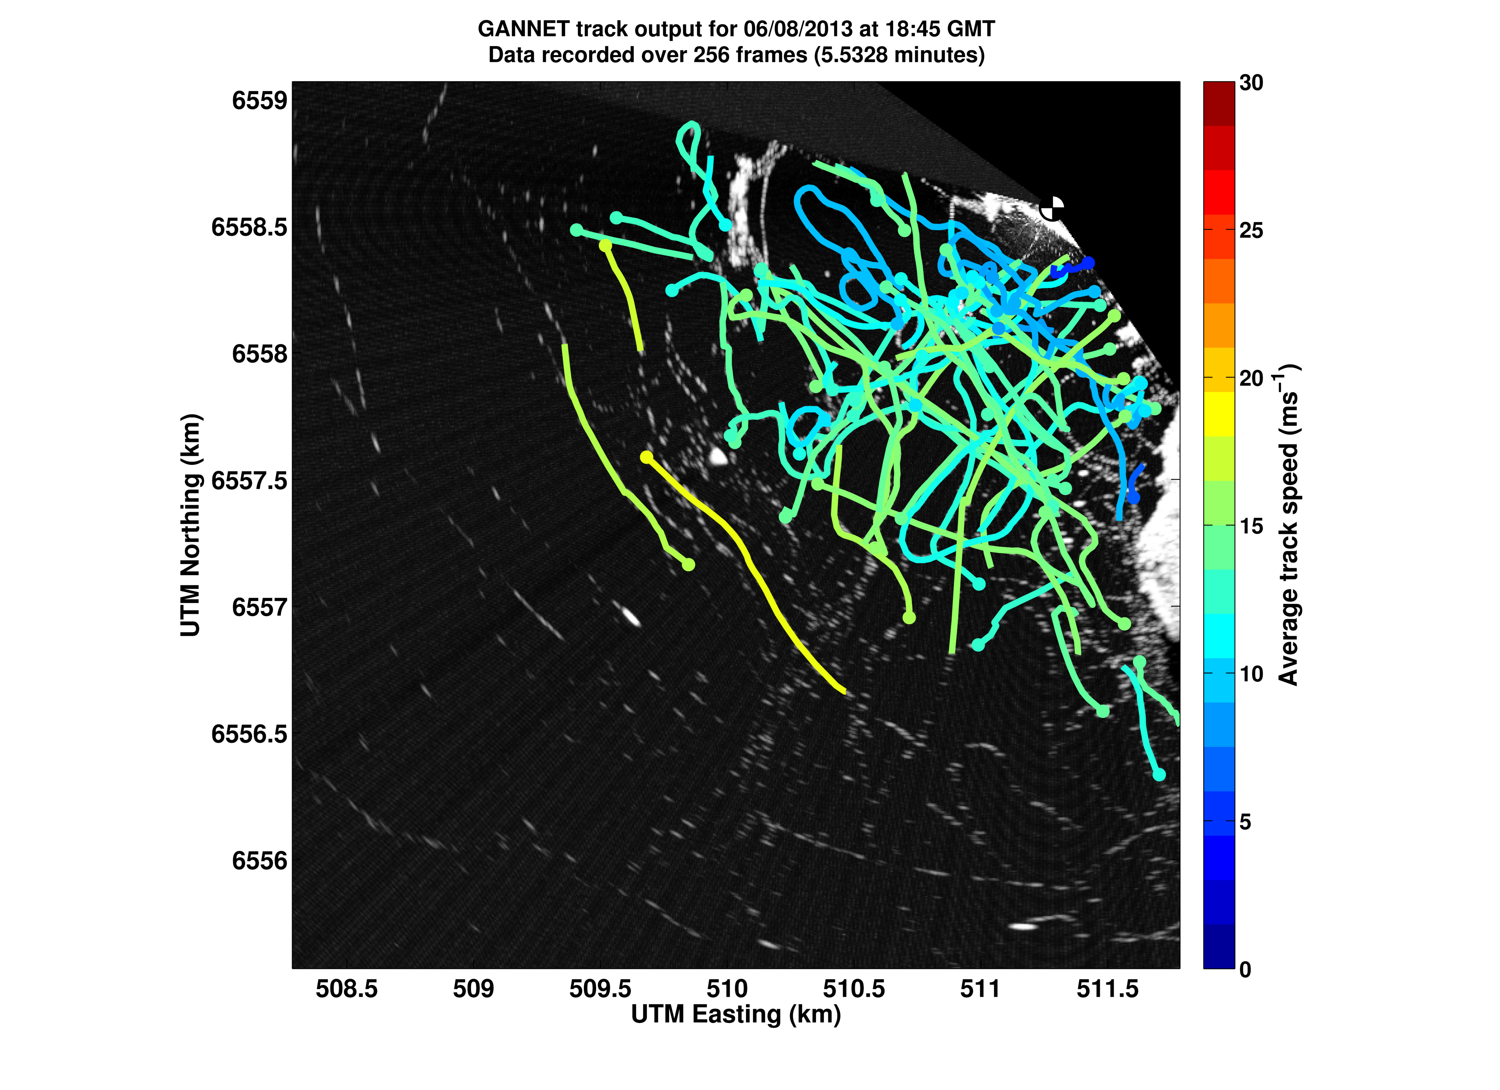
GANNET output

Slide 12
“If it looks like a duck and quacks like a duck – its probably a duck. Or a wave.”
Unfortunately, for a single scan there can be no discernible difference between the backscatter from a seabird and from a cresting wave.
As there was no validation data available to tune GANNET, outputs were inspected by eye to ensure that, for the most part, the program was tracking targets that looked like birds and ignoring sea clutter and parameters were tuned accordingly.
Satisfied that the majority of GANNET track outputs were of birds rather than clutter the algorithm was run on ~3 months of radar data collected during the FLOWBEC-4D project
Over 3094 records containing 102,000 tracks comprising 2.36 million target readings

Slide 13
Measurement of RCS
Traditionally, in order to detect and identify a target it must be distinguished from the radar background – i.e. clutter.
This is accomplished for aircraft by measuring the aspect-dependent radar cross section (RCS) of the particular model
In order to measure an aircraft’s RCS it is placed on a rotating pedestal or suspended by wires and illuminated by a calibrated radar.
Understandably the work is difficult and requires an intact specimen of the aircraft in question.
So if birds are detectable by radar and have (unsurprisingly) a similar shape to aircraft – how does one go about determining the aspect dependent RCS of a bird?

Slide 14
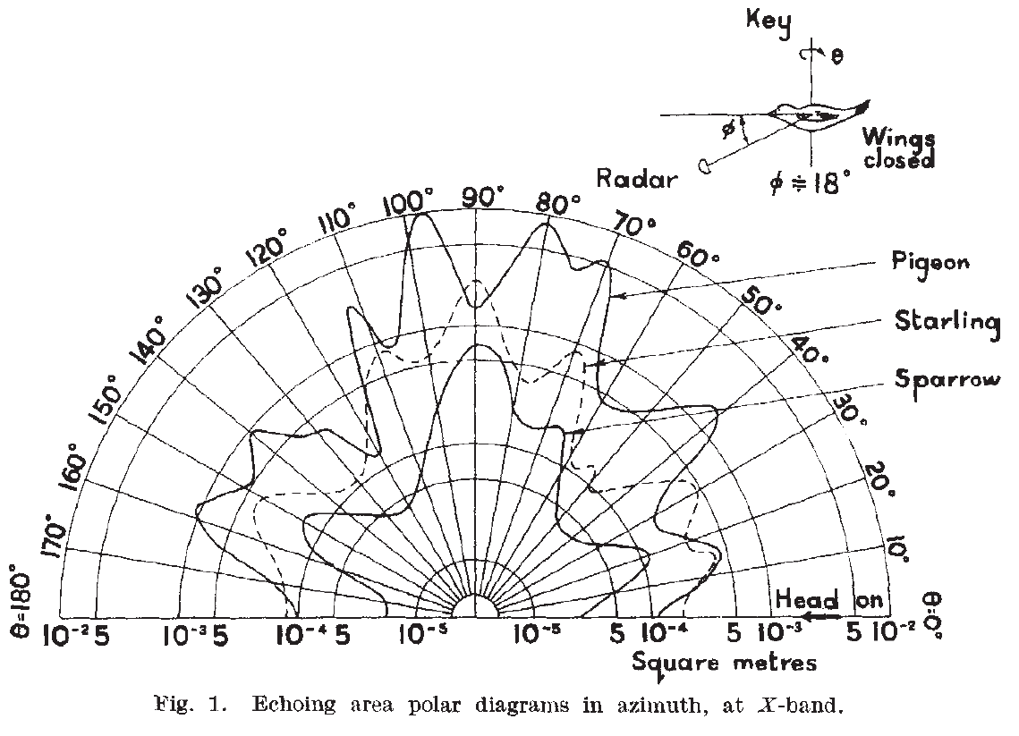
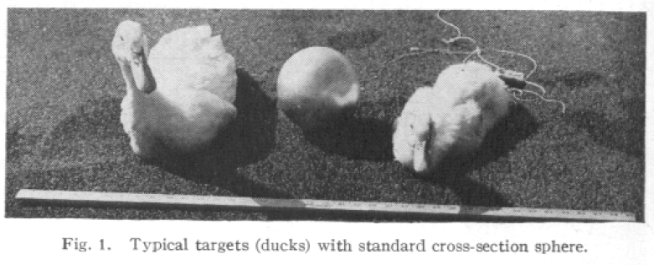
Microwaved duck.
Edwards & Houghton (1959) suspended deceased birds in front of a calibrated X-band radar and measured the aspect-dependent RCS (right). The authors came to suspect conclusions about the effect of wing area on echo magnitude given the experimental setup.
Polar aspect-dependent RCS (m2) of 3 birds from Edwards & Houghton (1959)
Blacksmith & Mack (1965) illuminated tethered, live ducks with a 400MHz (75cm) HF radar and drew no solid conclusions apart from how difficult it is to keep a live duck still for 10 minutes.

Slide 15
Method
To attempt to replicate a polar RCS plot the radar aspect angle was calculated for each target that GANNET had tracked over the survey period
Combined with the prior assumption that GANNET mostly tracks birds rather than clutter and the large data set (>2 million readings) the statistical validity is assumed to be sound.
Finding the aspect angle c from the radar azimuth b and the target track direction a

Slide 16
Method
The calculated aspect angles were then combined with the digitised, non-dimensional echo magnitude of the target ‘blob’ and the target range.
The data was then interpolated onto a range-aspect-angle polar image.
An attempt was made to ‘calibrate’ the radar but unfortunately without any information regarding the conversion between received power and digital echo magnitude there was no way to accomplish this
The resulting image is therefore normalised to the maximum return (12bit).

Slide 17
Result
As the radar is un-calibrated only a relative echo magnitude can be visualised – no information on received or transmitted power is possible.
The method assumed the vast majority of targets are birds but can not differentiate between species, body size etc. Result is only valid ‘for flying seabirds’
However, as all birds follow a very similar form, are composed of almost identical material and behave in largely the same manner (i.e. they flap wings to fly) the final result has interesting implications.

Slide 18
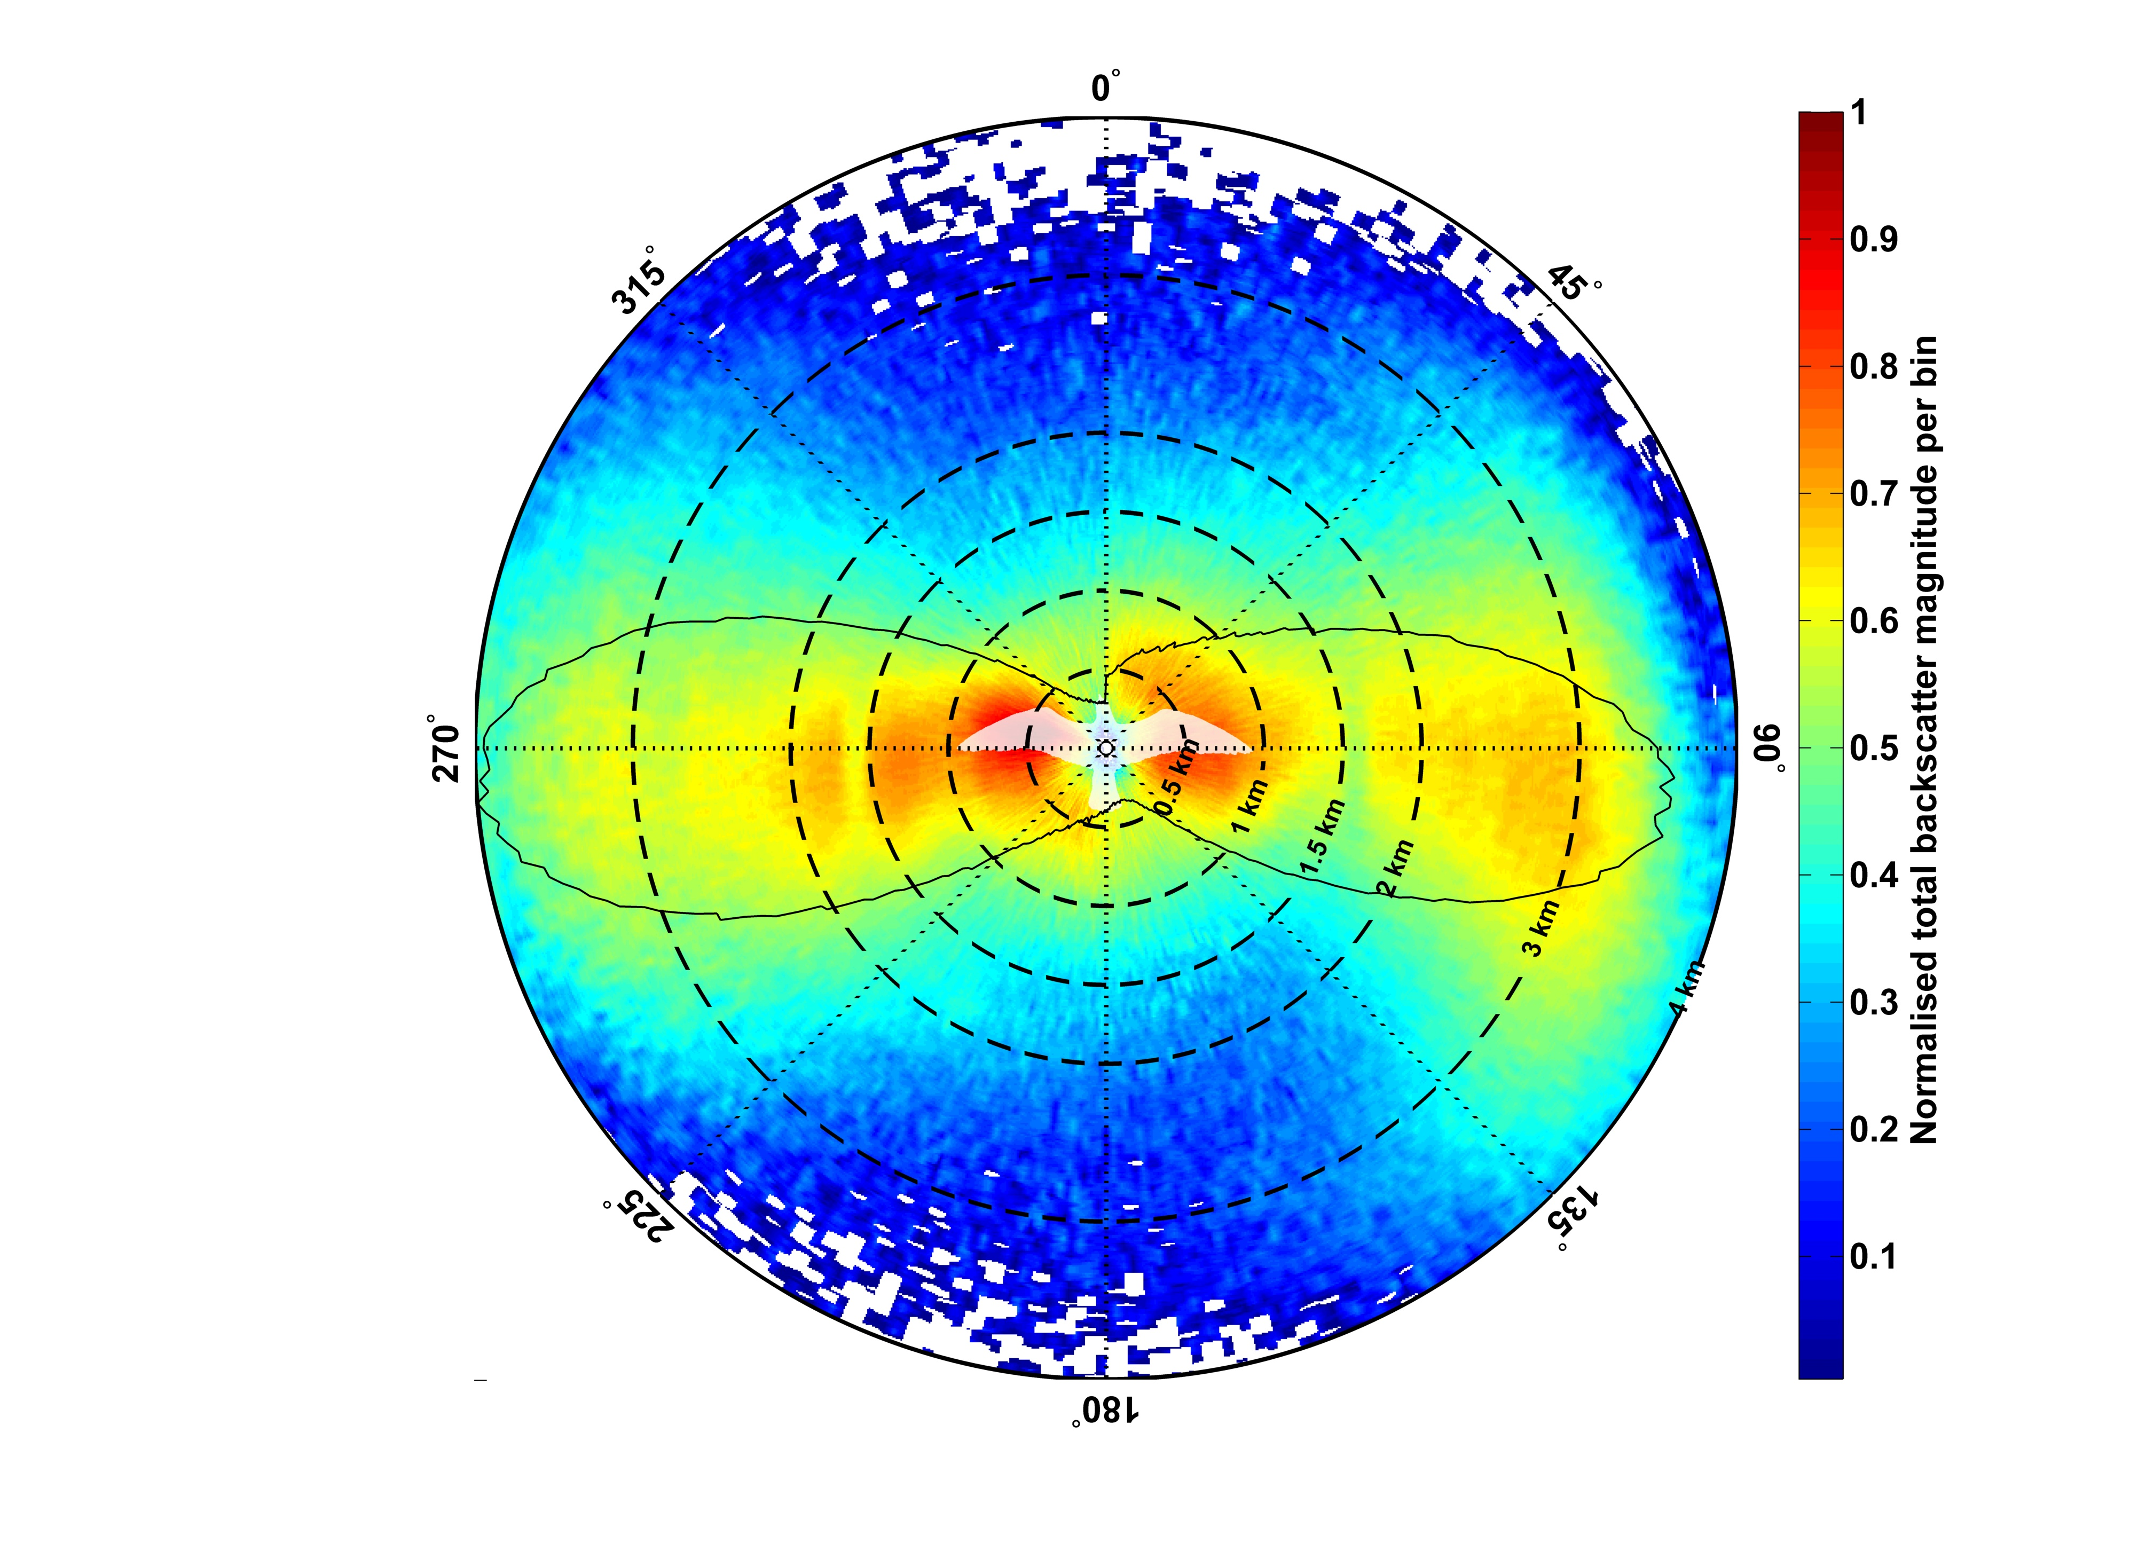

Slide 19
Conclusions
The length of most bird’s wings are multiples of the centimetric X-band wavelength – potential for Bragg resonant scattering when wings are at a particular aspect angle and wingbeat phase.
Can explain the ‘flashing’ seen in digitised images – potential for discriminating species based on wingbeat?
Potentially very important if data like this is used to enumerate sea birds – just because the radar can not see them does not mean they aren’t there.

