Slide 1
Wave height estimates from coherent marine radar
J. Perez

Slide 2
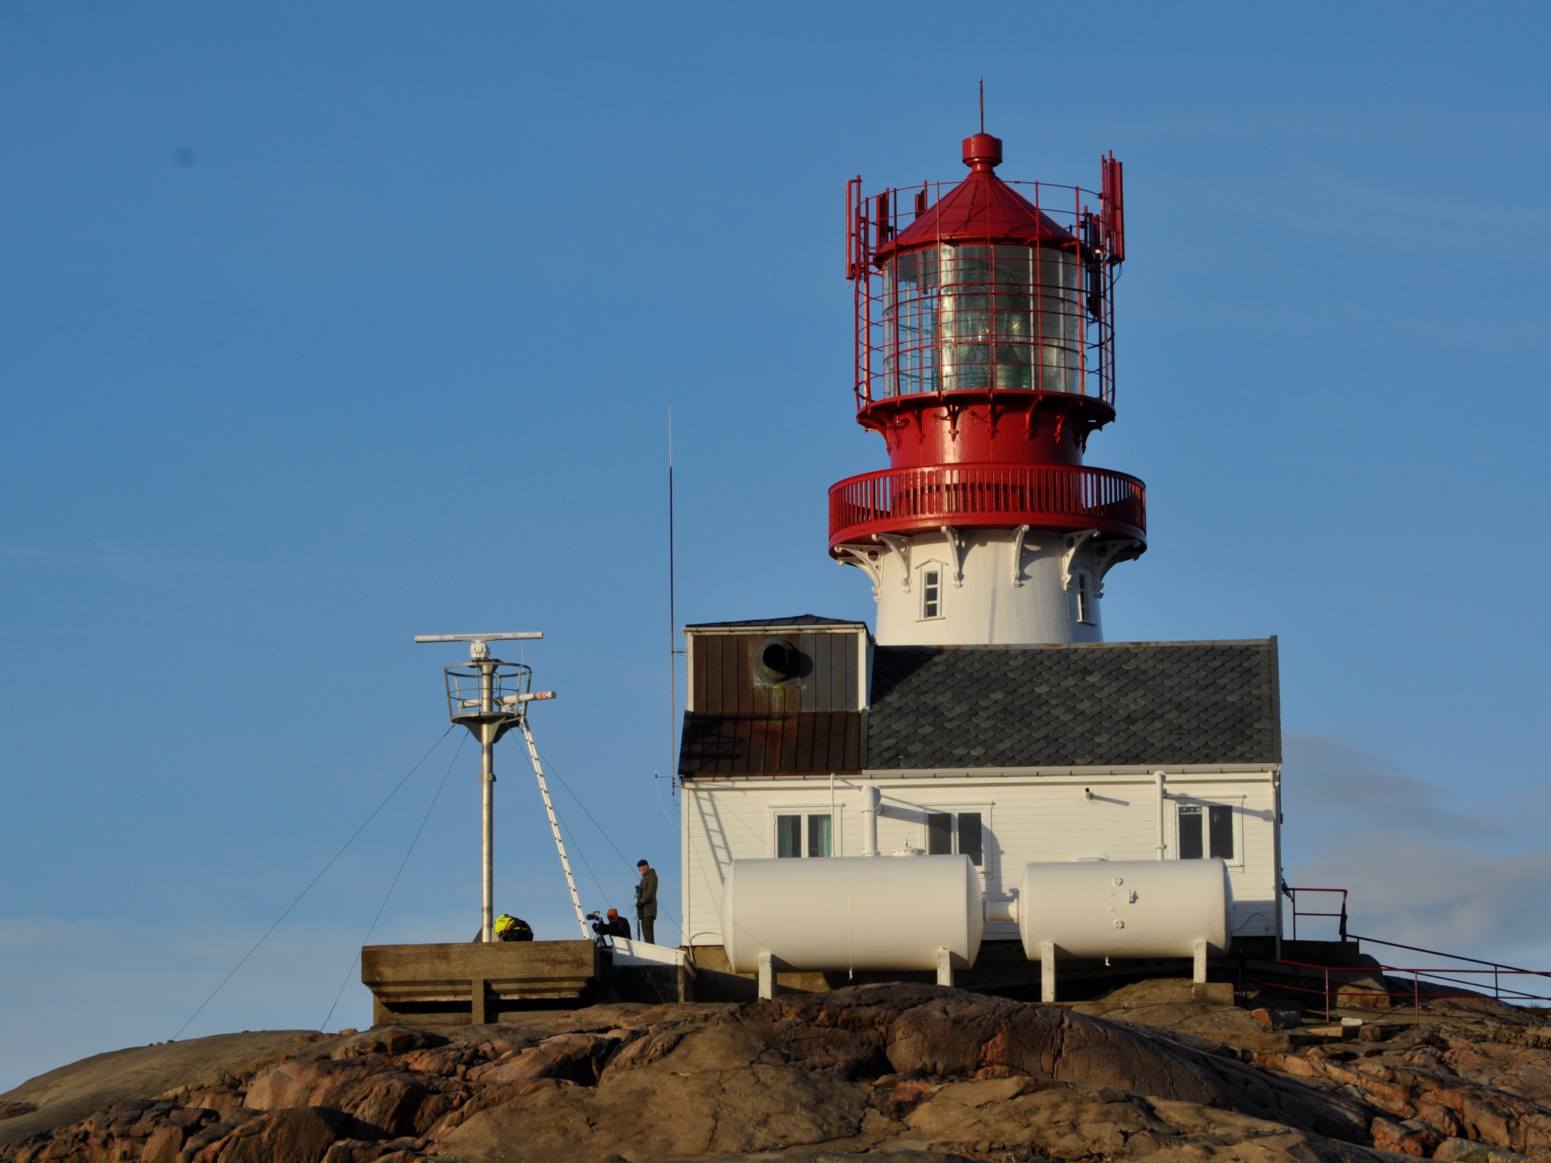
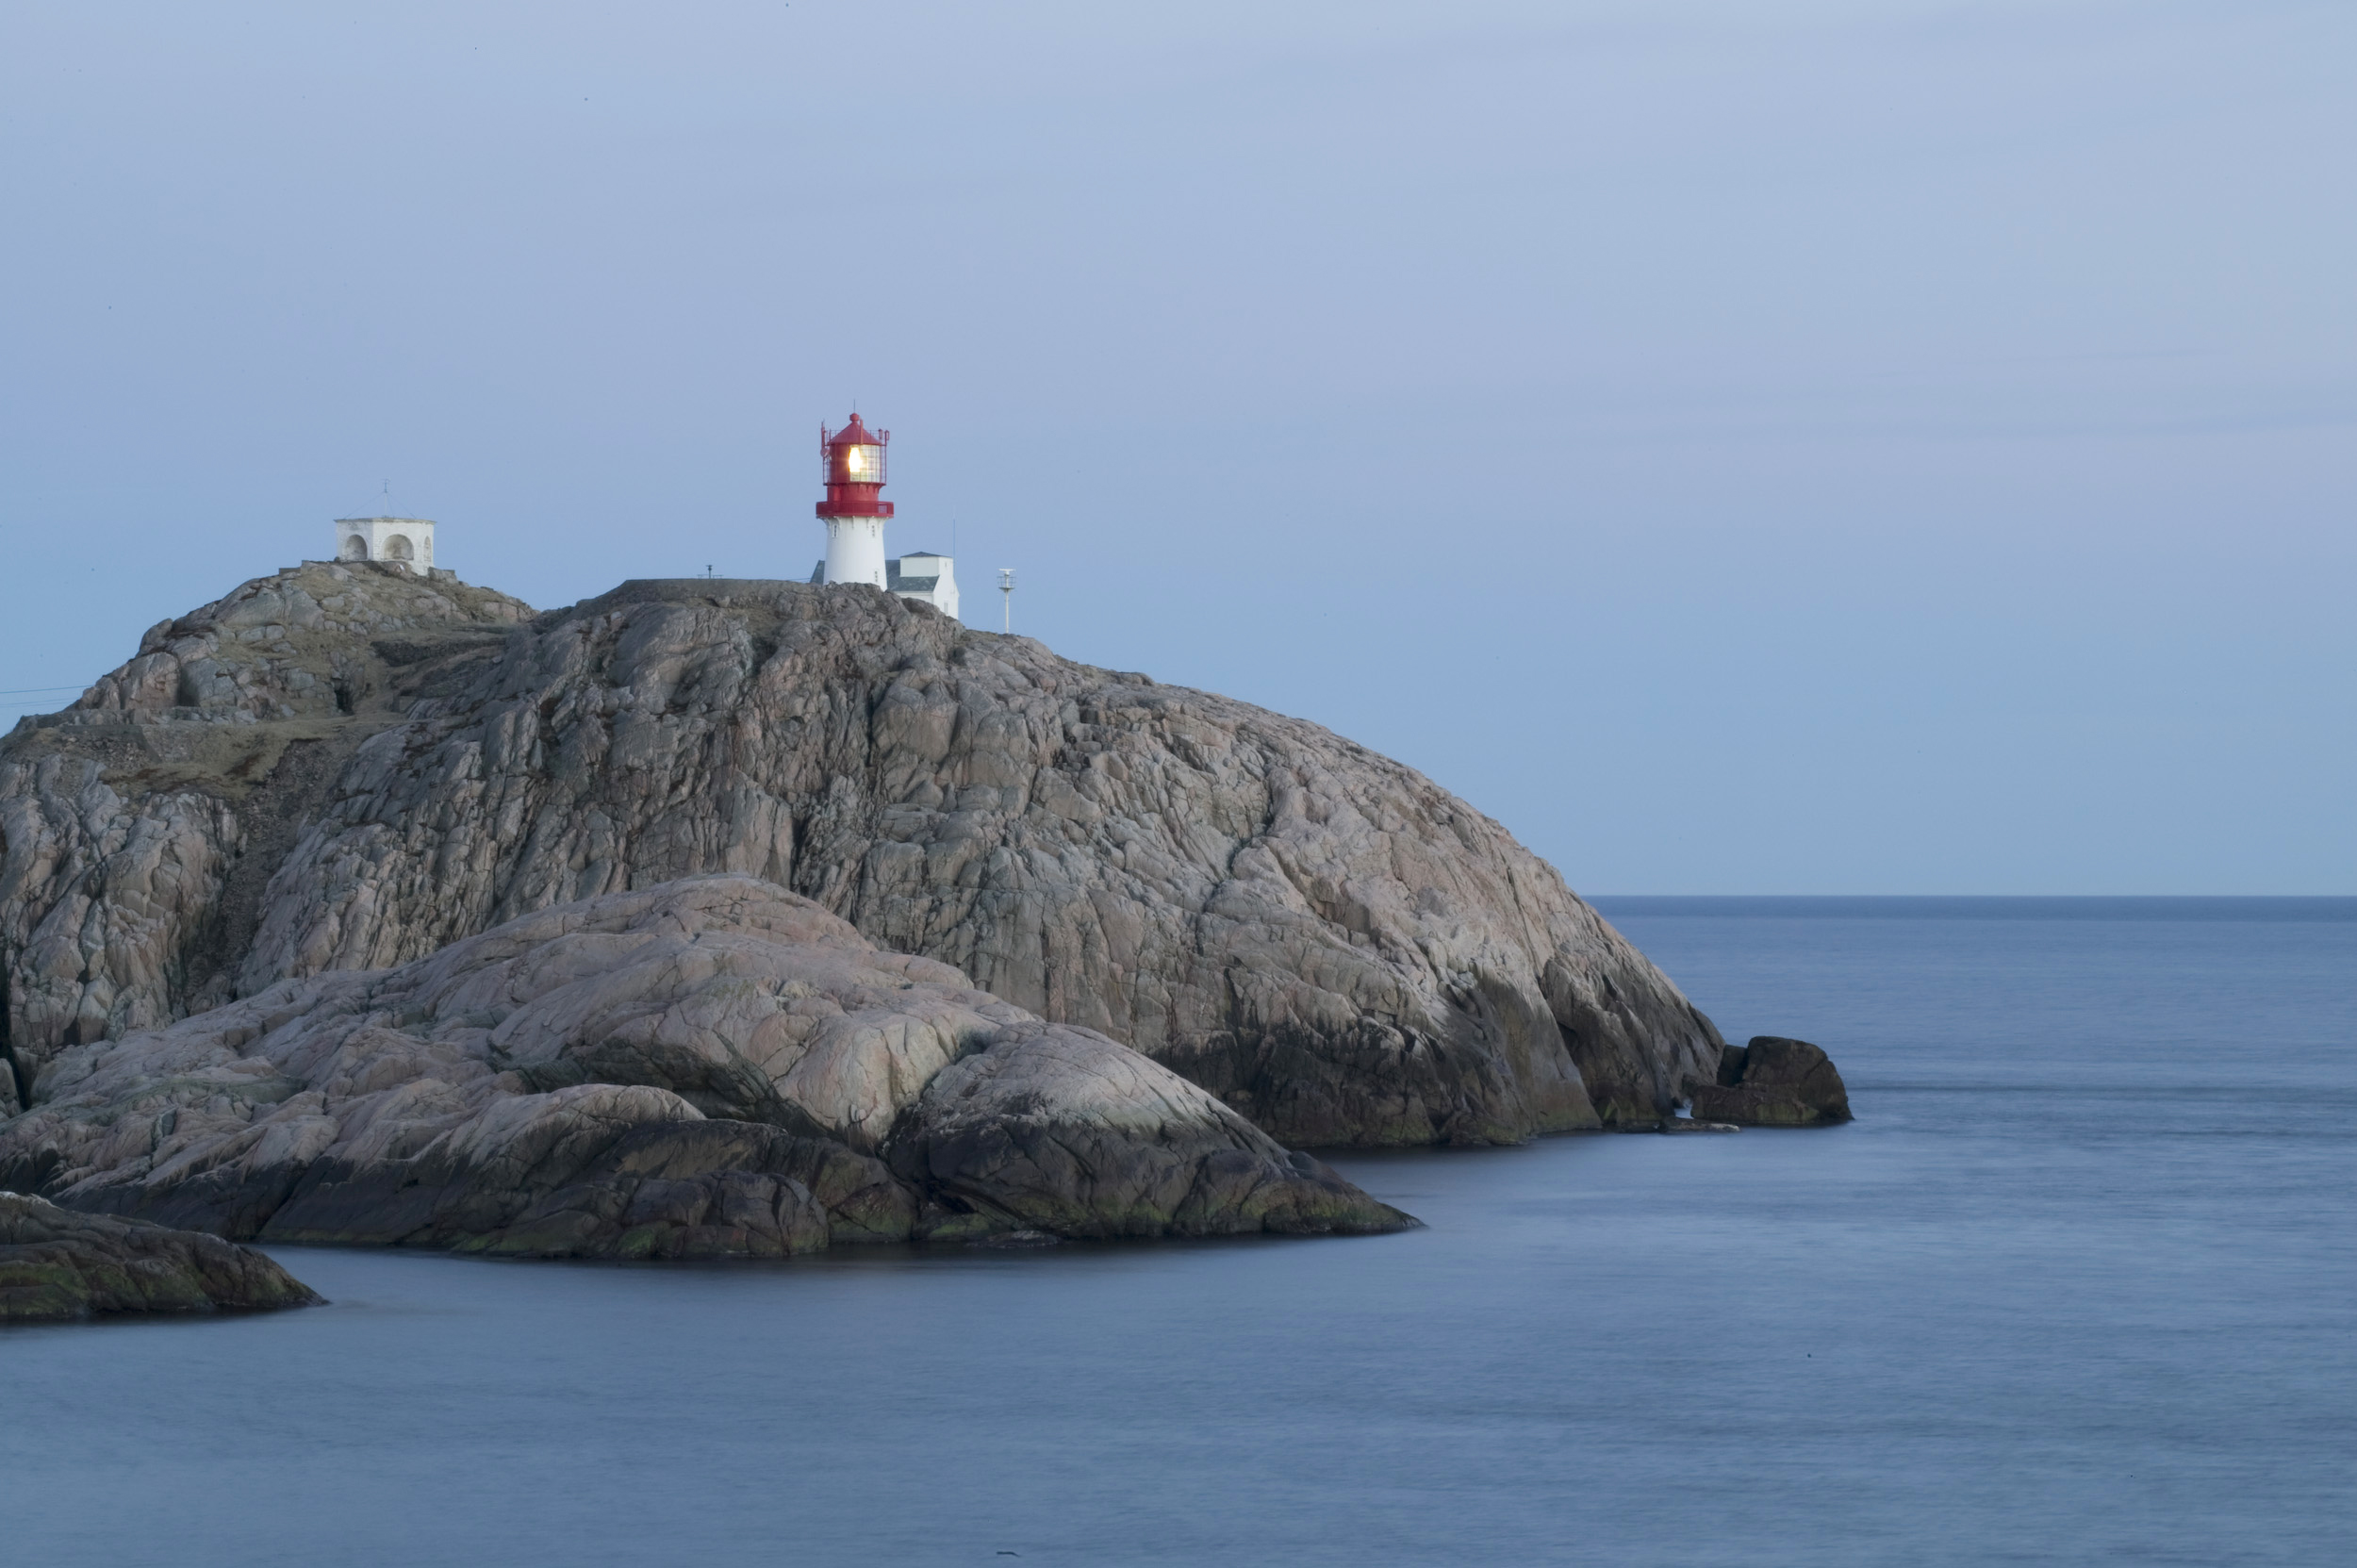
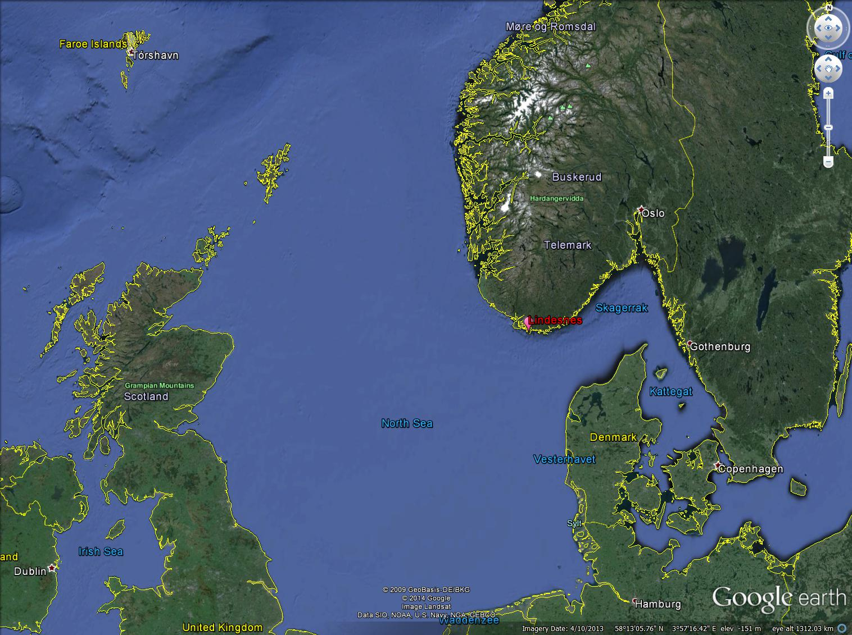
Location

Slide 3
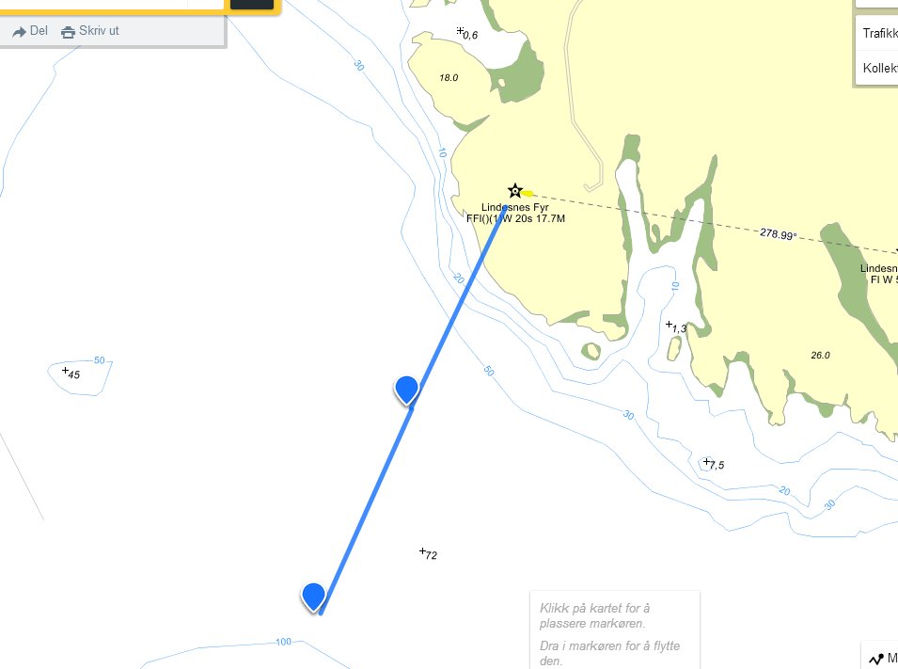
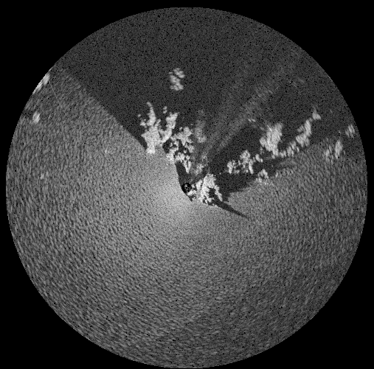
Experiment setup
AWAC 300 meter
WGS8457°58'47.6"N 7°2'39.8"E
WGS84 (lat, lon) 57.979888, 7.044382
12 KW coherent on receive radar
8 ft VV antenna
Short pulse 7.5m range bin, 1 KHz PRF
Antenna height ≈20 m, 3 Km range
Data collected in stepping and rotating modes
Wind sensor
60-70 m
AWAC300
AWAC600
AWAC 600 meter
WGS8457°58'38.7"N 7°2'32.3"E
WGS84 (lat, lon)57.97743, 7.042311
90-100 m

Slide 4
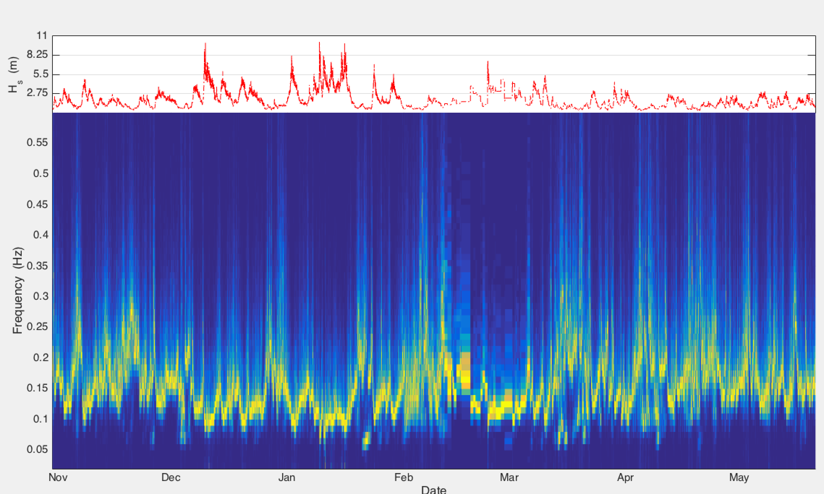
Analysis period
23-25 January
Radar deployment
AWAC300
AWAC600

Slide 5
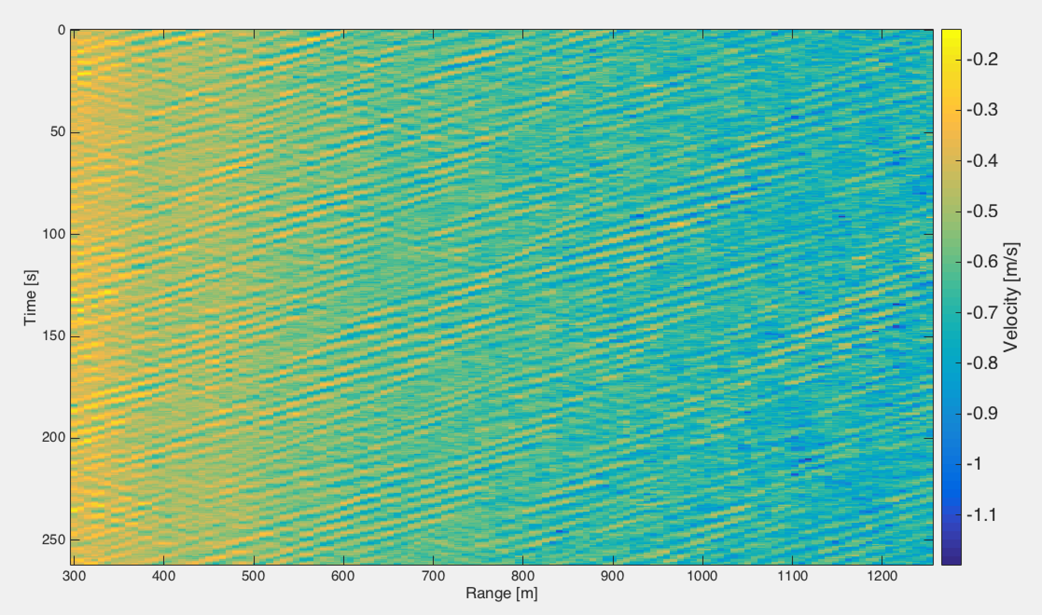
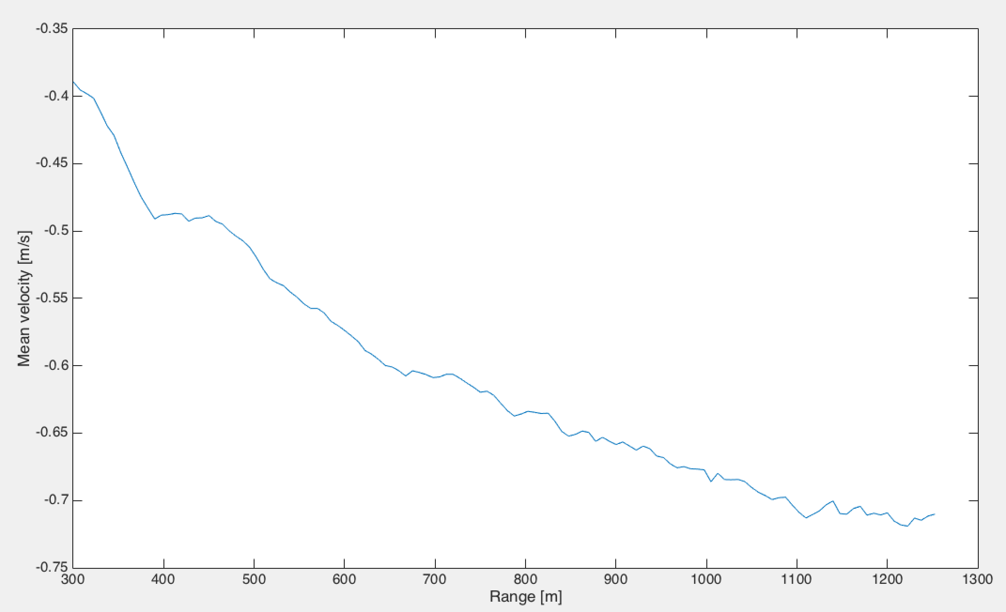
Processing
Velocity samples from pulse pairs over a 512 window
Samples collected in a processing window of 4.4 minutes
Rescale velocities according to AWAC600 mean wave direction :
Remove range trend
Compute processing window PSD

Slide 6
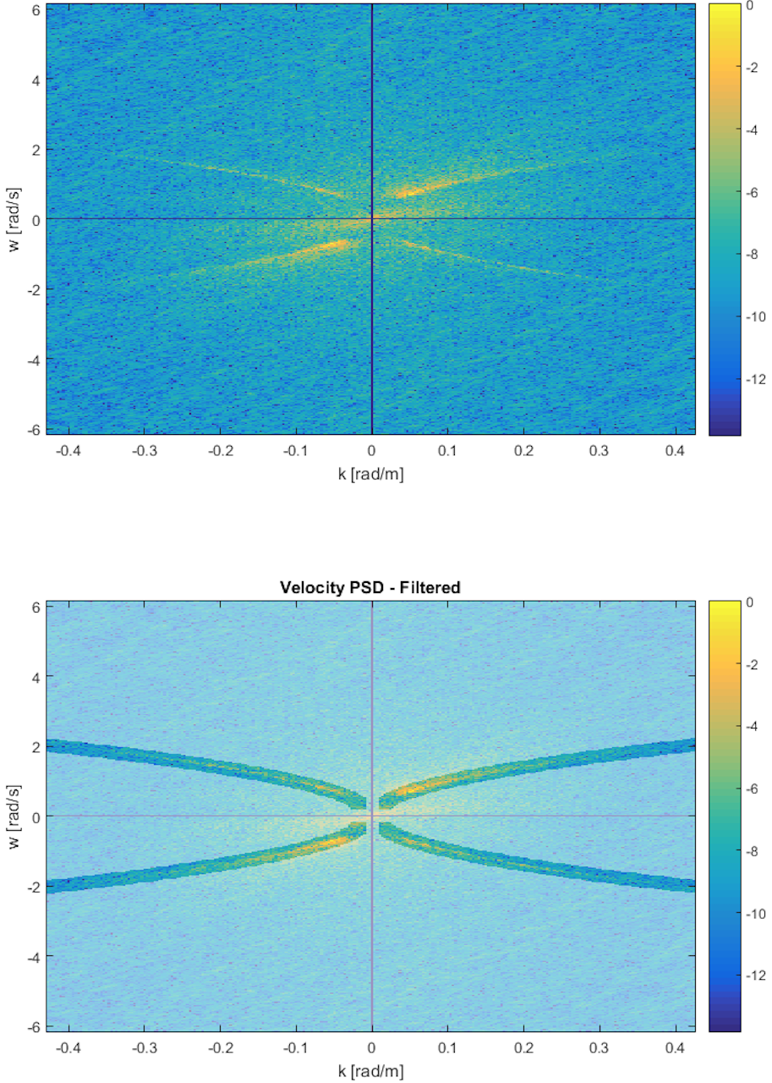
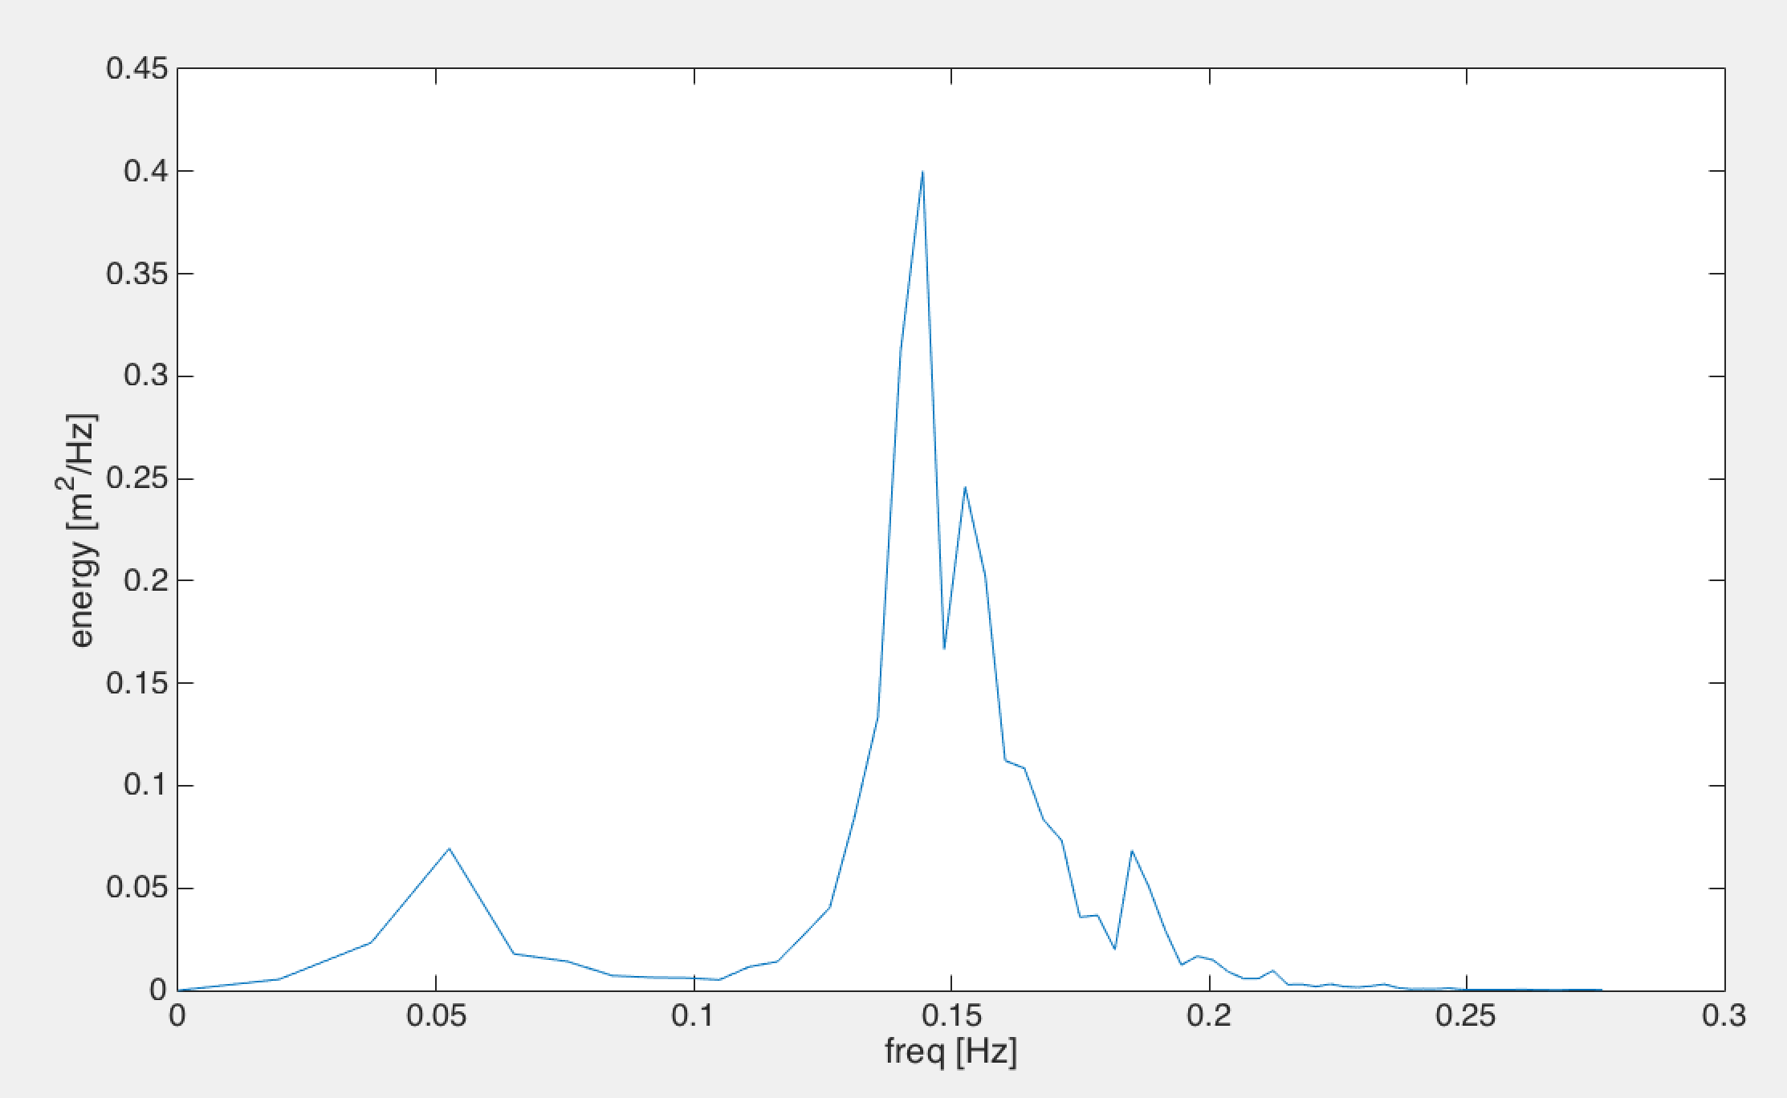
Processing cont.
Filter spectra using dispersion. AWAC estimates used to build the filter
Integrate over w and compute the surface elevation spectra :
Compute frequency spectra :

Slide 7
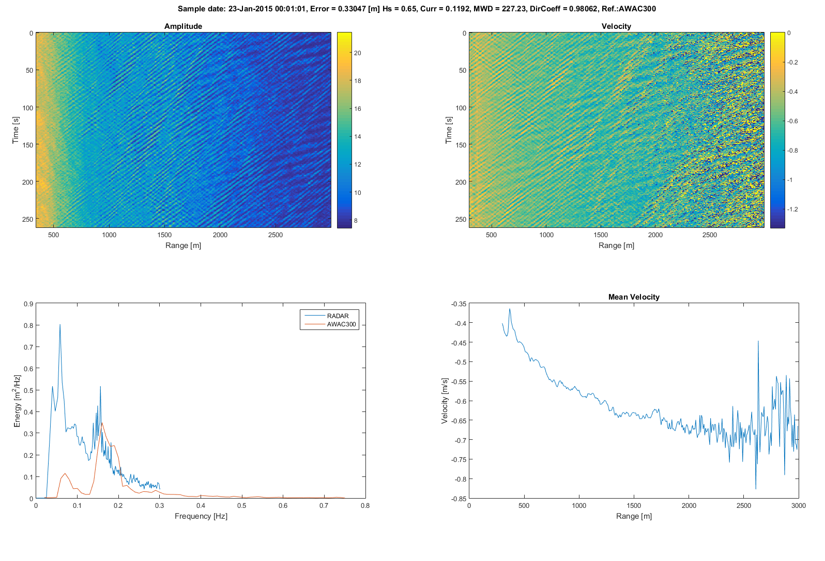
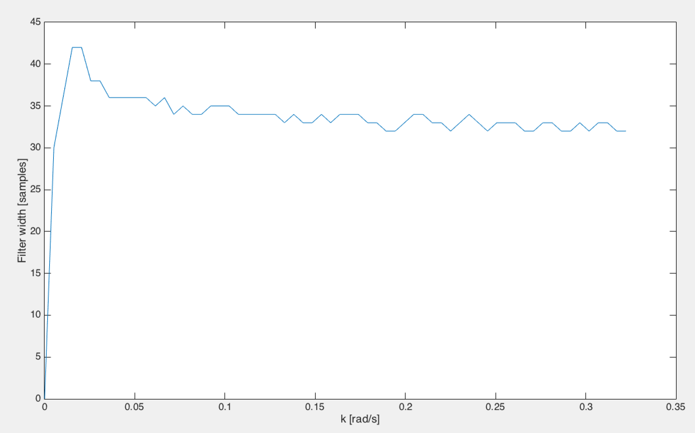
Processing limitations
Dependence on AWAC mean wave direction estimate
In presence of multiple wave directions some velocity components are not rescaled correctly
The repositioning of the wavelength components will also be incorrect
The dispersion filter gain is not completely uniform over k
Assume orbital velocities after filtering
Notes:
Need to consider directionality. Multiple wave direction and reflected energy

Slide 8
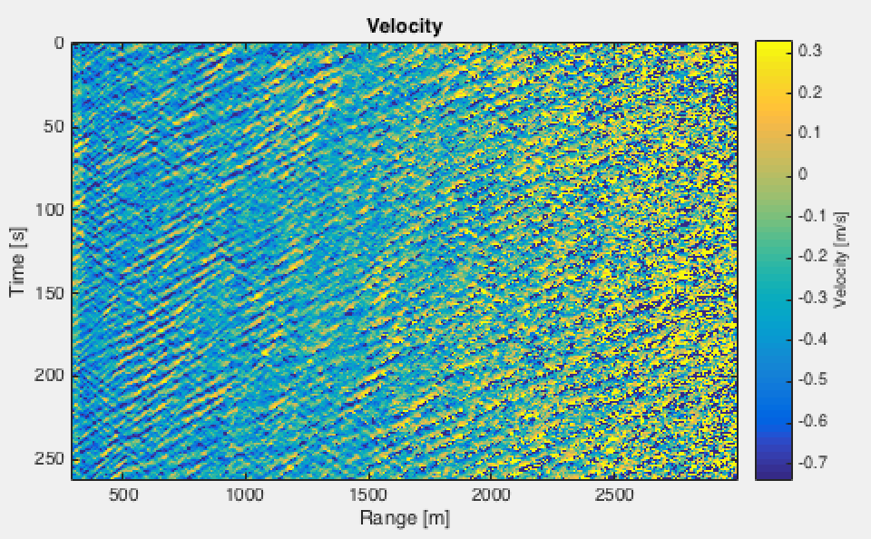
Range selection
Range Samples | RMSE AWAC300 | RMSE AWAC600
64 | 0.67 | 0.75
128 | 0.655 | 0.67
256 | 0.92 | 0.88
360 | 1.09 | 1.03

Slide 9
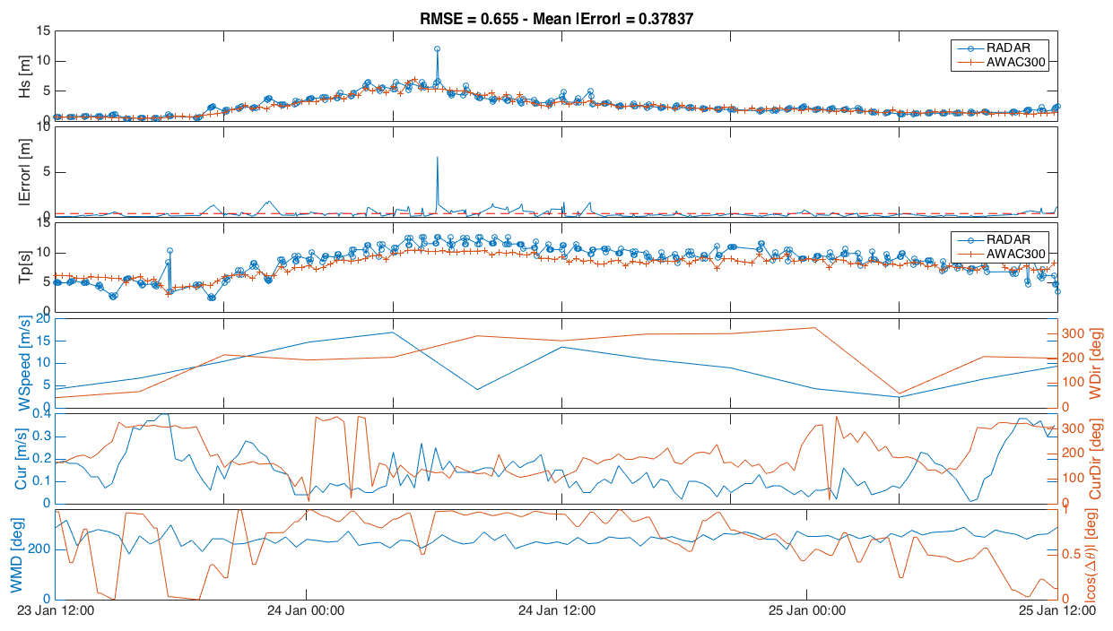
Results

Slide 10
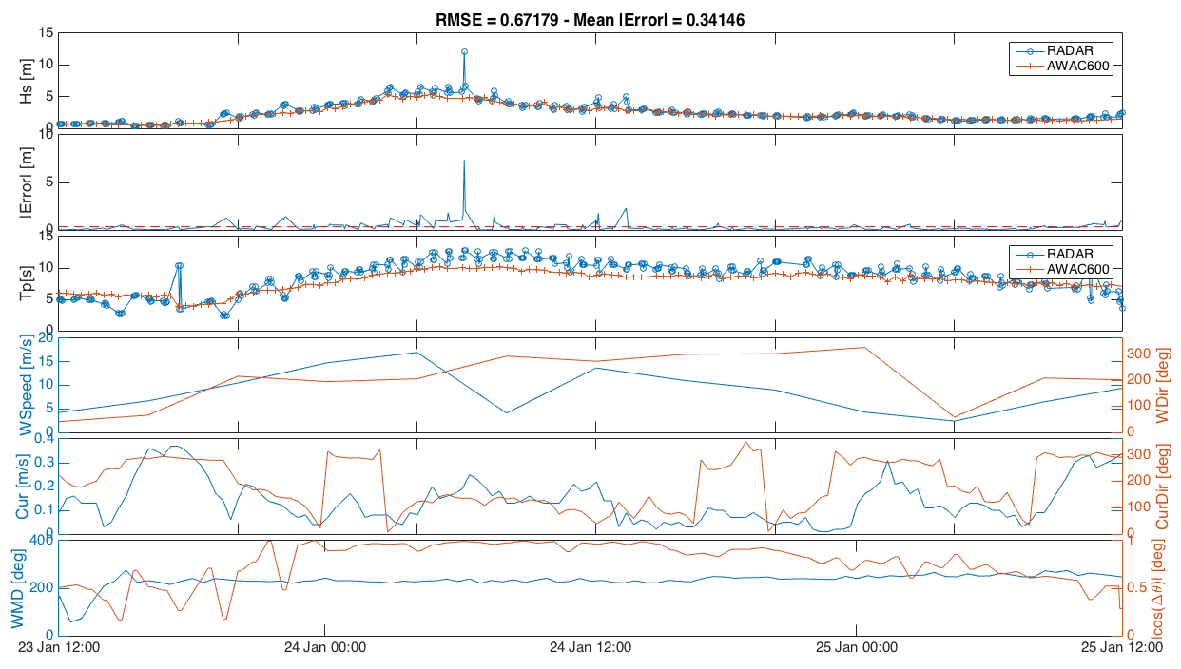
Results

Slide 11
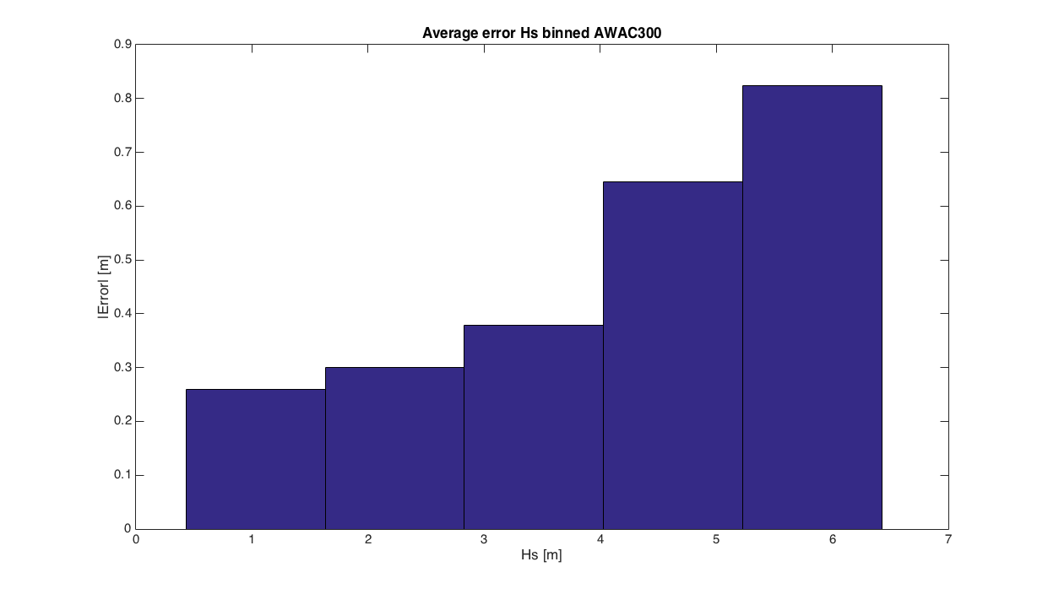
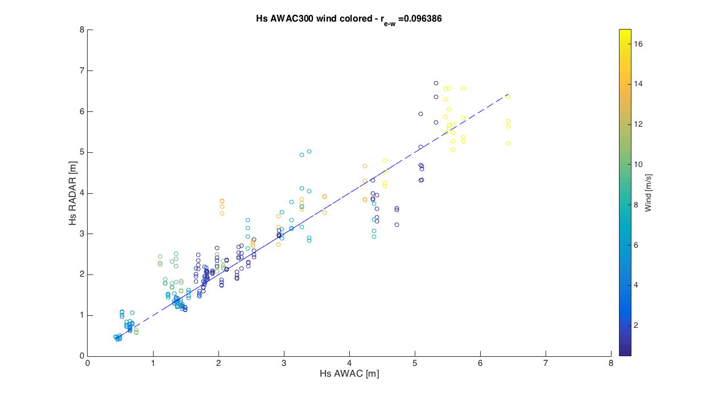
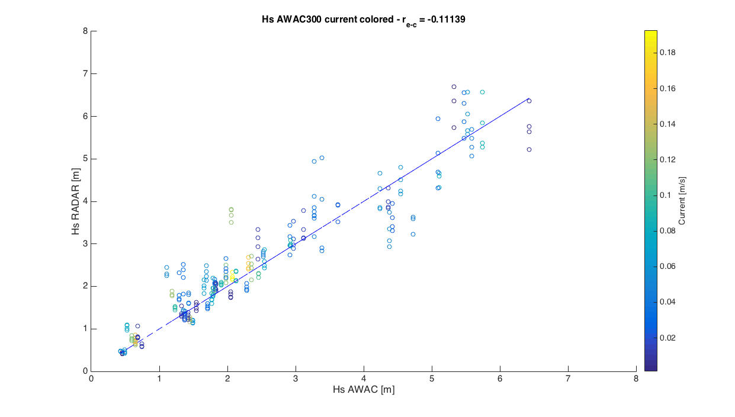
Results

Slide 12
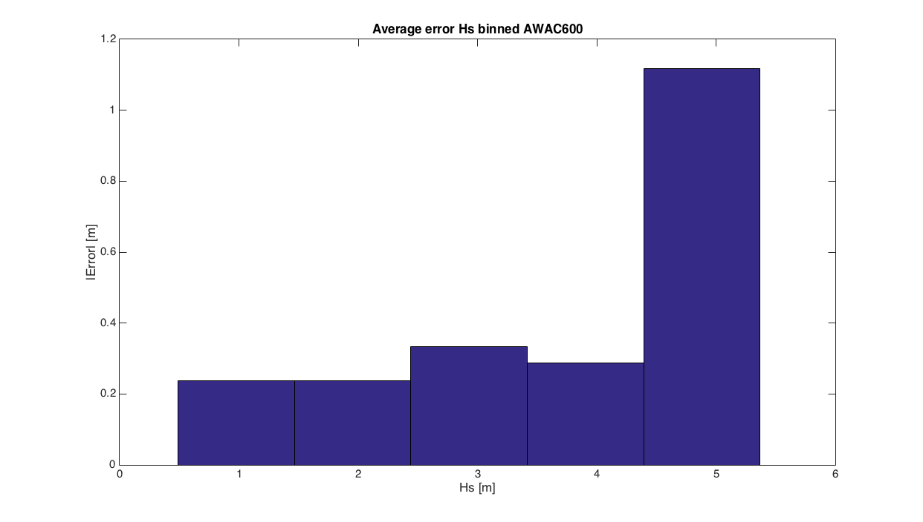
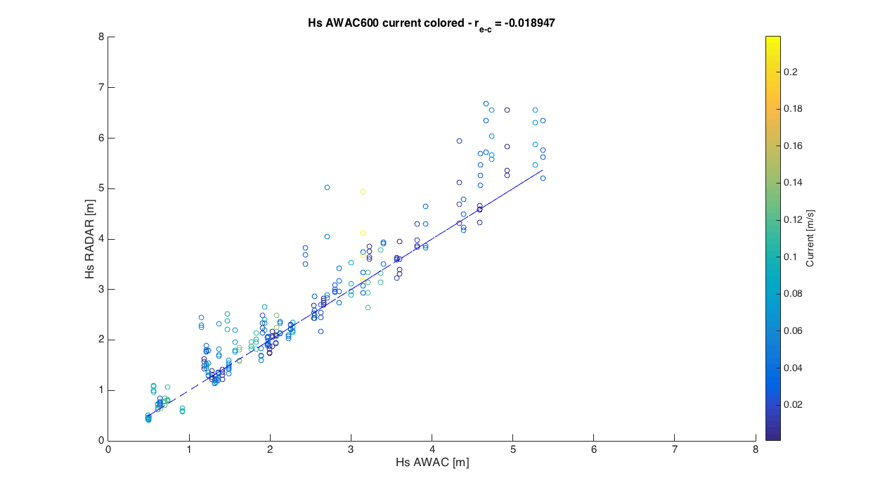
Results

Slide 13
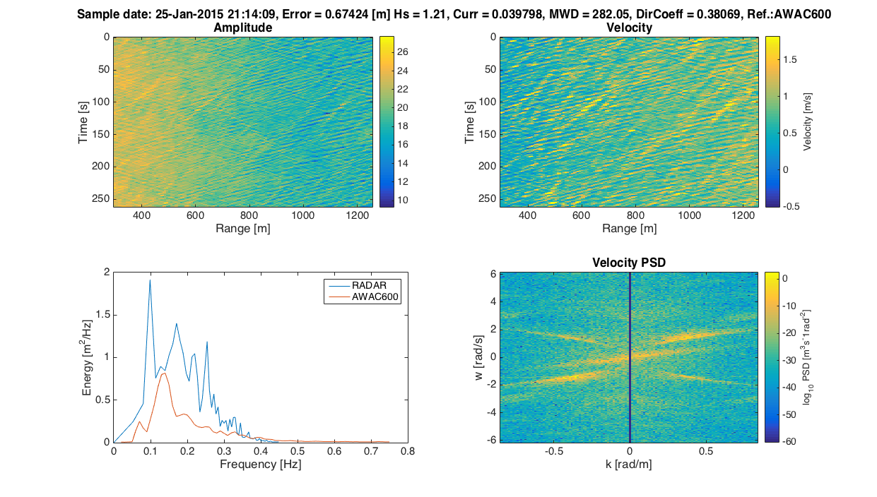
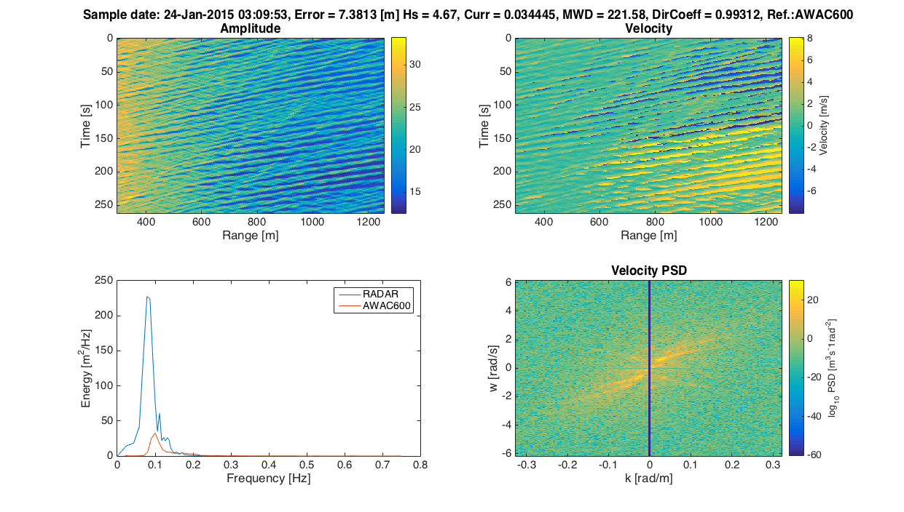
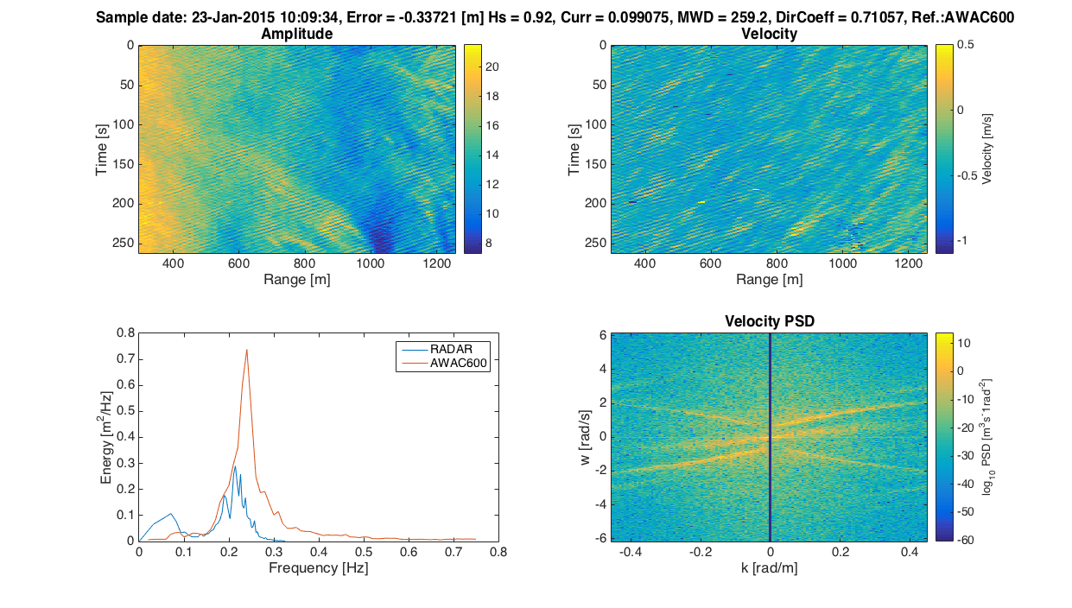
Outliers

Slide 14
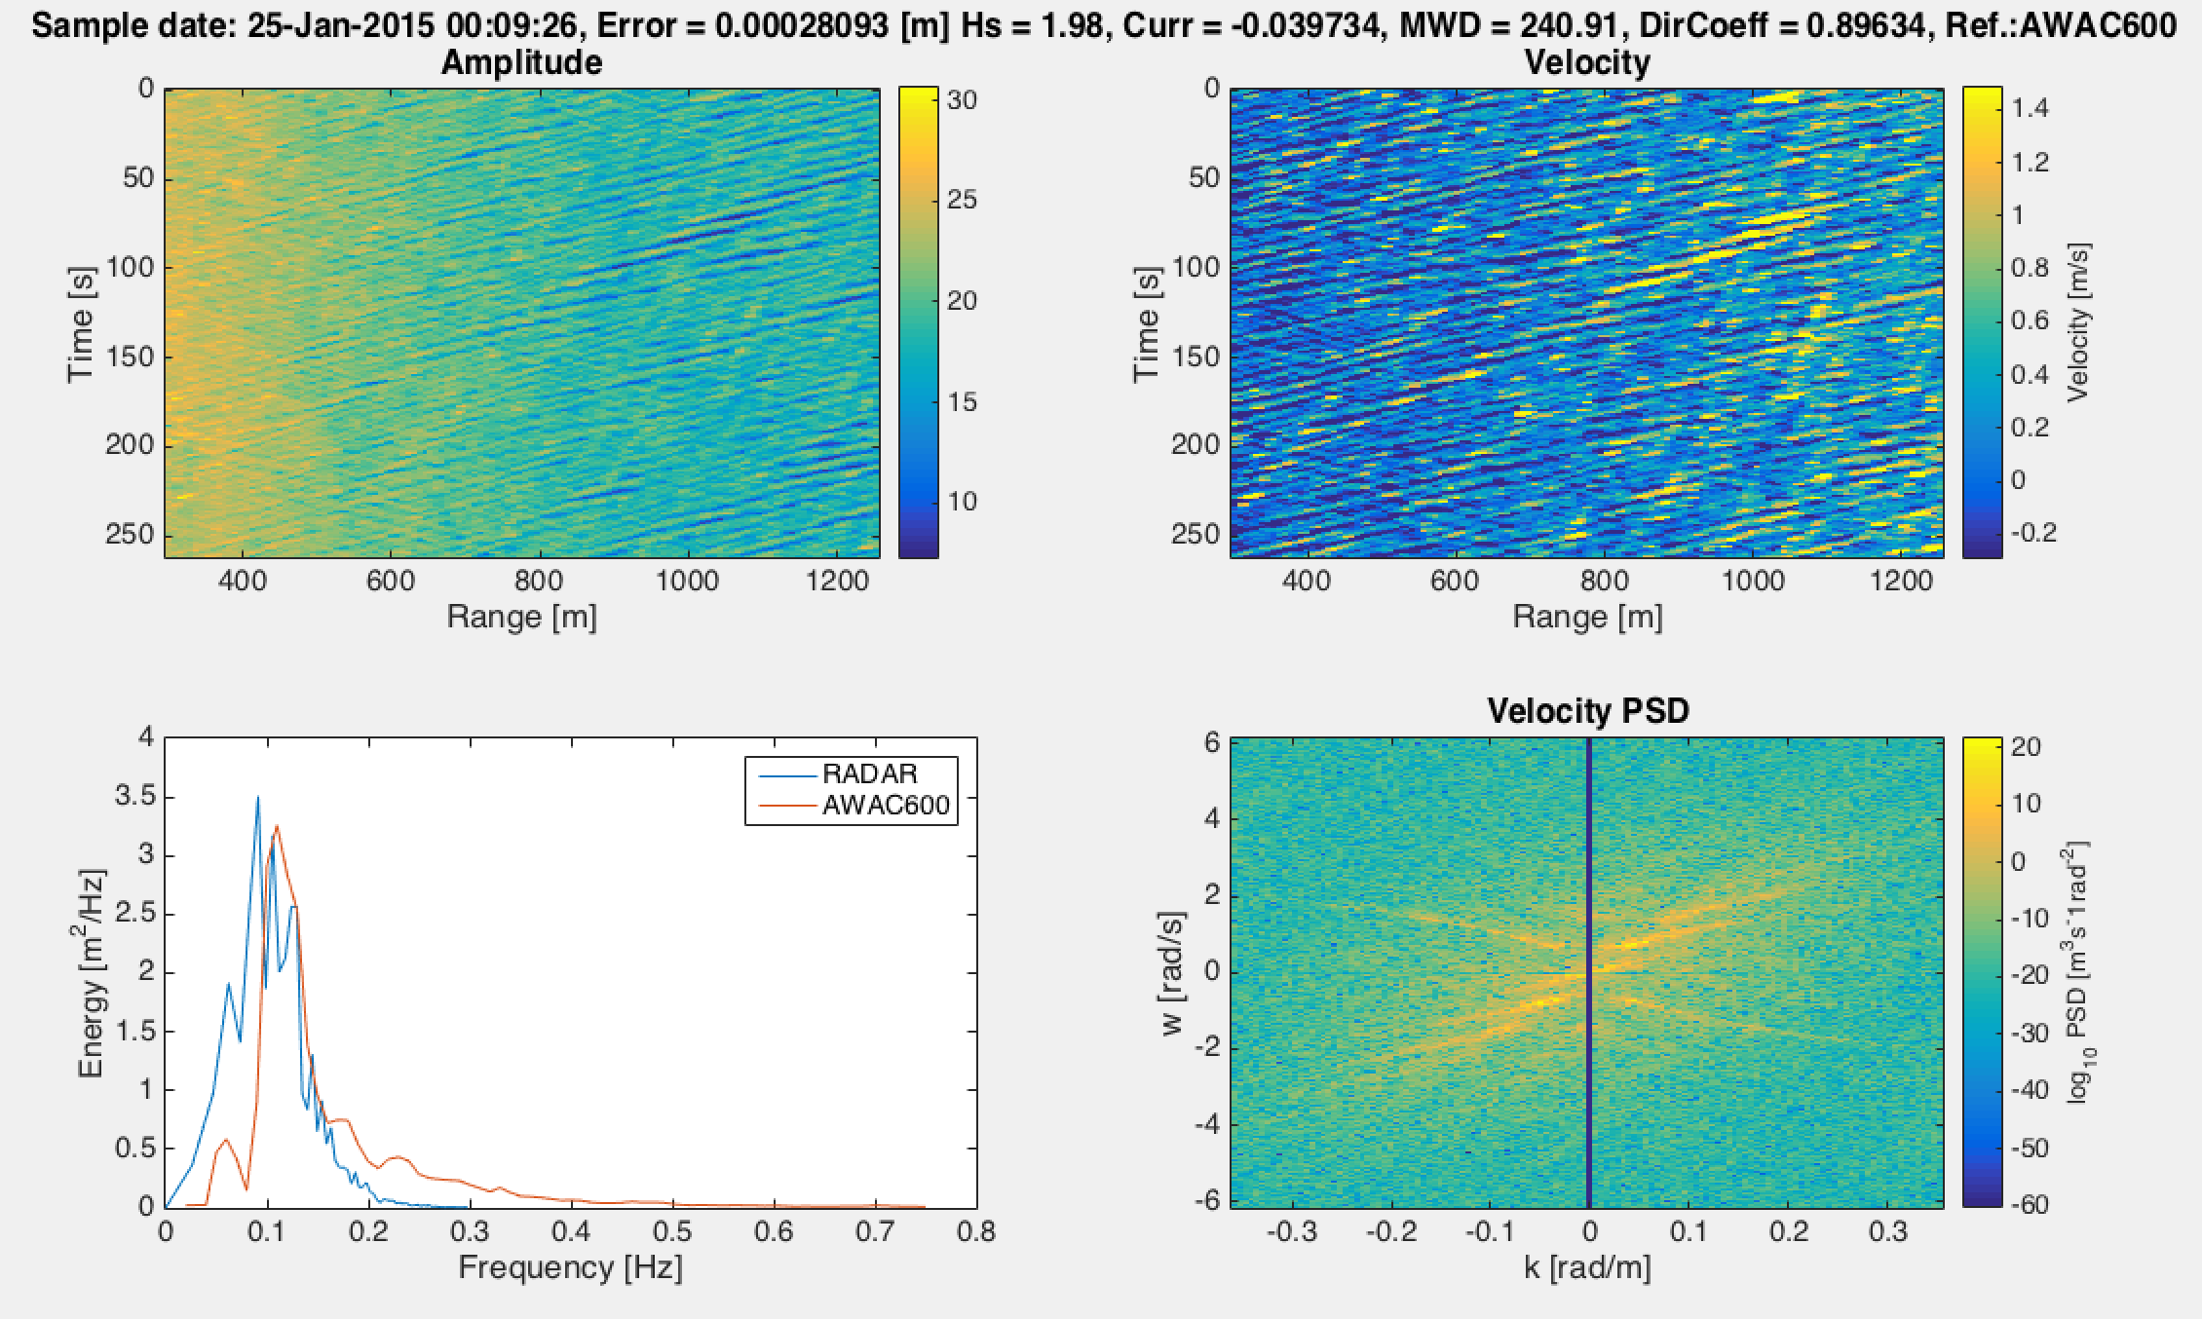
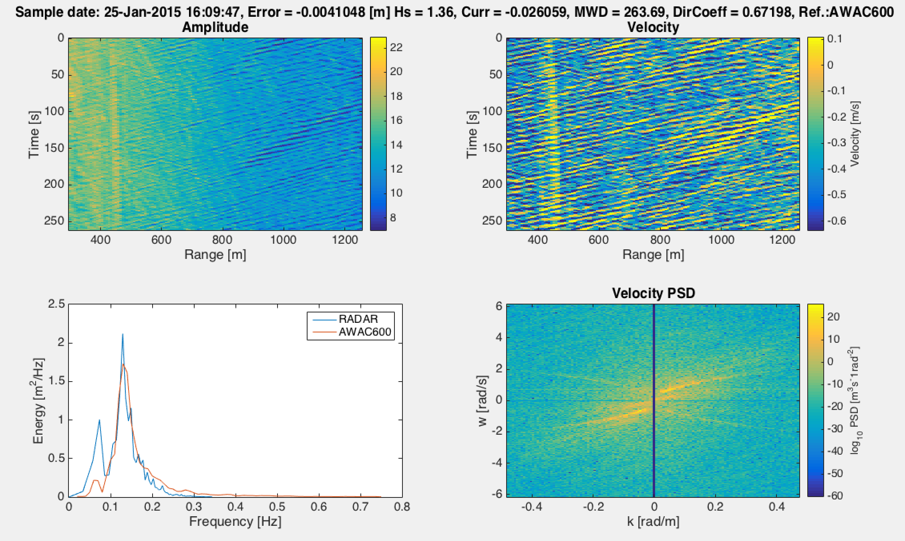
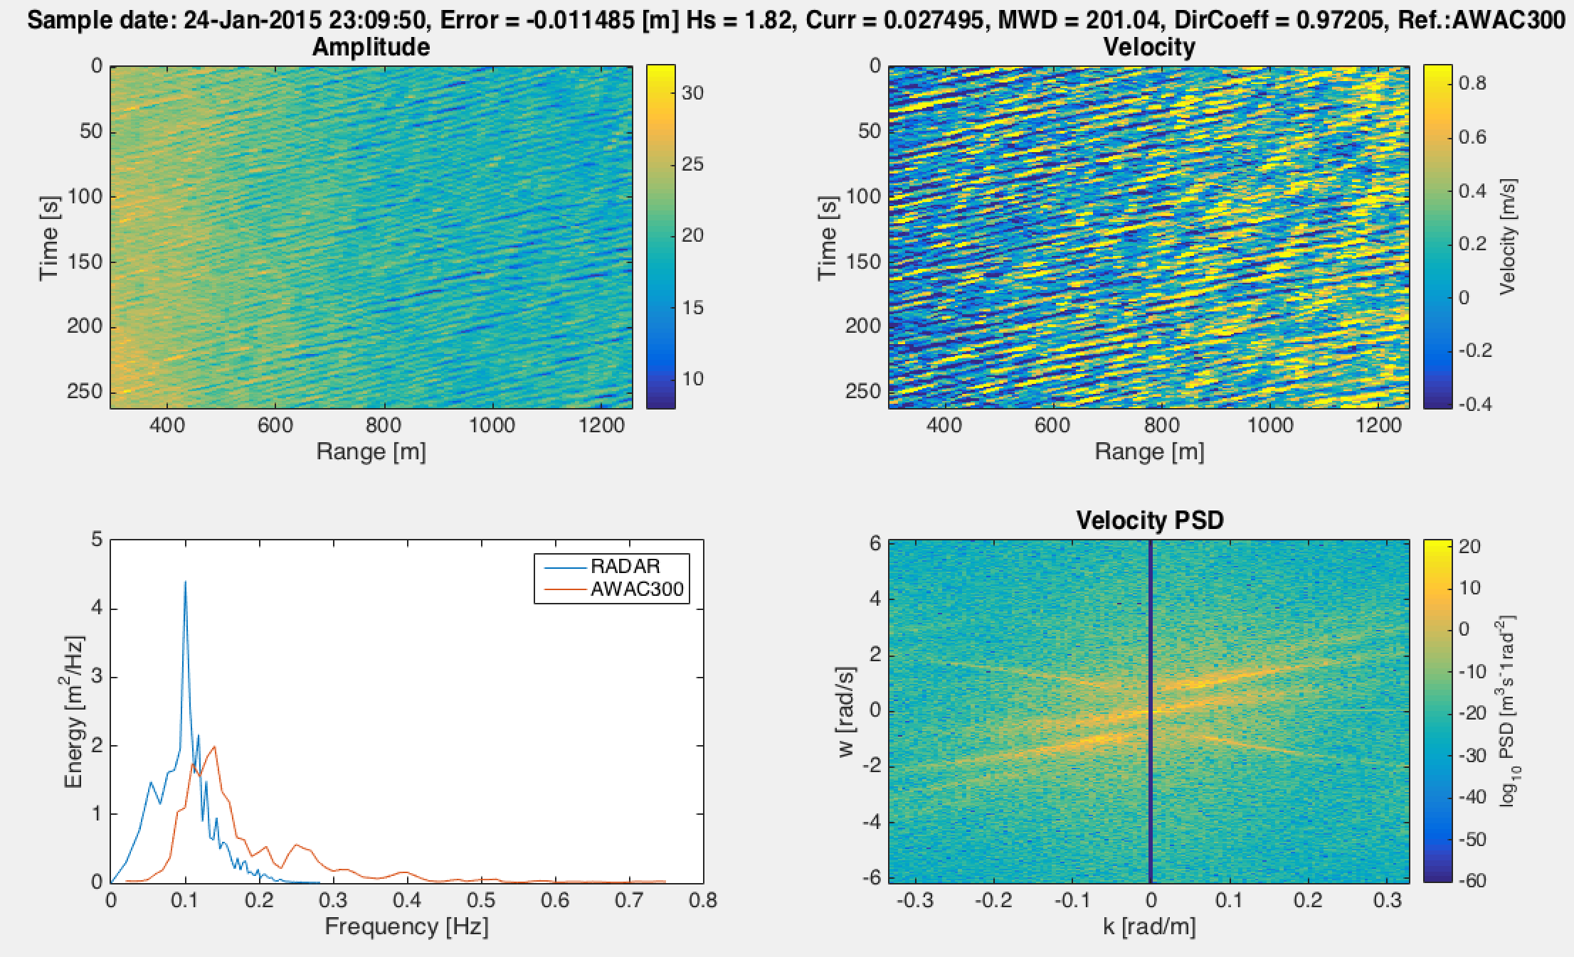
Spectra comparison
Shift in frequency
Amplified low frequencies and attenuated or missing high frequencies
Comparable in shape
Umax=0.7 m/s
Umax=0.64 m/s
Umax=0.8 m/s

Slide 15
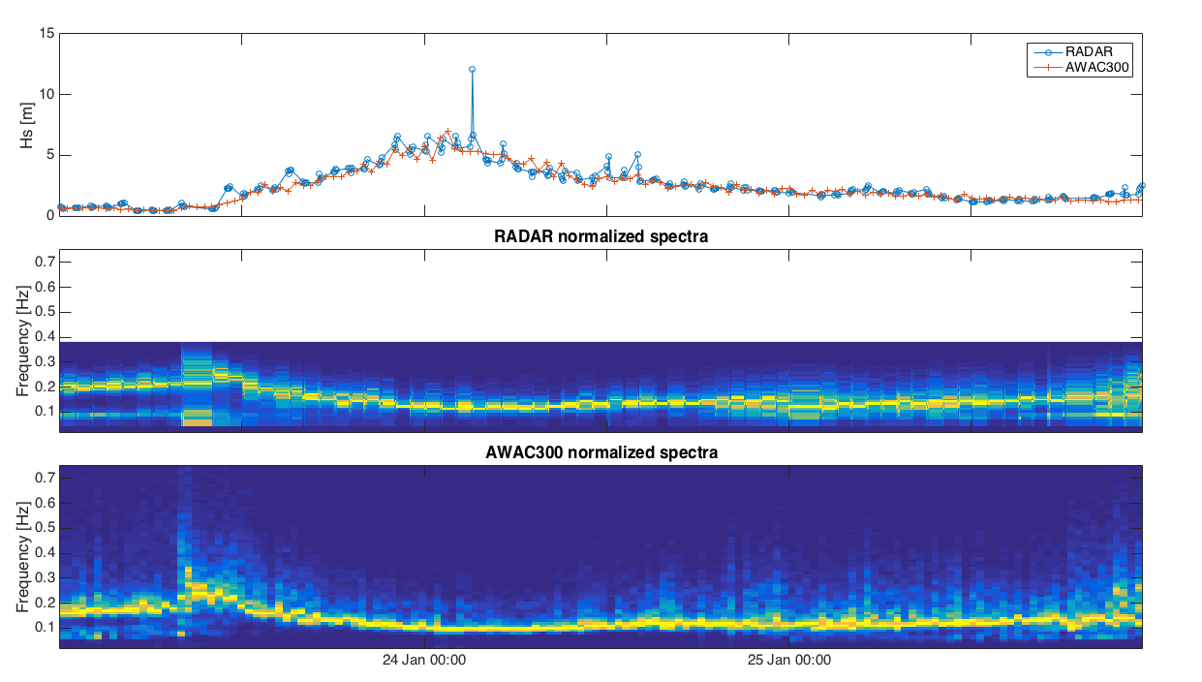
Results

Slide 16
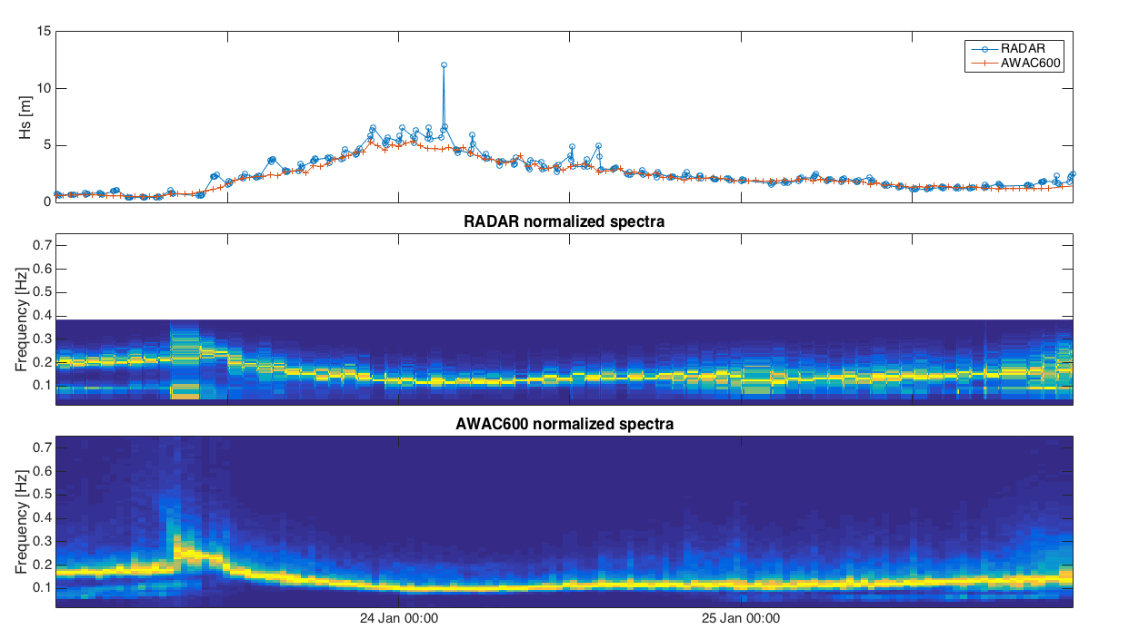
Results

Slide 17
Conclusion / future work
Promising results : estimates comparable with reference without calibration
Need to consider directionality
Validation on the extended dataset

