Slide 1
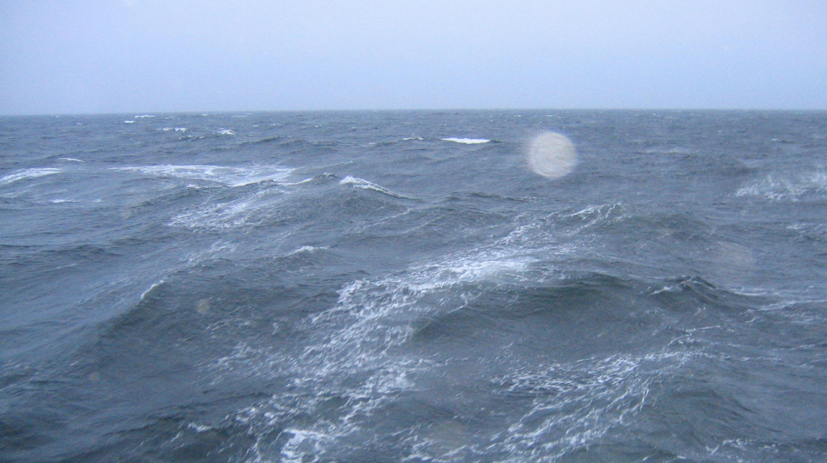
How Do Breaking Waves Show Up In Low-Grazing Angle Backscatter and Ocean Wave Spectra?
William J. Plant, APL/UW, SoMaR, July 14, 2015

Slide 2
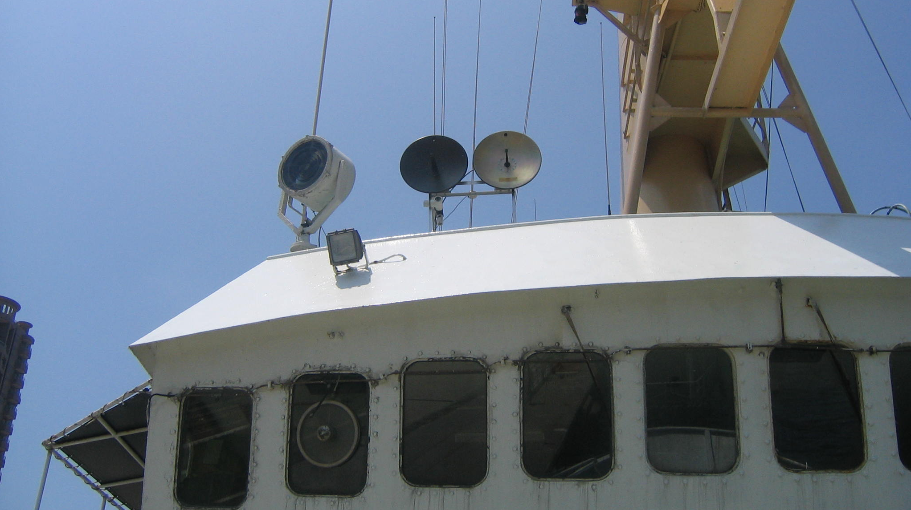

Slide 3
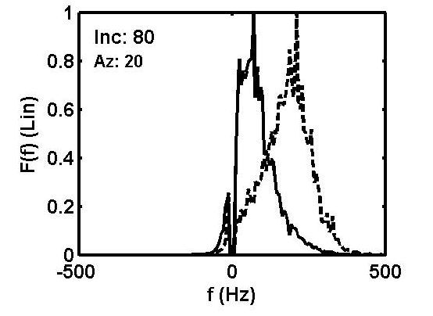
VV = Solid
HH = Dashed
Plant, JGR, 1997
X-Band
7 m/s

Slide 4
Notes:
All VV

Slide 5
Data
Simulation
Without Breaking
Simulation
With Breaking
Notes:
Left: Data, Upwind, 7.5 m/s; Right: Simulation, Upwind, 7.5m

Slide 6
Plant, GRL, 2012
o
o
o Ding and Farmer Acoustic Tracking

Slide 7

So far I believe the material presented to be pretty well established.
Now I begin to speculate

Slide 8
From Trokhimovski, JTech, 2000
Hwang et al., Tank, 1993
Hwang et al., Field, 1996
Friction Velocity
about 25 cm/s
Trokhimovski, Radiometer

Slide 9
Speculation:
This peak in B is caused by the breakers
moving at the speed of the
downwind interference pattern.

Slide 10
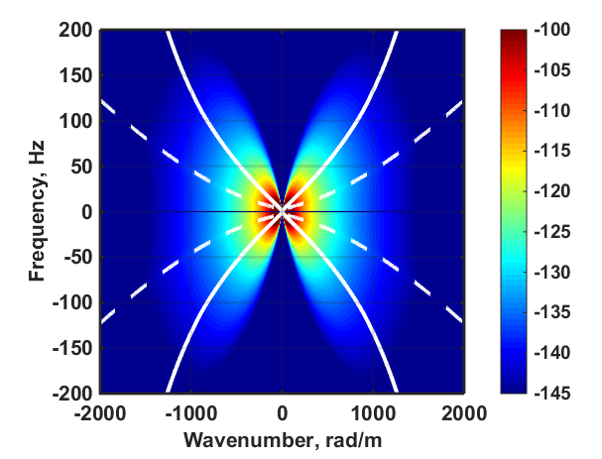
Plant, JGR, 2015

Slide 11
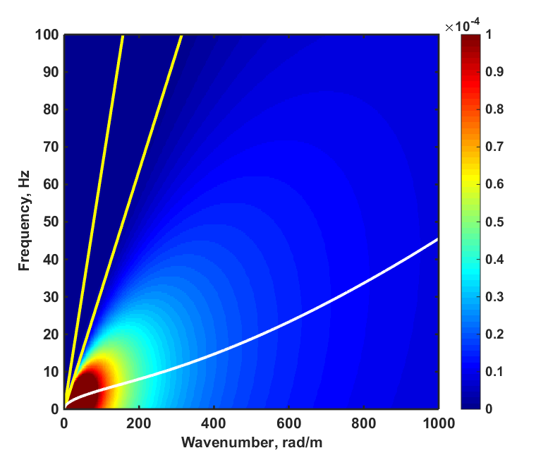
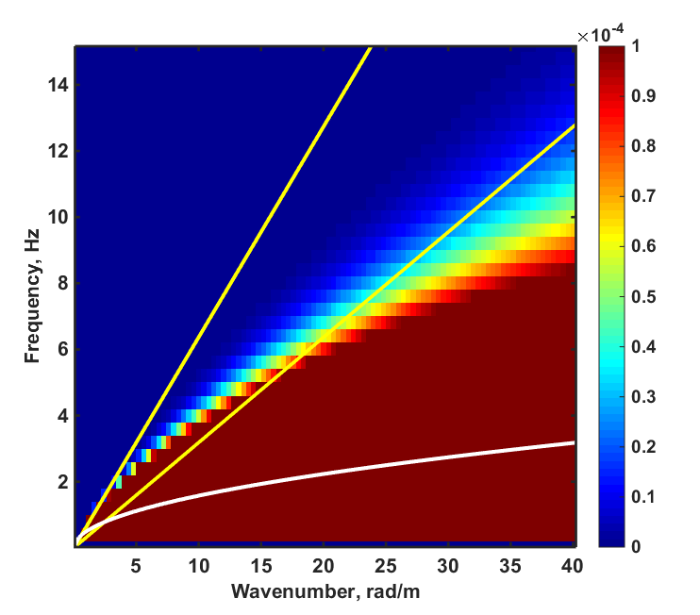
Combine f-k Spectra with Speeds of Breakers
4 m/s 2 m/s
4 m/s 2 m/s

Slide 12
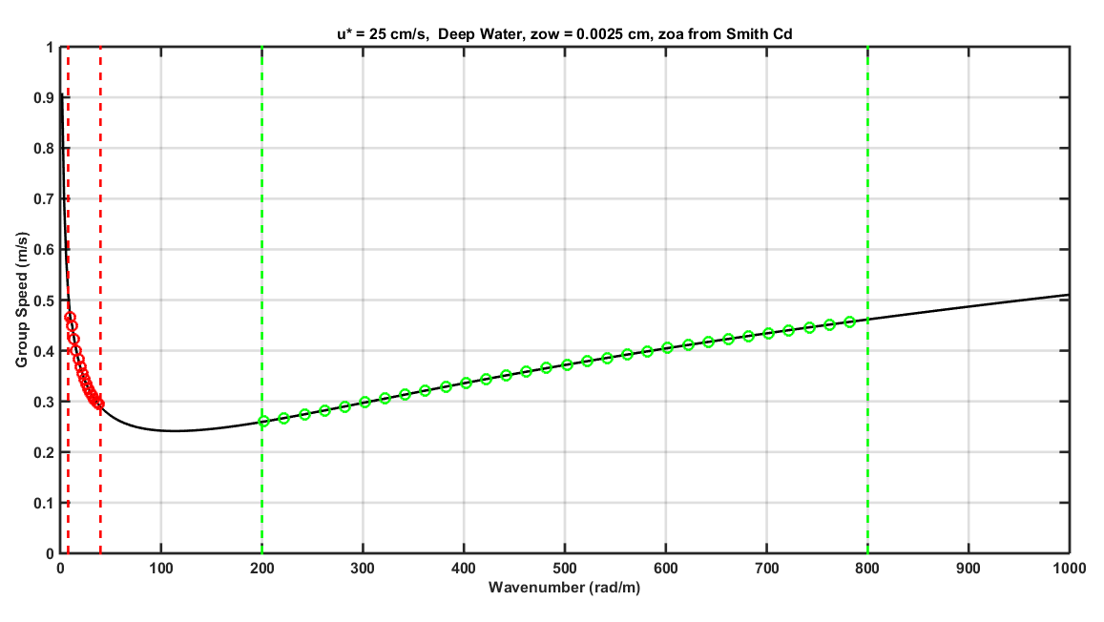
8 40
200
800

Slide 13
From Hwang and Wang, GRL, 2004
Dissipation Rate:
“In the middle range
(about 3<k<40 rad/m or
0.16<λ<2.1 m), the dependence
[of dissipation on wavenumber]
is as strong as B¹⁰, approaching
a delta function.”

Slide 14
Contour plots of constant spectral density from Banner et al. (JFM, 1989), their figures 6 and 7. Left: Wind speed 5.5 m/s from the right (East). Right: Wind speed 13.3 m/s from the left (West) . The short lines in the fourth quadrant give the confidence intervals

Slide 15
kb ≈ 41 rad/m
From Yueh et al., TGRS, 2013
L-Band, Inc = 29-46 deg

Slide 16
SPECTRAL FEATURES, MANY UNUSUAL
0.6 rad/m to 40 rad/m | 100 rad/m to 800 rad/m
Speeds match those of downwind interference pattern if advection by orbital velocities in taken into account. | Peak of X-band Low-Grazing-Angle HH Doppler spectra match those of downwind interference pattern
Greatly increased dissipation rates according to Hwang and Wang (2004). | Curvature spectrum peaks in this range.
Group speeds match those in the higher range | Group speeds match those in the lower range.
At low wind speeds, crosswind spectra are larger than downwind ones | Upwind spectra always larger than downwind ones.
Much wave breaking | Unexplained Roughness

Slide 17
8 40
200
800
Ka
1450
L
C
X
Ku
( Bragg Wavenumber at 10º Grazing )
K

Slide 18
VV = Solid
HH = Dashed
Plant, JGR, 1997
X-Band
7 m/s

Slide 20
Plant, GRL, 2012, Figure 4b

