Slide 1
Coastal fronts and water temperature variation observed at the research pier HORS
Satoshi Takewaka, University of Tsukuba, Japan
Coastal fronts
(Maybe) internal tidal waves
Observation with X-band radar
Simultaneous measurements with radar and thermometer-chain at the pier
2013 July / August (27 days, after the SOMaR-2013)

Slide 2
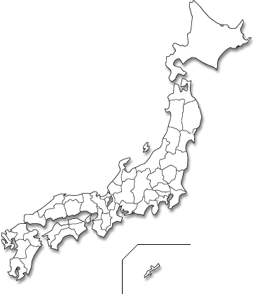
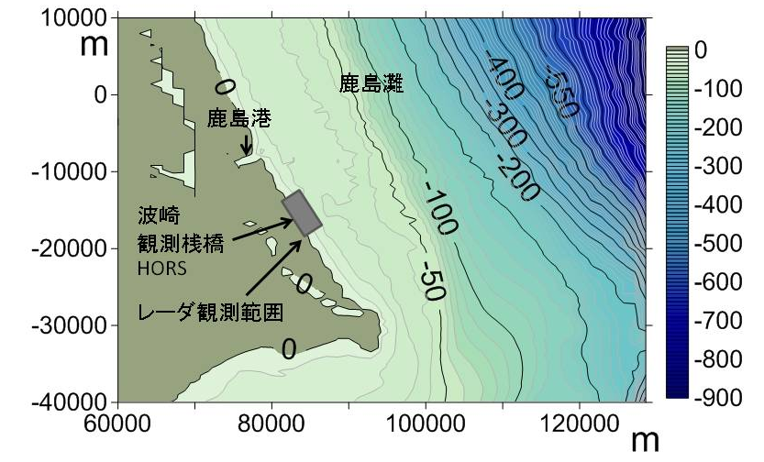
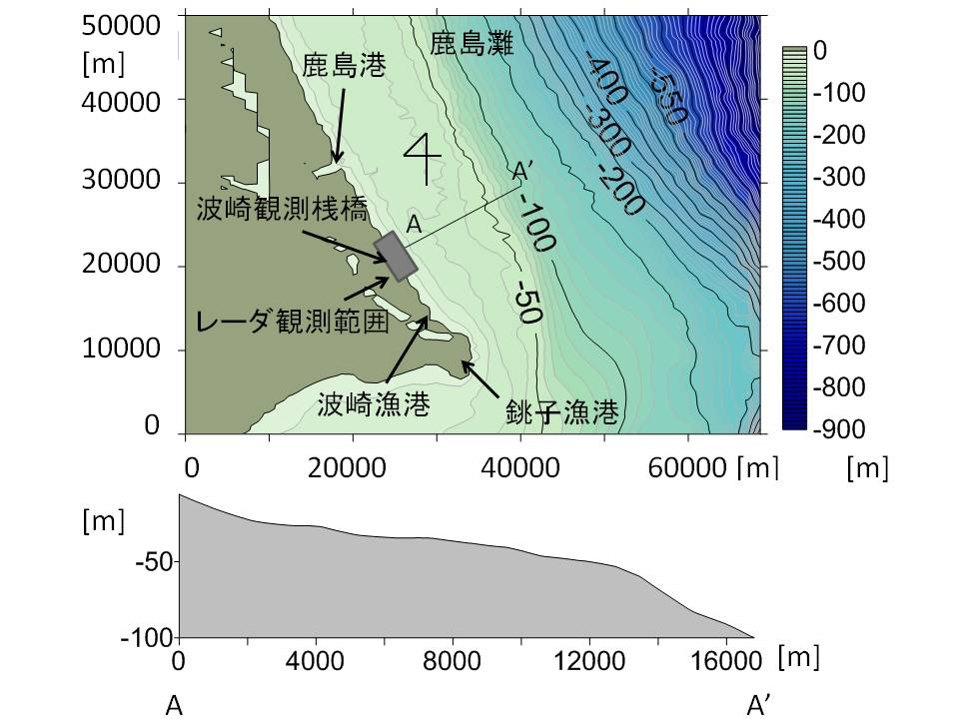
X-band radar at the research pier HORS
Radar coverage
Tokyo
Hasaki Oceanographic Research Station

Slide 3
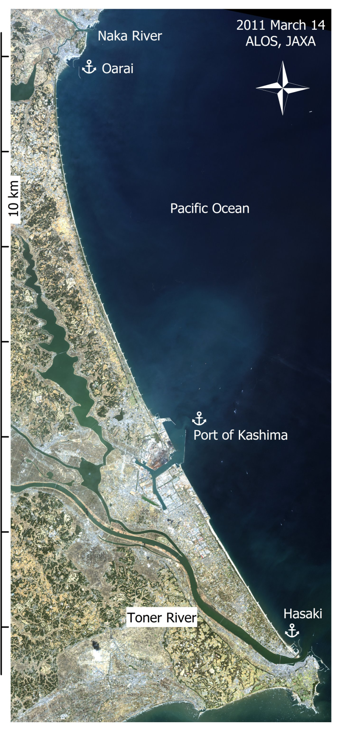


Slide 4
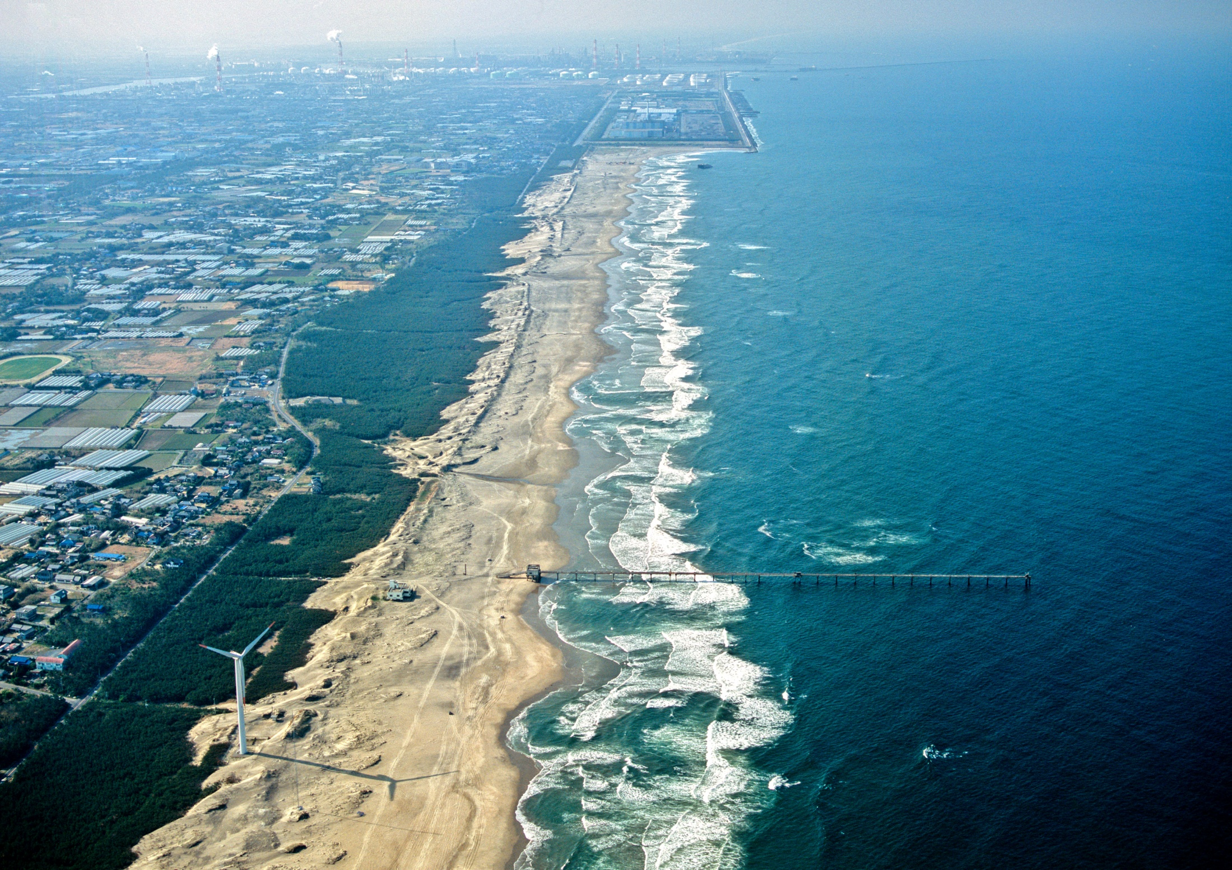
X-band radar at research pier HORS

Slide 5
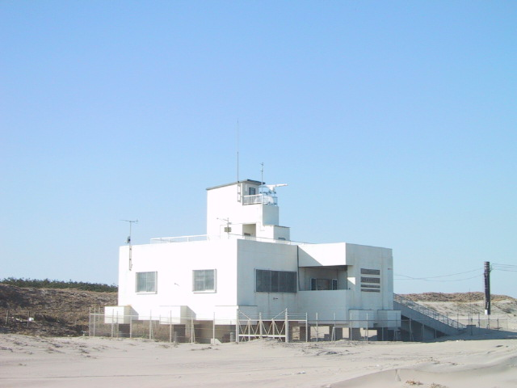
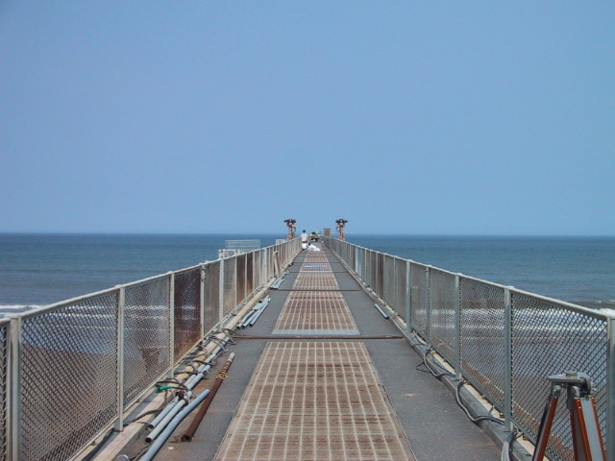
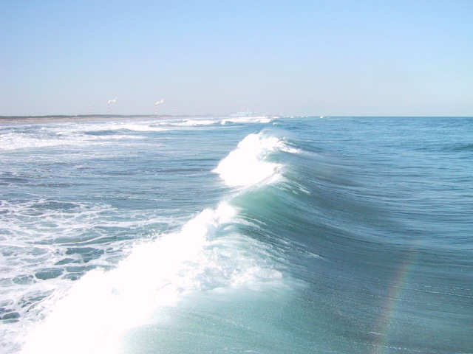
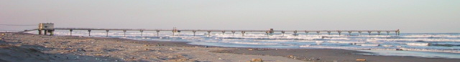
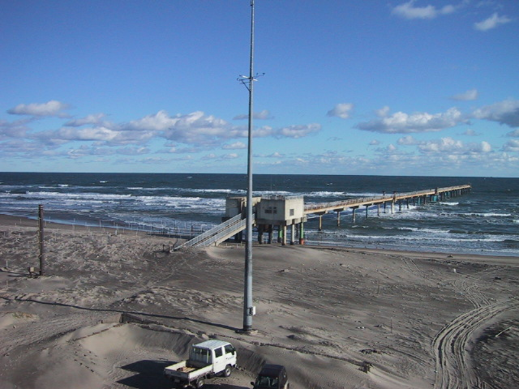
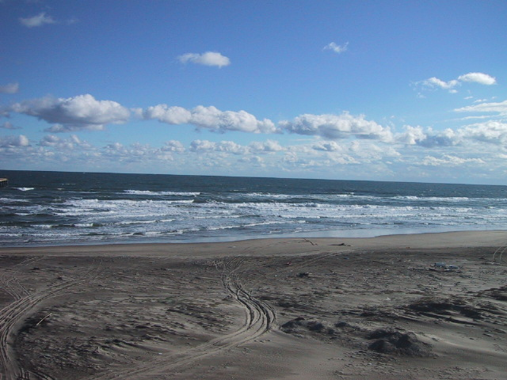
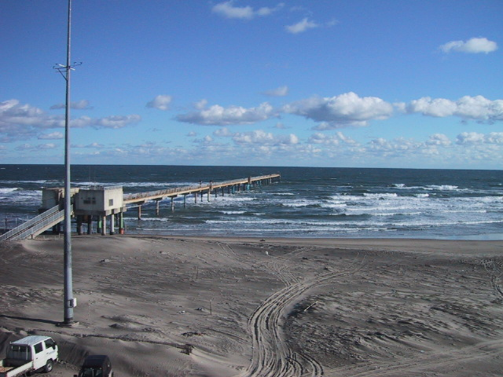

Slide 6
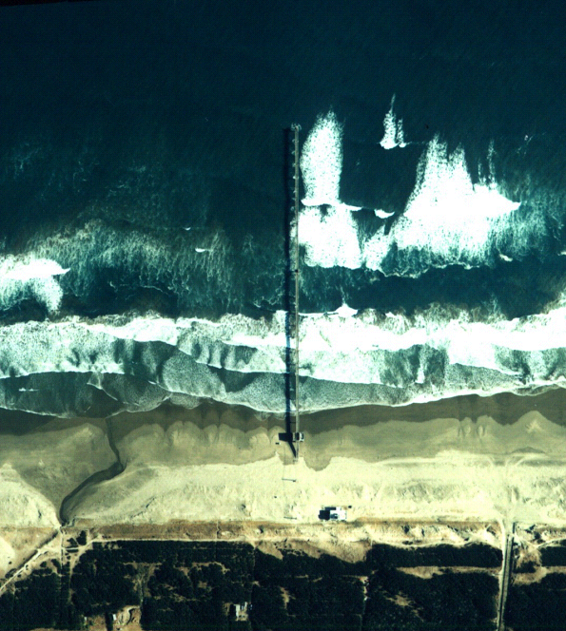
Pacific Ocean
400 m
Pier tip: Thermometer
Research building
Radar: 17 m above M.S.L.

Slide 7
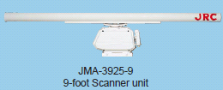
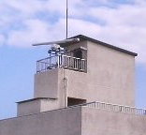
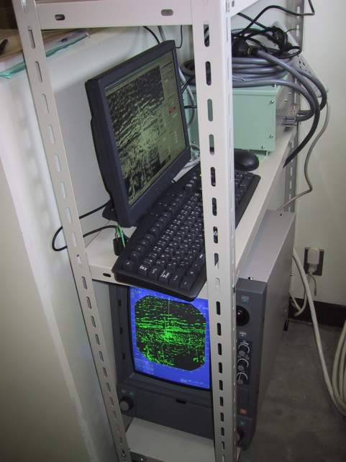
JRC JMA-3925-9
Antenna length ~ 2.9 m
HH polarization
Transmitter frequency 9410 Mhz
Maximum power 25 kw (120 NM)
Pulse width 0.08 ms – 0.8 ms
Pulse frequency 2080 Hz – 520 Hz
Rotation speed ca. 24 rpm ~ 2.5 s / rotation
Data grabber (0.5Hz = 1 image / 2s)

Slide 8
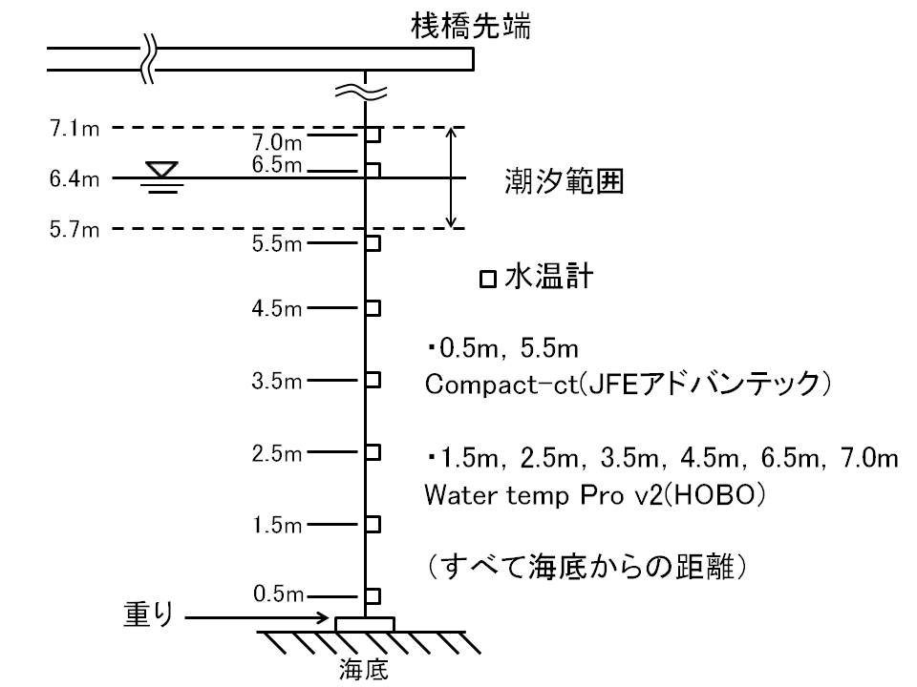
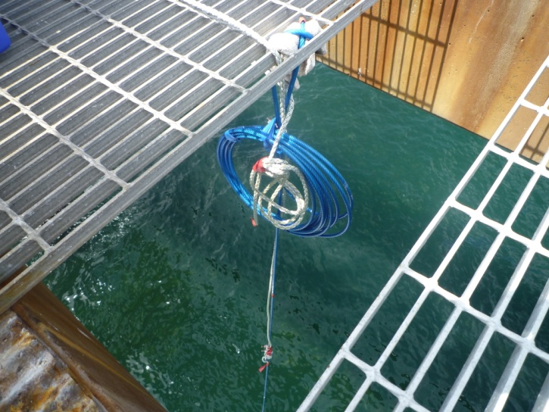
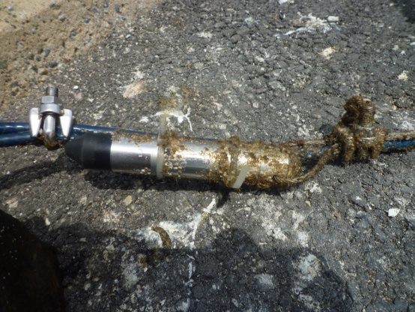
Thermometer chain installed at the tip of the pier
mean depth = 6.4 m
pier deck
tidal range: 1.4 m
thermometer

Slide 9
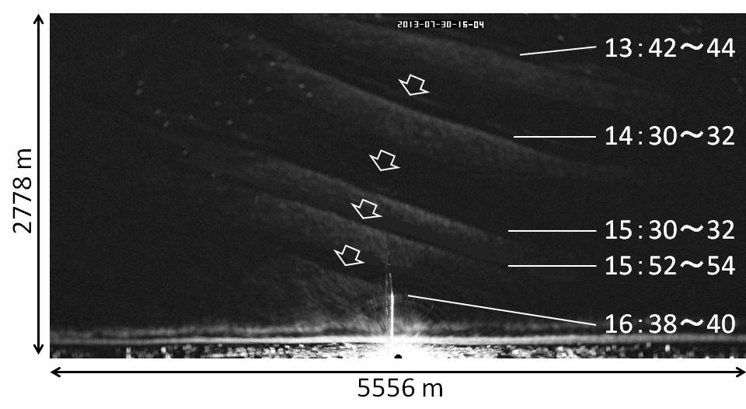
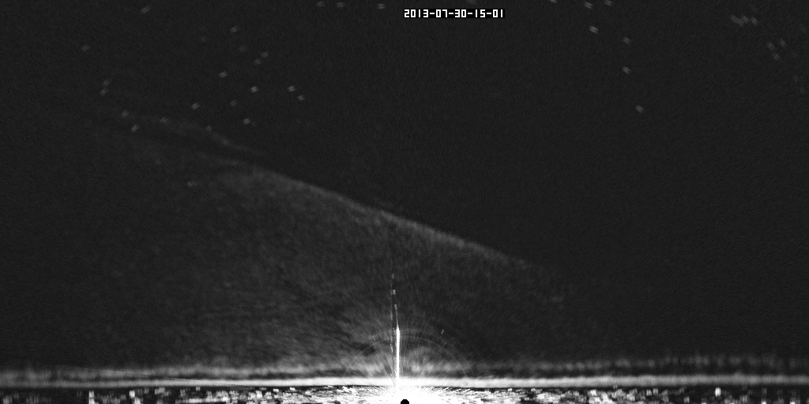
A front captured in a time exposure
2013 July 30, 15:30

Slide 10
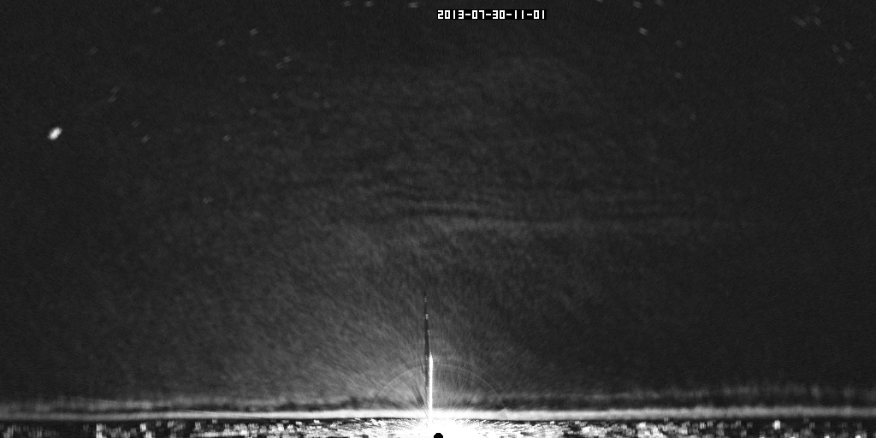
Time exposure (time average) of 2 minutes (or 30 images)
Processed at every hour from 30 min. to 52 min.
2013 July 30, 11:30 – 17:30

Slide 11
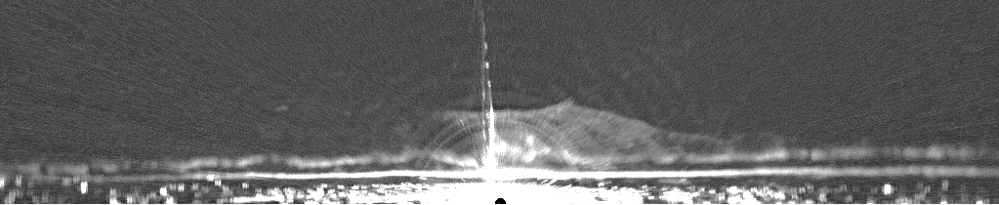
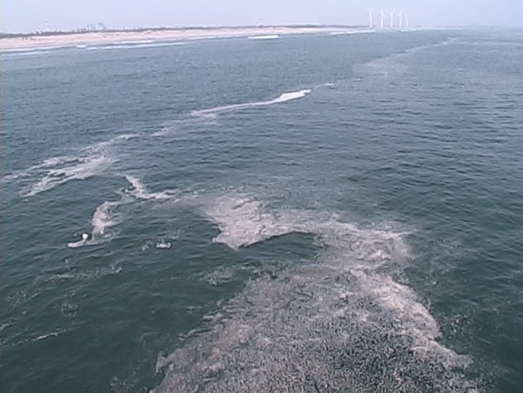
A front captured in a time exposure and video image
2013 August 9, 10:30
Video image at the pier tip

Slide 12
35 fronts detected in 27 days
clear (13) unclear (22)
water temperature [ºC]
tide [m]
- 0.7 m to + 0.7 m
wind speed [m/s]

Slide 13
Spectra of water level & temperature: M2-tide
amplitude [ºC]
amplitude [cm]
water temperature
tide
Period [hour]

Slide 14
2013 July 30

Slide 15
Water temperature at the bottom starts lowering before 5 hours than the radar captures the arrival of the front at the pier
Water temperature rises approximately 3 ºC after passing the front
Length of the wave: 0.3 m/s × 3600 s ~ 6,000 m
Water temperature variations at the tip of the pier
2013 July 30
[ºC]
surface
bottom
Captured at the off shore
in the radar image
Reached the pier and vanished from the image

Slide 16
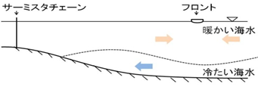
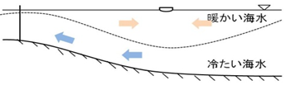
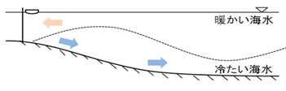

Imaging mechanism: tidal internal waves
Convergence at the surface resulting ‘front’
thermometer
front
(Yanagi,1990)

Slide 17

Propagation angle and speed of the front
α

Slide 18
Propagation angle and speed of the front
2013 July 30
No refraction, no reflection
Cross shore position [m]
Propagation angle [deg.]

Slide 19


Propagation speeds of the front: 0.1 – 0.3 m/s
ε dimensionless density gradient
g gravity
H total depth
h₁ depth of upper layer
h₂ depth of lower layer
observation [m/s]
C_{T}
C₂
[m/s]

Slide 20
Remarks
Coastal fronts
(Maybe) internal tidal waves
Termination in the shallow region
(?) No refraction, no reflection
No further information of current and depths extractable from the front propagations
What is the true propagation direction of a front ?

