Slide 1
Phase Resolved X-Band Wave Inversions in Multi-modal Seas
SOMaR-3 July 14-17, 2015
Eric Terrill, Tony de Paolo, Tom Cook, Sean Celona, Heidi Batchelor
Scripps Institution of Oceanography – UCSD
La Jolla, CA

Slide 2
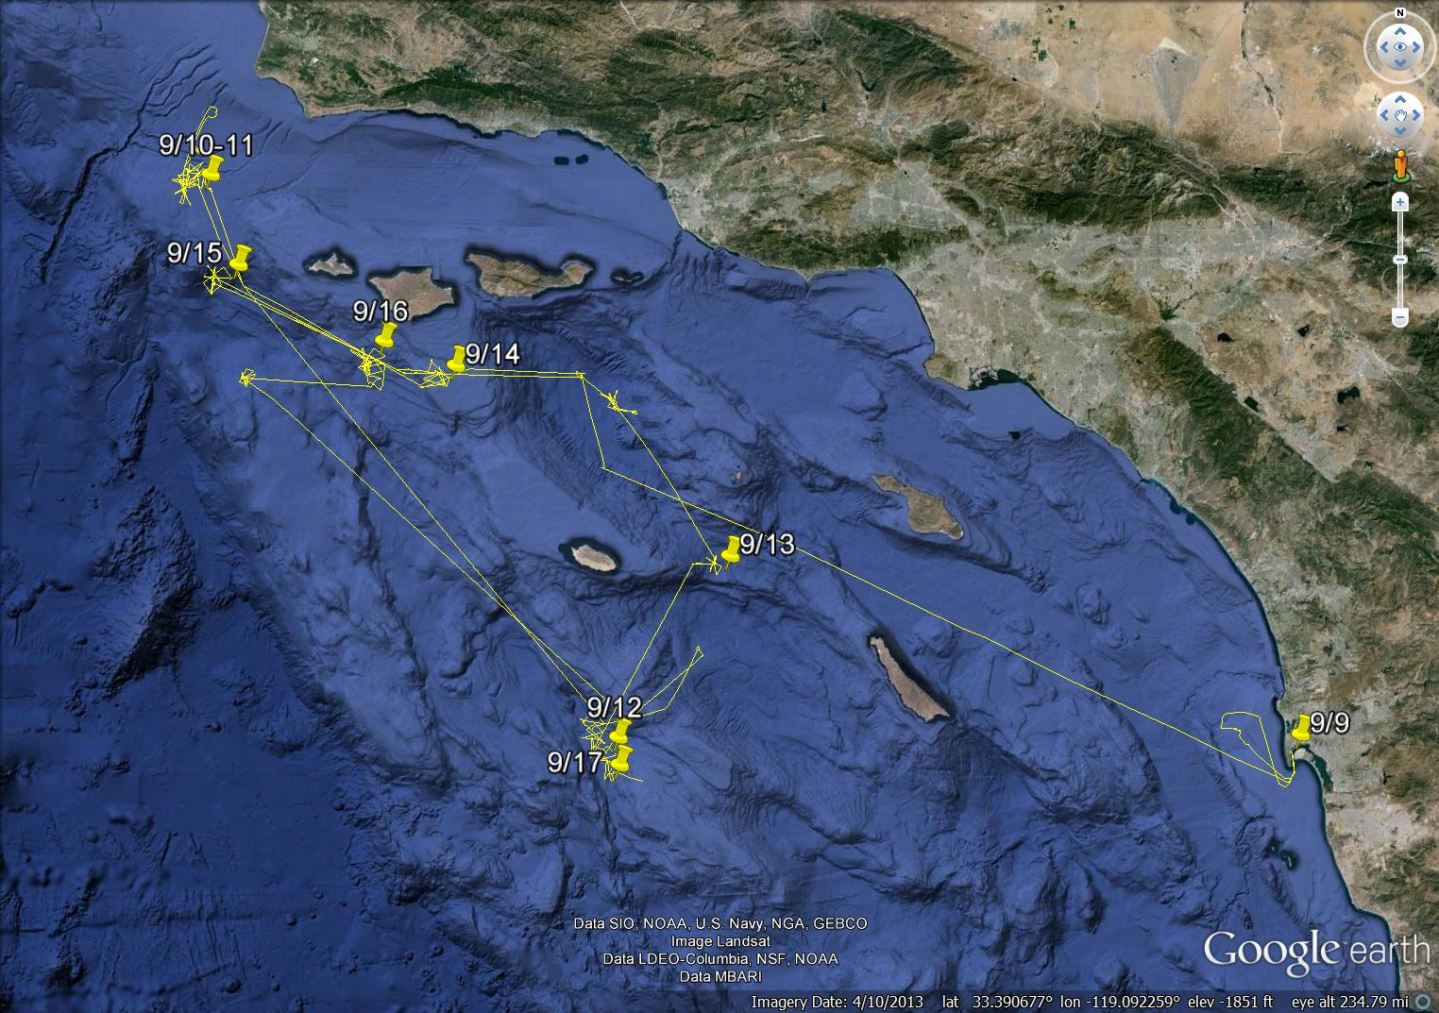
Environment and Ship Motion Forecasting (ESMF)
September 9-17, 2013
R/V Melville track shown to the right
SIO assets:
Rutter/WAMOS II X-Band System
5-point bow laser array
Miniature wave buoys (GPS)
Datawell 0.7m Waveriders
Airborne scanning LIDAR (MASS)

Slide 3
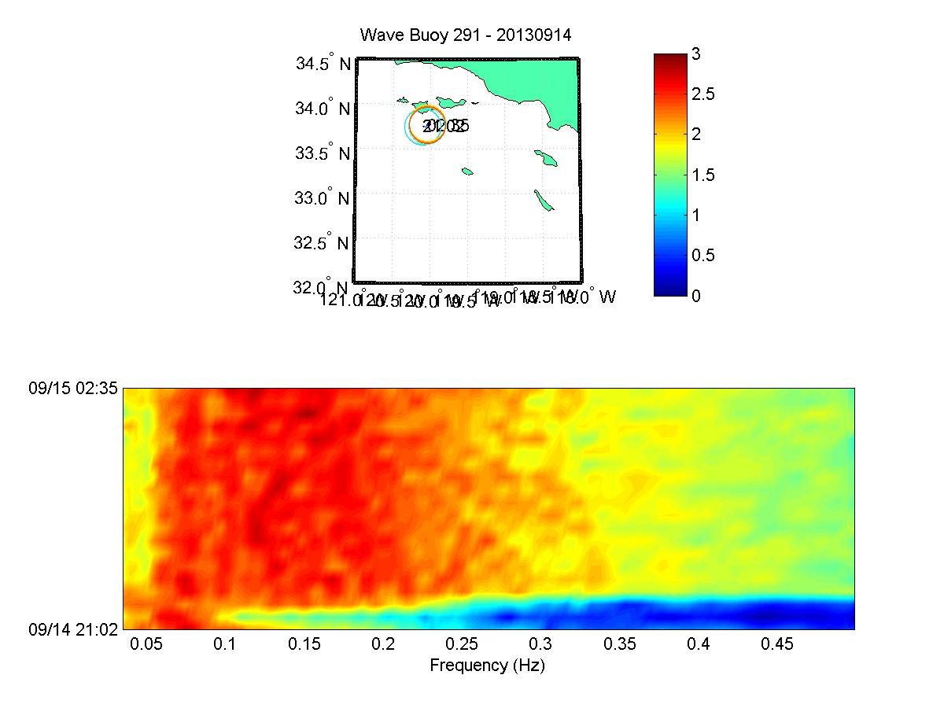
Environment and Ship Motion Forecasting (ESMF)
September 14, 2013
Location: south of Santa Rosa Island
Winds: early 12 m/s wind spike from the WNW, then light and variable, then a sharp increase to 14 m/s WNW
Waves: bi-modal, decreasing 13 seconds 270 degrees, rising south swell 18-20 seconds degrees, combined significant wave from 2 to 2.5 meters

Slide 4
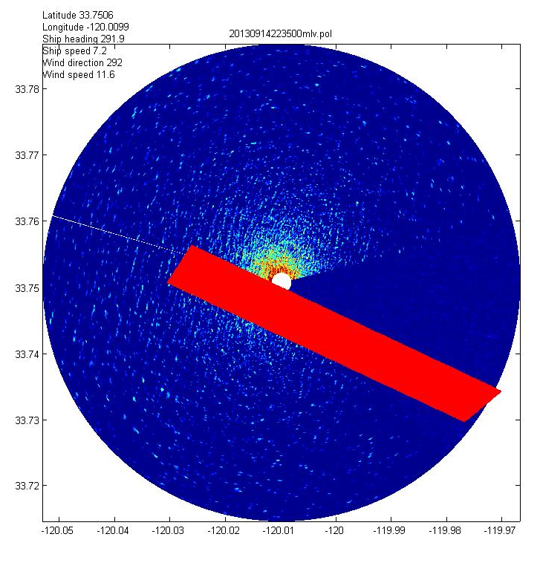
Wind 11.6 m/s from 292 degrees
LIDAR flight path is going upwind
X-Band processing box is also oriented upwind

Slide 5
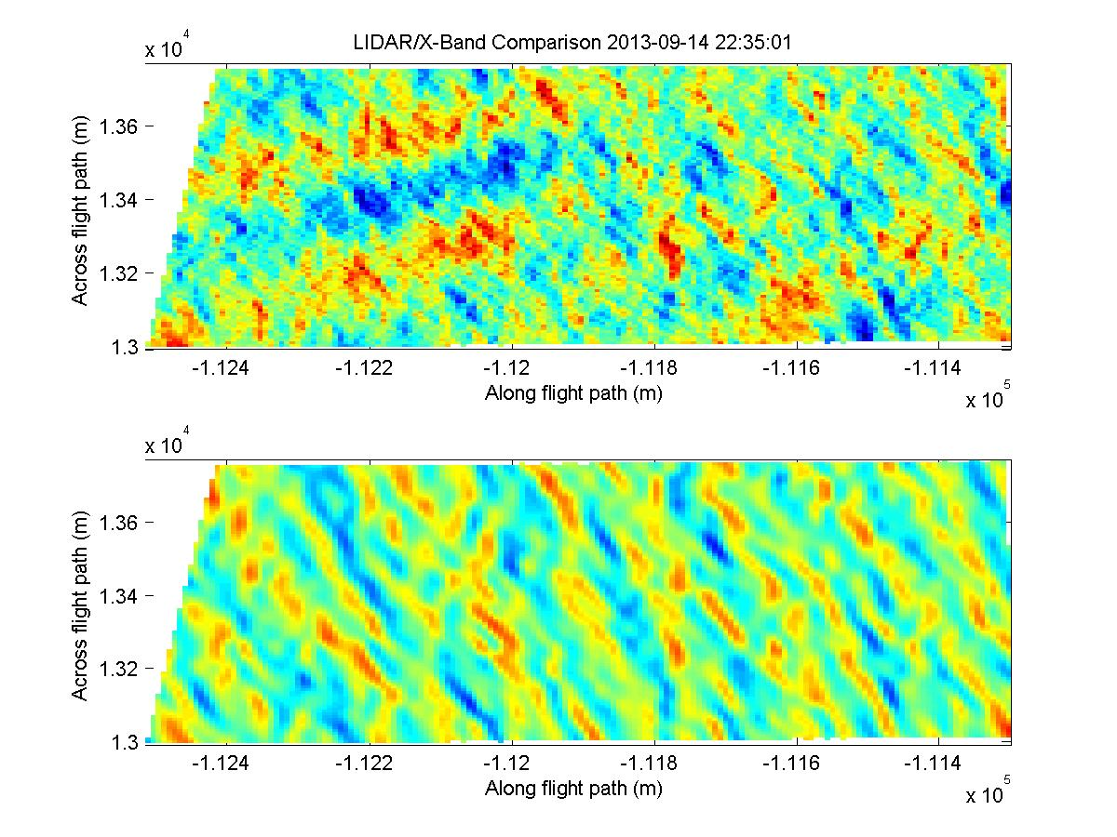
LIDAR data on top, shows wind waves and south swell
X-Band wave inversion does not show the south swell since it is imaging along the crests, rather than imaging perpendicular to the crests
2-D correlation R = 0.60

Slide 6
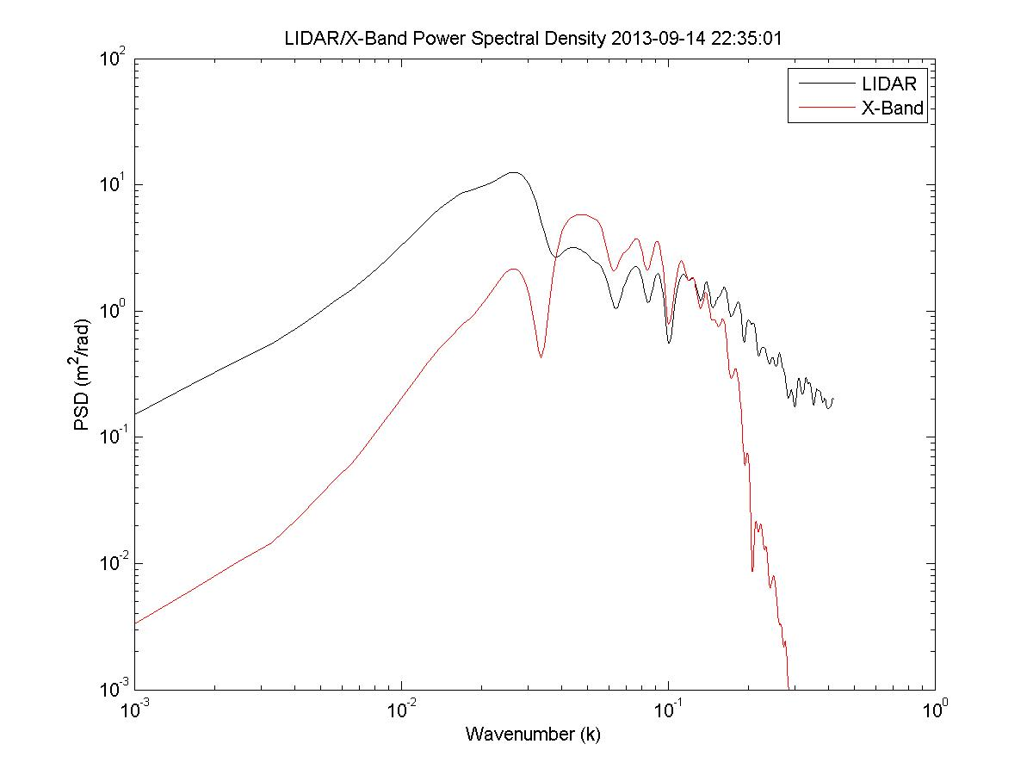
The lack of low frequency (south swell) components is evident in the wave number spectra derived from the LIDAR (black) and X-Band (red).

Slide 7
Same day, a little later
X-Band processing box placed downwind,
but more oriented into the south swell

Slide 8
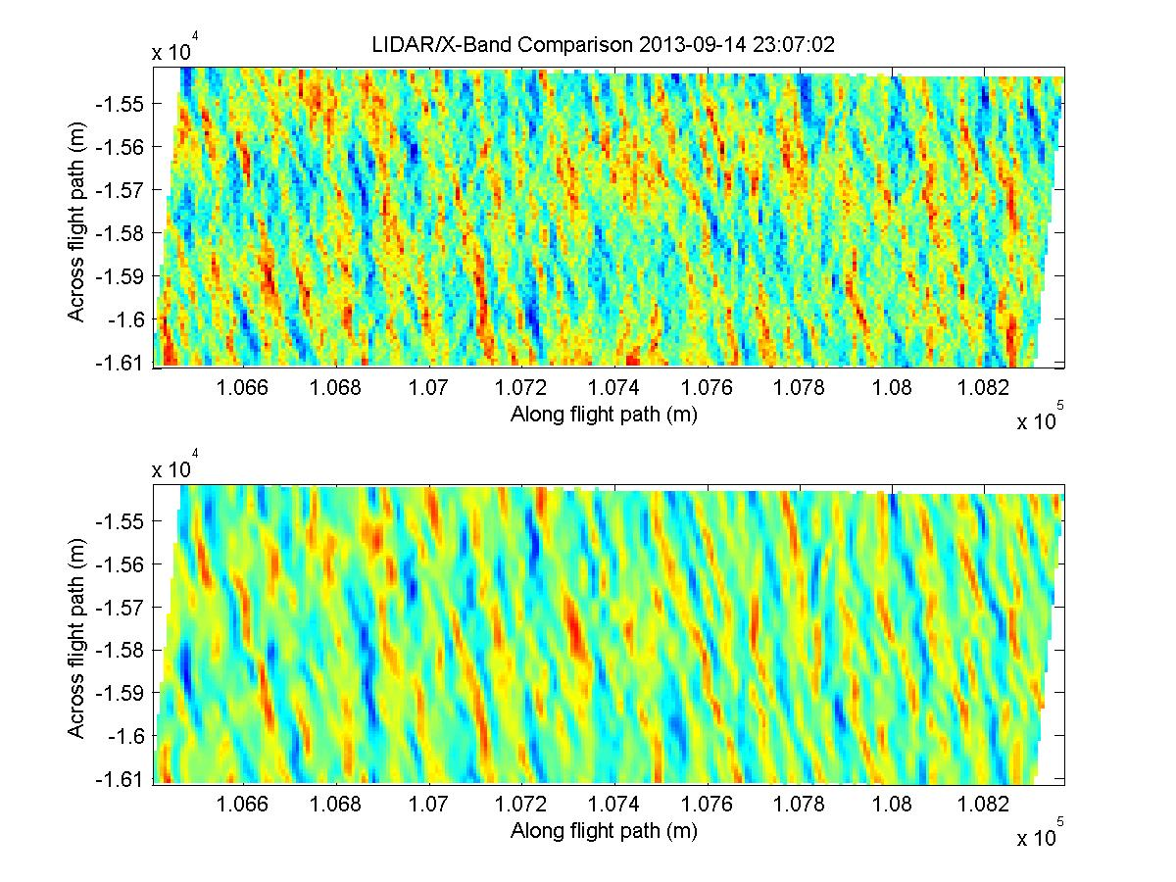
Results are better, X-Band inversion is
picking up the south swell to a greater extent
Correlation R = 0.66
Still room for improvment

Slide 9
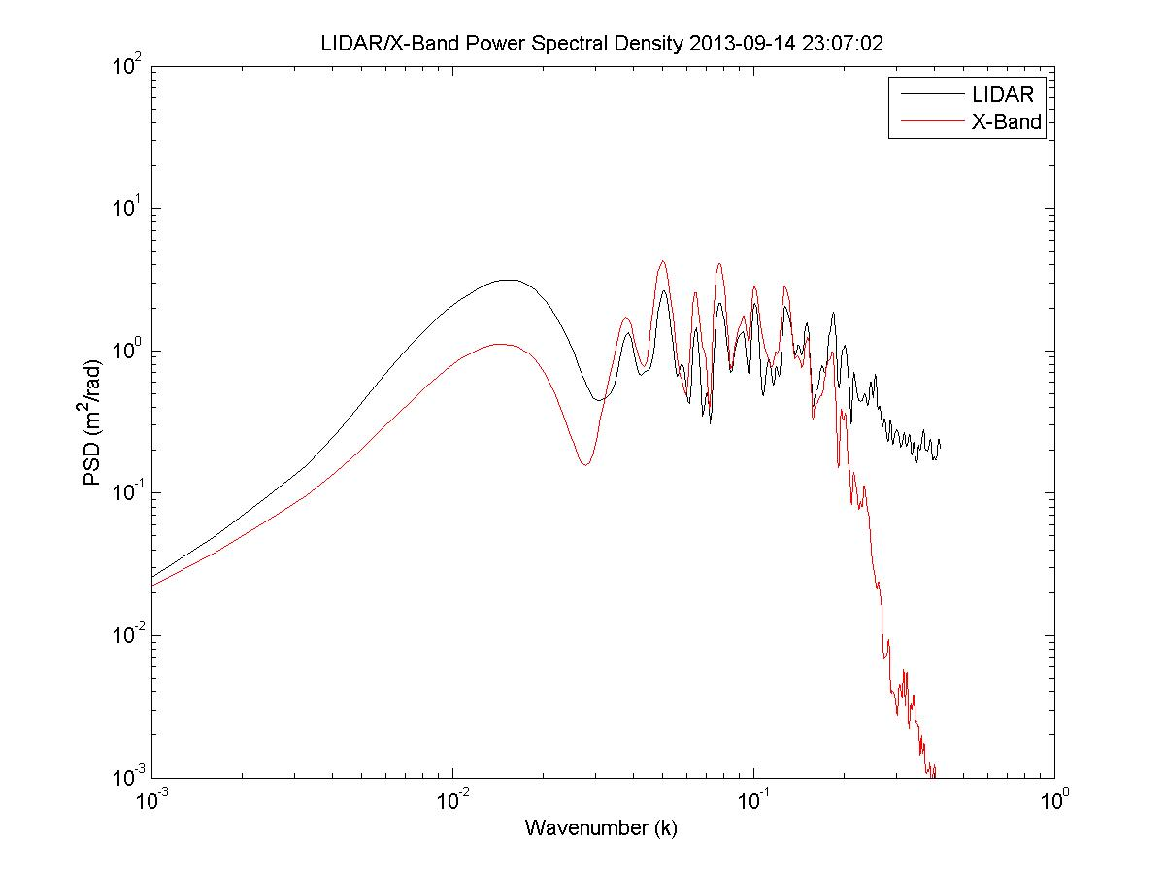
Wavenumber spectrum compares better, but X-Band still doesn’t pick up enough south swell energy.

Slide 10
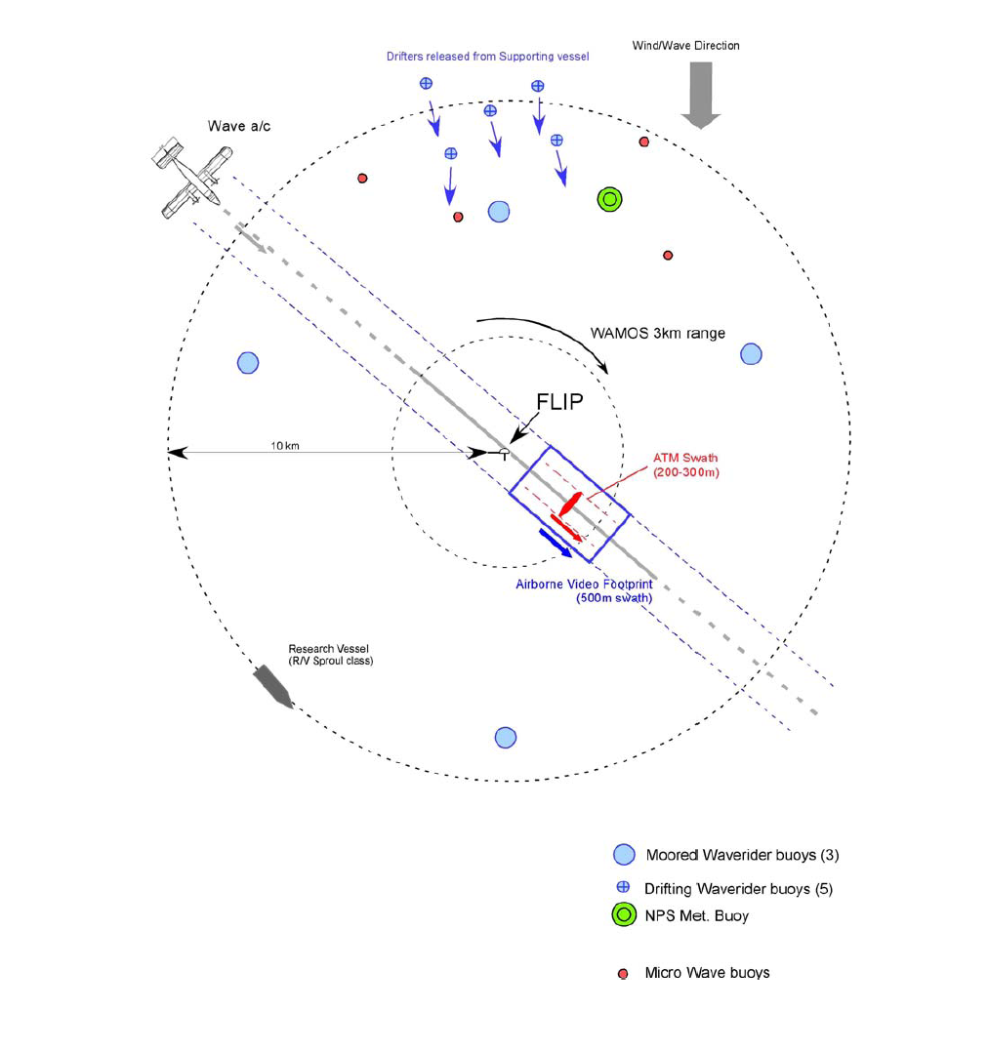
SoCal 2013
November 8-22, 2013
Fixed location near San Clemente Island
R/V Melville
R/P FLIP
SIO assets:
Rutter/WAMOS II X-Band Systems
Miniature wave buoys (GPS)
Moored Datawell 0.9m Waverider
Airborne scanning LIDAR (MASS)
ADCPs
And many more instruments unrelated to this presentation…….

Slide 11
November 14, 2013 1600UTC
Bi-modal seas, SW swell, NW wind waves,
overall Hs=1.18m
R/V Melville radar scan, LIDAR flight path, and wave inversion processing area shown

Slide 12
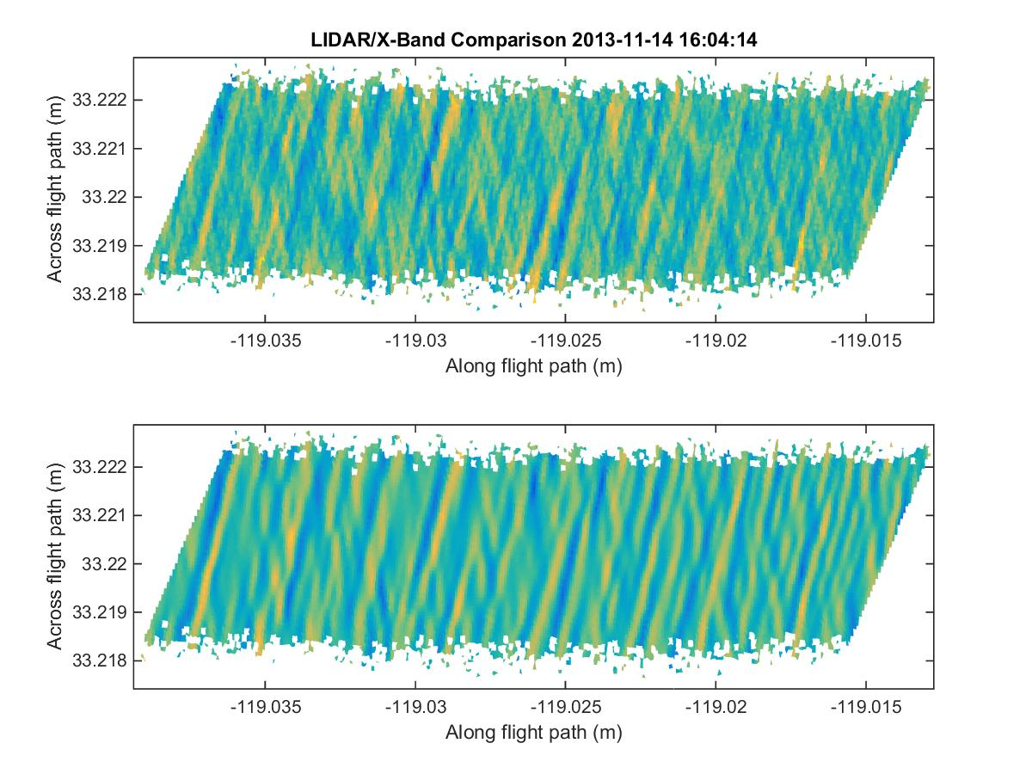
R/V Melville
LIDAR X-Band comparison
R=0.78
X-Band does a better job of detecting both wave systems due to position of processing area

Slide 13
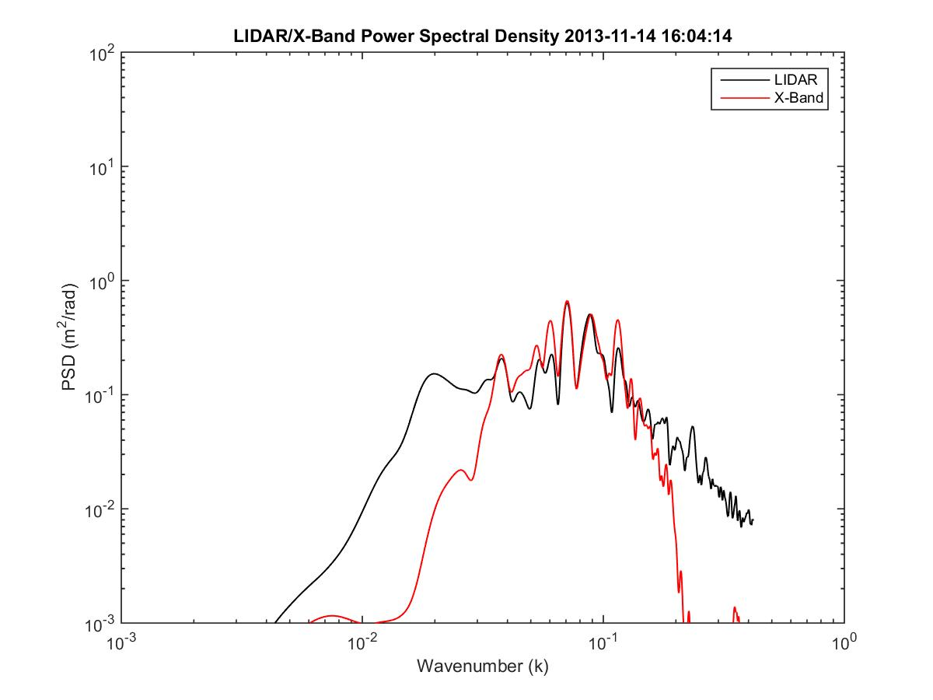
Inversion still does not get all of the low frequency south swell energy

Slide 14
R/P FLIP
Range resolution = 3m

Slide 15
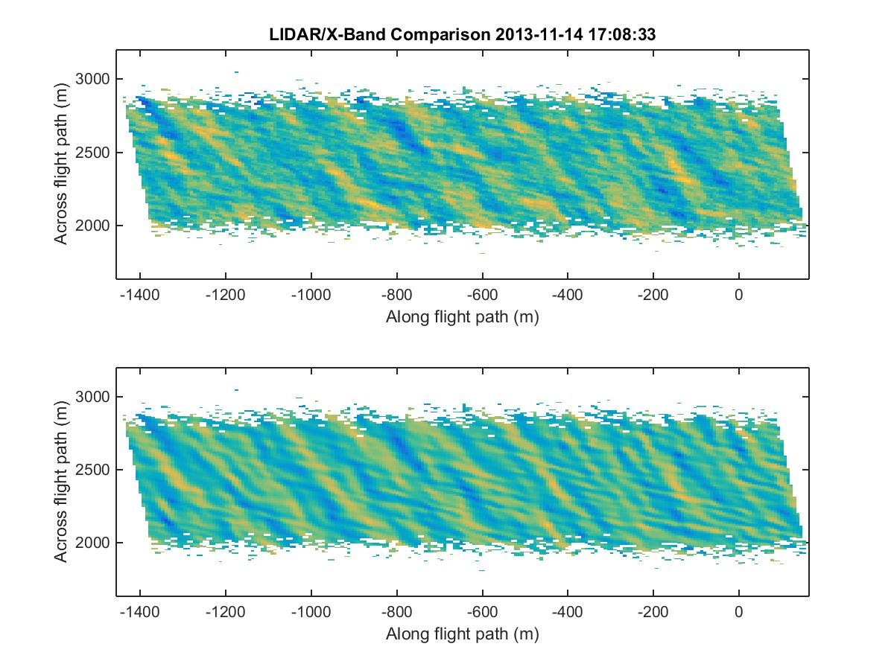
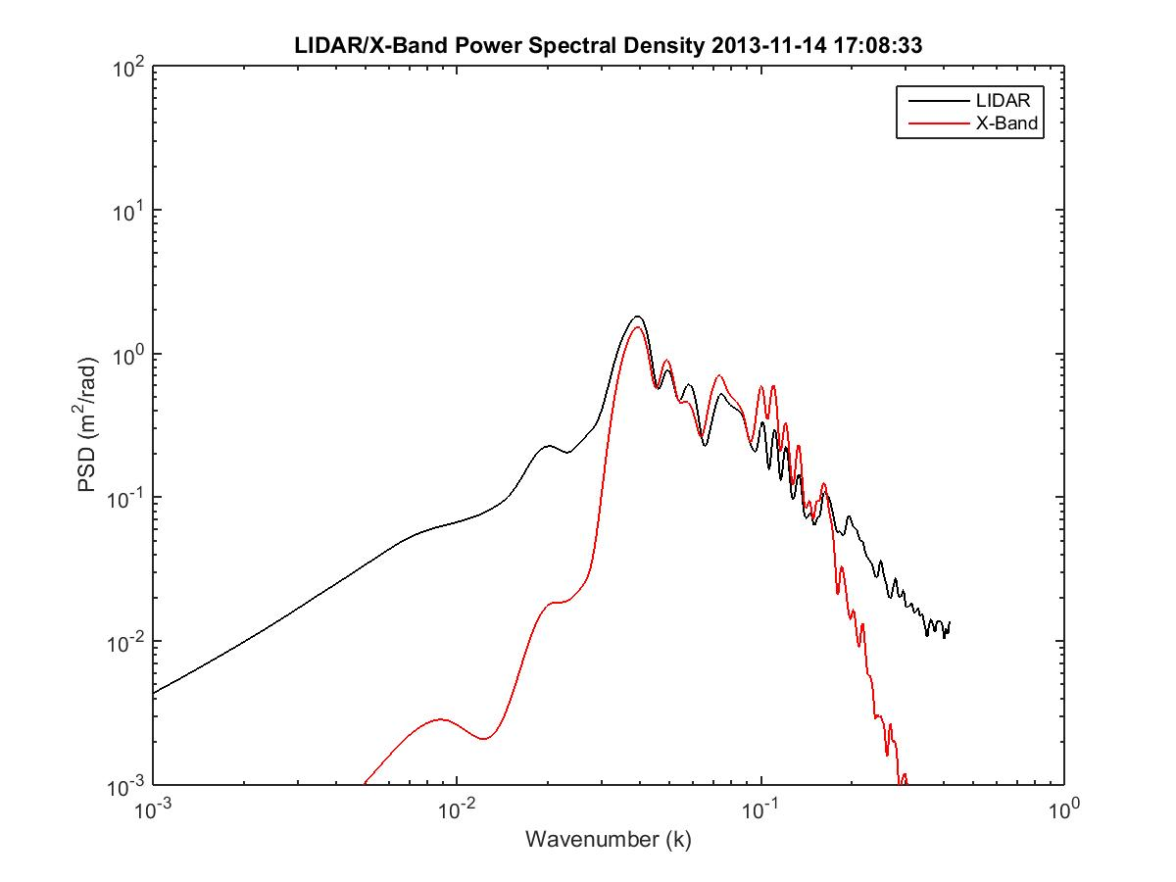
R = 0.75

Slide 16
Case study of R/P FLIP X-Band wave inversions - November 14, 2013 1700UTC
Multi-modal seas present an interesting challenge in recreating sea surface elevation maps from X-Band backscatter
Wave inversion accuracy has a large dependence on look angle, or where the processing area lies
LIDAR comparisons from over 65 aircraft flights can be as high as R=0.85, or can be very uncorrelated
Other factors in success include
Wind speed
Significant wave height (Hs)
LIDAR data is higher resolution and contains much higher wavenumber content
X-Band wave inversion is band limited due to lack of SNR at very low, and very high wavenumbers
We will attempt to analyze wave inversion quality over multiple processing areas at different azimuths

Slide 17
Processing areas are all 256x256 pixels at angles of:
180
210
240
270
300
325
Wave inversions and 2-D directional spectra are computed in each processing area

Slide 18
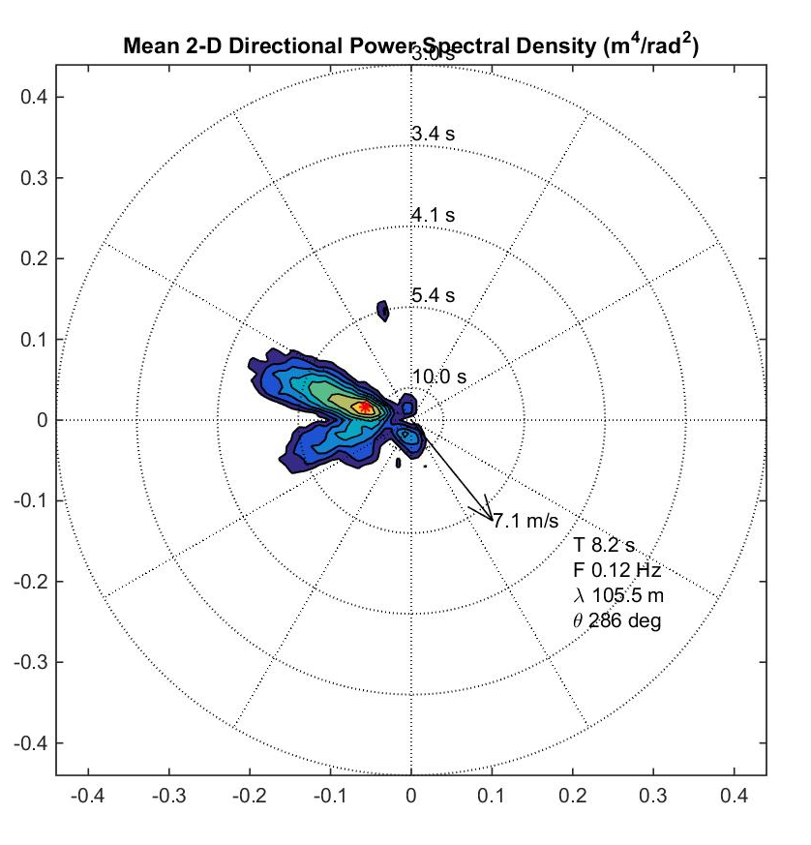
Processing Area at 180 degrees azimuth

Slide 19
Processing Area at 210 degrees azimuth

Slide 20
Processing Area at 240 degrees azimuth

Slide 21
Processing Area at 270 degrees azimuth

Slide 22
Processing Area at 300 degrees azimuth

Slide 23
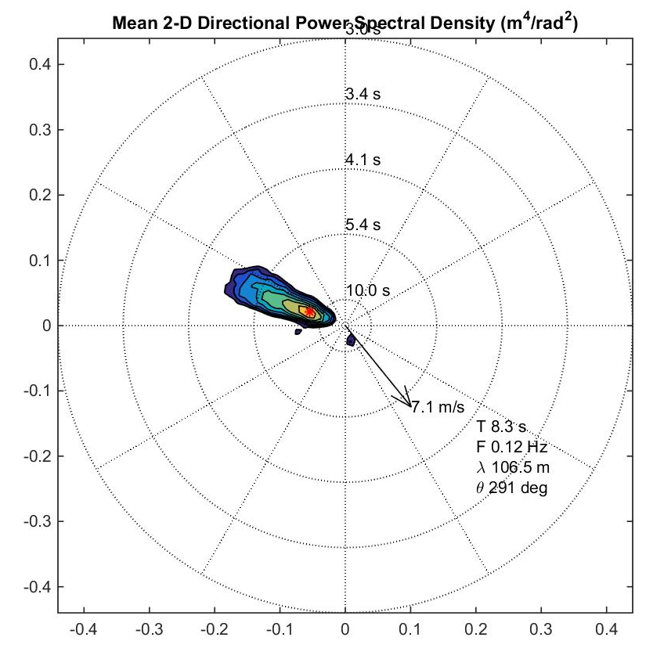
Processing Area at 325 degrees azimuth

Slide 24
Analysis of 2-D Wavenumber Spectrum
6 sectors, 30 degrees wide
Compute relative, normalized, power in each sector, using each X-Band processing area/azimuth angle

Slide 25
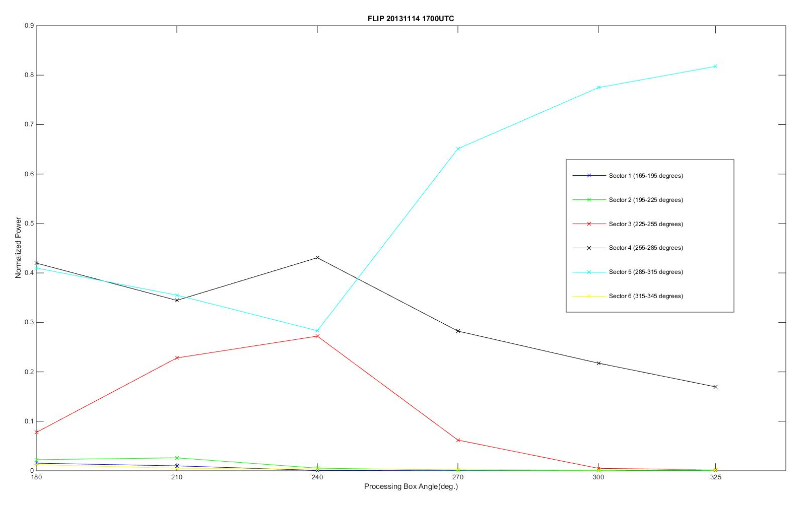
Normalized power by look angle
X-axis is processing box angle
Y-axis is normalized power in each of the following sectors
165-195 (dark blue)
195-225 (green)
225-255 (red)
255-285 (black)
285-315 (cyan)
315-345 (yellow)

Slide 26
Preliminary conclusions
There are three wave modes sensed
South swell from 210
Southwest swell from 255
Wind waves from 295
Some of the processing areas/angles see all three modes, the best being 180 degrees
As we look more and more into the wind, the swells tend to diminish, one-by-one
In this case, the best look angle to sense all modes is into the south swell

Slide 27
Ongoing and Future Work
Continue working on our huge database of X-band radar images
HiRes 2010
New River Inlet 2012 (my talk Thursday)
Mouth of the Columbia River 2013 (my talk Thursday)
ESMF 2013
SoCal 2013
Western Scotland/North Atlantic 2014
Potential collaboration with interested parties in the areas of
Waves
Currents
Bathymetry
Kelvin Hughes SharpEye Coherent Radar now on site at SIO!

